Slide 1
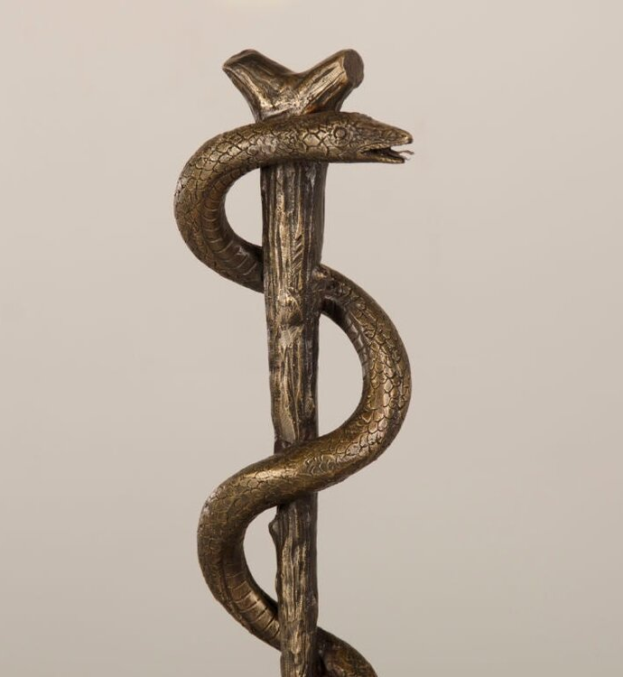
EZEKIEL 36:24-28
24 For I will take you from the nations, and gather you from all the lands; and I will bring you into your own land. 25 Then I will sprinkle clean water on you, and you will be clean; I will cleanse you from all your filthiness and from all your idols. 26 Moreover, I will give you a new heart and put a new spirit within you; and I will remove the heart of stone from your flesh and give you a heart of flesh. 27 And I will put My Spirit within you and bring it about that you walk in My statutes, and are careful and follow My ordinances. 28 And you will live in the land that I gave to your forefathers;
So you will be My people, and I will be your God.

Slide 2
LIFTED UP

Slide 3
NUMBERS 21:4-9
⁴ Then they set out from Mount Hor by the way of the Red Sea, to go around the land of Edom; and the people became impatient because of the journey. ⁵ So the people spoke against God and Moses: “Why have you brought us up from Egypt to die in the wilderness? For there is no food and no water, and we are disgusted with this miserable food.” ⁶ Then the Lord sent fiery serpents among the people and they bit the people, so that many people of Israel died. ⁷ So the people came to Moses and said, “We have sinned, because we have spoken against the Lord and against you; intercede with the Lord, that He will remove the serpents from us.” And Moses interceded for the people. ⁸ Then the Lord said to Moses, “Make a fiery serpent, and put it on a flag pole; and it shall come about, that everyone who is bitten, and looks at it, will live.” ⁹ So Moses made a bronze serpent and put it on the flag pole; and it came about, that if a serpent bit someone, and he looked at the bronze serpent, he lived.

Slide 4
JOHN 3

Slide 5
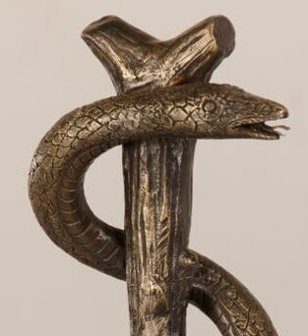
Nicodemus is deeply curious, respectful, and far from typical at this early point in Jesus’ ministry. It is noted at the end of the previous chapter that Jesus knew the hearts of all, and was cautious in His self-disclosure. The Lord must have relished conversing with someone as sincere and substantial as Nicodemus.

Slide 6
Nicodemus is deeply curious, respectful, and far from typical at this early point in Jesus’ ministry. It is noted at the end of the previous chapter that Jesus knew the hearts of all, and was cautious in His self-disclosure. The Lord must have relished conversing with someone as sincere and substantial as Nicodemus.
Nicodemus is challenged with language that undermines many common preconceptions about the Kingdom, including the notion of being “born from above.”

Slide 7
Nicodemus is deeply curious, respectful, and far from typical at this early point in Jesus’ ministry. It is noted at the end of the previous chapter that Jesus knew the hearts of all, and was cautious in His self-disclosure. The Lord must have relished conversing with someone as sincere and substantial as Nicodemus.
Nicodemus is challenged with language that undermines many common preconceptions about the Kingdom, including the notion of being “born from above.”
The Spirit, like the breeze touching their faces, comes and goes with some mystery. Yet it is true and felt and purposeful.

Slide 8
Nicodemus is deeply curious, respectful, and far from typical at this early point in Jesus’ ministry. It is noted at the end of the previous chapter that Jesus knew the hearts of all, and was cautious in His self-disclosure. The Lord must have relished conversing with someone as sincere and substantial as Nicodemus.
Nicodemus is challenged with language that undermines many common preconceptions about the Kingdom, including the notion of being “born from above.”
The Spirit, like the breeze touching their faces, comes and goes with some mystery. Yet it is true and felt and purposeful.
“How can these things be?” is not Nicodemus being dense. It is amazement, perhaps even bewilderment, at what he is hearing.

Slide 9
It’s not so much the “what” that confuses Nicodemus, but the “how”

Slide 10
Jesus isn’t trying to be rude in vv. 10-12, but He is challenging Nicodemus. If he really wants to know the answer to his questions, he must be willing to accept ideas that his fellow Pharisees will reject.
HEAVENLY THINGS

Slide 11
Jesus isn’t trying to be rude in vv. 10-12, but He is challenging Nicodemus. If he really wants to know the answer to his questions, he must be willing to accept ideas that his fellow Pharisees will reject.
Jesus and His disciples are pointing people away from earthly conceptions of what the Kingdom means, what the Messiah will do, what it means to serve God’s purpose, what spirit-filled living looks like, and what all of our most essential spiritual needs are. The Pharisees pushed back against all of those things! Now, Nicodemus… what about you?
HEAVENLY THINGS

Slide 12
Jesus isn’t trying to be rude in vv. 10-12, but He is challenging Nicodemus. If he really wants to know the answer to his questions, he must be willing to accept ideas that his fellow Pharisees will reject.
Jesus and His disciples are pointing people away from earthly conceptions of what the Kingdom means, what the Messiah will do, what it means to serve God’s purpose, what spirit-filled living looks like, and what all of our most essential spiritual needs are. The Pharisees pushed back against all of those things! Now, Nicodemus… what about you?
So the Son of Man is the only One qualified to deliver these spiritual truths because He has descended from heaven. He will also ascend to heaven. But why?
HEAVENLY THINGS

Slide 13
“So must the Son of Man be lifted up”

Slide 14
Nicodemus could acknowledge the signs of Jesus as evidence of His authority. But what was Jesus offering? What was He going to do? What is the endgame?
HERE’S THE POINT

Slide 15
Nicodemus could acknowledge the signs of Jesus as evidence of His authority. But what was Jesus offering? What was He going to do? What is the endgame?
Jesus immediately points Nicodemus to the Kingdom – the manifestation of God’s presence and sovereignty, His domain, His citizens. One must be “born from above” to partake of a Kingdom “from above” (i.e., heavenly).
HERE’S THE POINT

Slide 16
Nicodemus could acknowledge the signs of Jesus as evidence of His authority. But what was Jesus offering? What was He going to do? What is the endgame?
Jesus immediately points Nicodemus to the Kingdom – the manifestation of God’s presence and sovereignty, His domain, His citizens. One must be “born from above” to partake of a Kingdom “from above” (i.e., heavenly).
A “fleshly” life is insufficient. It is vain, passing, limited. God’s people have their eyes opened to the oft-mysterious, but always apparent, presence of the Spirit. He directs us in a spiritual life (see Ezekiel 36).
HERE’S THE POINT

Slide 17
Nicodemus could acknowledge the signs of Jesus as evidence of His authority. But what was Jesus offering? What was He going to do? What is the endgame?
Jesus immediately points Nicodemus to the Kingdom – the manifestation of God’s presence and sovereignty, His domain, His citizens. One must be “born from above” to partake of a Kingdom “from above” (i.e., heavenly).
A “fleshly” life is insufficient. It is vain, passing, limited. God’s people have their eyes opened to the oft-mysterious, but always apparent, presence of the Spirit. He directs us in a spiritual life (see Ezekiel 36).
The “how” is obedient belief in the Son. Looking upon the serpent in Numbers 21 was a similar act. So we behold the Son of Man, lifted up, as our only hope of salvation!
HERE’S THE POINT

Slide 18
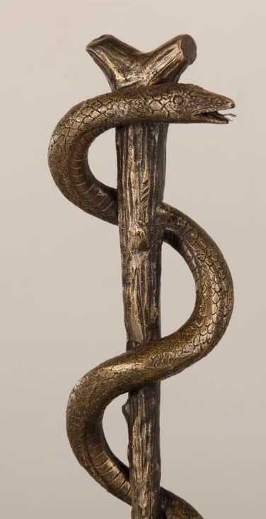
APPLICATIONS
The Israelites had to face their pain and failure in the bronze serpent. It wasn’t cute and cuddly. It was grim. In the same way, facing Jesus on the cross should be, at first, an uncomfortable experience for us. The very pain we feel (the sting of sin and death) is embodied in the scene on Golgotha.

Slide 19
APPLICATIONS
The Israelites had to face their pain and failure in the bronze serpent. It wasn’t cute and cuddly. It was grim. In the same way, facing Jesus on the cross should be, at first, an uncomfortable experience for us. The very pain we feel (the sting of sin and death) is embodied in the scene on Golgotha.
Even the so-called “Teacher of Israel” needed to be taught. “You must be born again” applies in equal measure to all, for ”all have sinned and fallen short of God’s glory.”

Slide 20
APPLICATIONS
The Israelites had to face their pain and failure in the bronze serpent. It wasn’t cute and cuddly. It was grim. In the same way, facing Jesus on the cross should be, at first, an uncomfortable experience for us. The very pain we feel (the sting of sin and death) is embodied in the scene on Golgotha.
Even the so-called “Teacher of Israel” needed to be taught. “You must be born again” applies in equal measure to all, for ”all have sinned and fallen short of God’s glory.”
Obedience to the call of the gospel is an expression of faith. There was no earthly reason a bronze serpent should have healed snake bites. It takes a spiritual person to inherit spiritual things.

Slide 21
APPLICATIONS
The Israelites had to face their pain and failure in the bronze serpent. It wasn’t cute and cuddly. It was grim. In the same way, facing Jesus on the cross should be, at first, an uncomfortable experience for us. The very pain we feel (the sting of sin and death) is embodied in the scene on Golgotha.
Even the so-called “Teacher of Israel” needed to be taught. “You must be born again” applies in equal measure to all, for ”all have sinned and fallen short of God’s glory.”
Obedience to the call of the gospel is an expression of faith. There was no earthly reason a bronze serpent should have healed snake bites. It takes a spiritual person to inherit spiritual things.
Just as with Israel, there are only two options: “Perish” or “have eternal life.”

