Slide 1
Romans 15: 5-7 (NAS)
⁵ Now may the God who gives perseverance and encouragement grant you to be of the same mind with one another according to Christ Jesus, ⁶ so that with one accord you may with one voice glorify the God and Father of our Lord Jesus Christ.
⁷ Therefore, accept one another, just as Christ also accepted us to the glory of God.

Slide 3
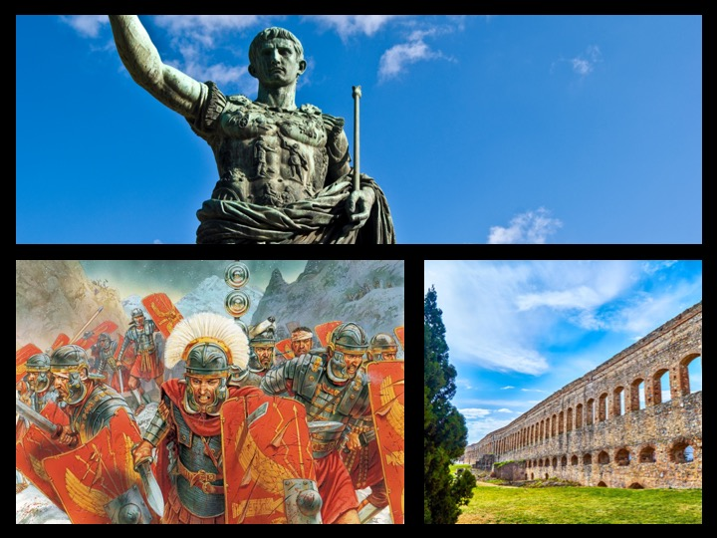

Slide 7
