Slide 1
Revelation 1:9-11
I, John, both your brother and companion in the tribulation and kingdom and patience of Jesus Christ, was on the island that is called Patmos for the word of God and for the testimony of Jesus Christ. ¹⁰ I was in the Spirit on the Lord’s Day, and I heard behind me a loud voice, as of a trumpet, ¹¹ saying, “I am the Alpha and the Omega, the First and the Last,” and, “What you see, write in a book and send it to the seven churches which are in Asia: to Ephesus, to Smyrna, to Pergamos, to Thyatira, to Sardis, to Philadelphia, and to Laodicea.”

Slide 3
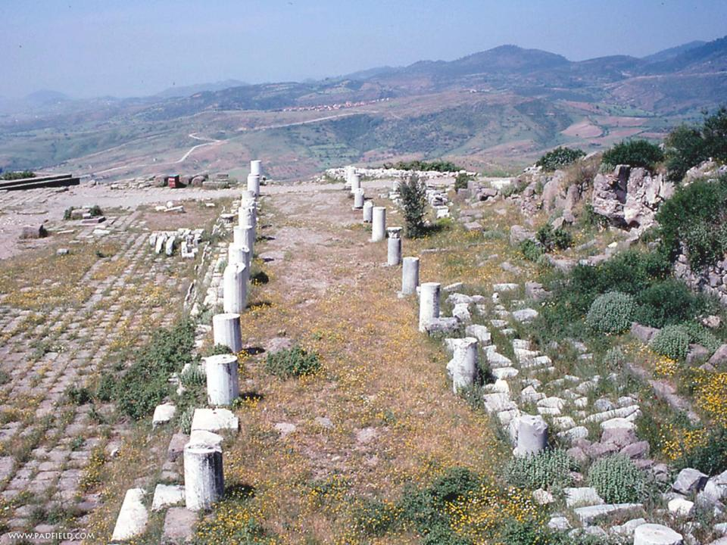
PERGAMOS: IS ALIVE!

Slide 4
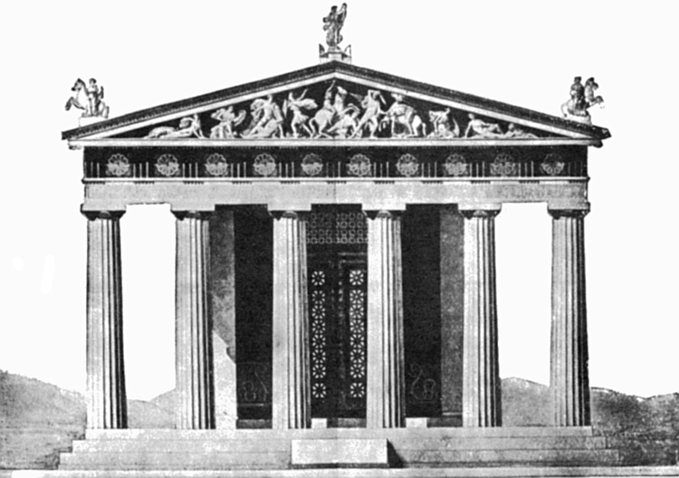

Slide 5
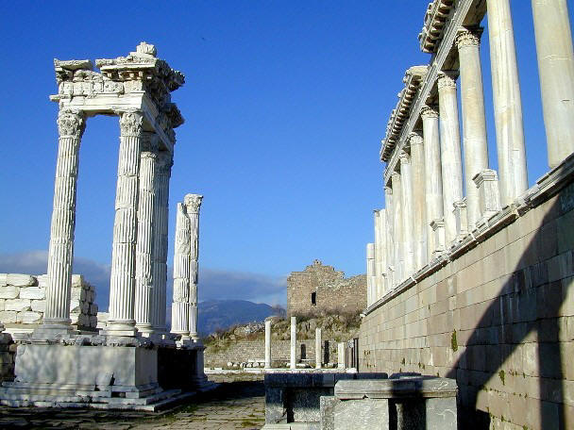

Slide 6
Revelation 2:12
¹² “And to the angel of the church in Pergamos write,
‘These things says He who has the sharp two-edged sword

Slide 7
Revelation 2:13
¹³ “I know your works, and where you dwell, where Satan’s throne is. And you hold fast to My name, and did not deny My faith even in the days in which Antipas was My faithful martyr, who was killed among you, where Satan dwells.

Slide 8
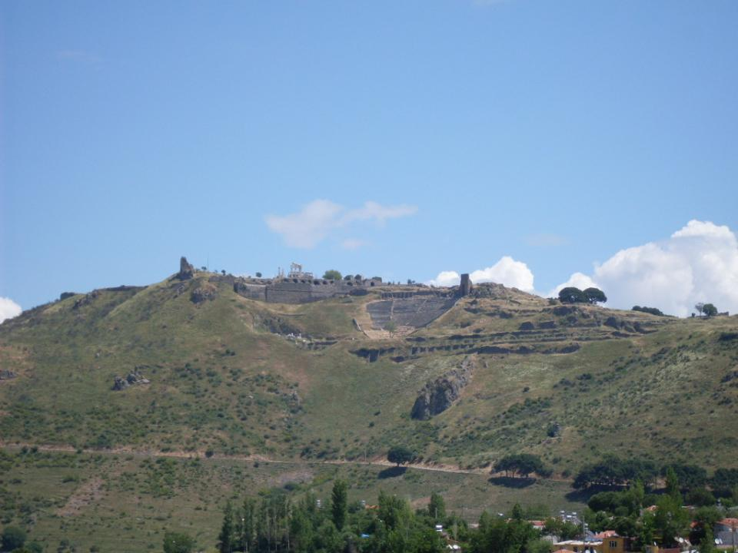

Slide 9
Revelation 2:13
¹³ “I know your works, and where you dwell, where Satan’s throne is. And you hold fast to My name, and did not deny My faith even in the days in which Antipas was My faithful martyr, who was killed among you, where Satan dwells.

Slide 10
Revelation 2:14-15
¹⁴ But I have a few things against you, because you have there those who hold the doctrine of Balaam, who taught Balak to put a stumbling block before the children of Israel, to eat things sacrificed to idols, and to commit sexual immorality. ¹⁵ Thus you also have those who hold the doctrine of the Nicolaitans, which thing I hate

Slide 12
Romans 1:29-32
being filled with all unrighteousness, sexual immorality, wickedness, covetousness, maliciousness; full of envy, murder, strife, deceit, evil-mindedness; they are whisperers, ³⁰ backbiters, haters of God, violent, proud, boasters, inventors of evil things, disobedient to parents, ³¹ undiscerning, untrustworthy, unloving, unforgiving, unmerciful; ³² who, knowing the righteous judgment of God, that those who practice such things are deserving of death, not only do the same but also approve of those who practice them.

Slide 13
Romans 1:29-32
being filled with all unrighteousness, sexual immorality, wickedness, covetousness, maliciousness; full of envy, murder, strife, deceit, evil-mindedness; they are whisperers, ³⁰ backbiters, haters of God, violent, proud, boasters, inventors of evil things, disobedient to parents, ³¹ undiscerning, untrustworthy, unloving, unforgiving, unmerciful; ³² who, knowing the righteous judgment of God, that those who practice such things are deserving of death, not only do the same but also approve of those who practice them.

Slide 14
Revelation 2:16
¹⁶ Repent, or else I will come to you quickly and will fight against them with the sword of My mouth.

Slide 15
Revelation 2:17
“He who has an ear, let him hear what the Spirit says to the churches. To him who overcomes I will give some of the hidden manna to eat. And I will give him a white stone, and on the stone a new name written which no one knows except him who receives it.

