Slide 1
2 Timothy 2:1–2
¹You then, my child, be strengthened by the grace that is in Christ Jesus, ²and what you have heard from me in the presence of many witnesses entrust to faithful men who will be able to teach others also.

Slide 4
The Need for an Internship
Biblical Leadership Training:
Moses and Joshua
Paul and Timothy
Jesus and the Apostles

Slide 5
Our Internship
Office Hours and Dress Code.
Build Relationships

Slide 6
Weekly Schedule
Tuesday Morning
Sermon evaluation
Study through Timothy and Titus
Wednesday Morning
Book review
Article assignment
Sermon assignment

Slide 7
Weekly Schedule
Thursday Morning
Article review
Sermon discussion
Preacher interview discussion
Friday
Sermon review
PowerPoint discussion

Slide 8
Weekly Schedule
Sunday
Teaching class.
Preaching one lesson.

Slide 9
Greg
Kline

Slide 10
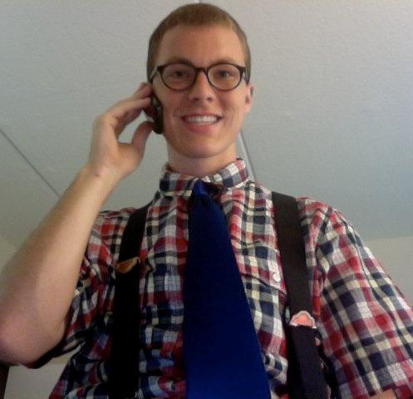
Greg
Kline

Slide 11
Your role…
Offer positive encouragement.
Show hospitality.
Build him up to other Christians.
Sermon evaluation.

