Slide 1
James 3:13-18 (ESV)
¹³ Who is wise and understanding among you? By his good conduct let him show his works in the meekness of wisdom. ¹⁴ But if you have bitter jealousy and selfish ambition in your hearts, do not boast and be false to the truth. ¹⁵ This is not the wisdom that comes down from above, but is earthly, unspiritual, demonic. ¹⁶ For where jealousy and selfish ambition exist, there will be disorder and every vile practice. ¹⁷ But the wisdom from above is first pure, then peaceable, gentle, open to reason, full of mercy and good fruits, impartial and sincere. ¹⁸ And a harvest of righteousness is sown in peace by those who make peace.

Slide 4
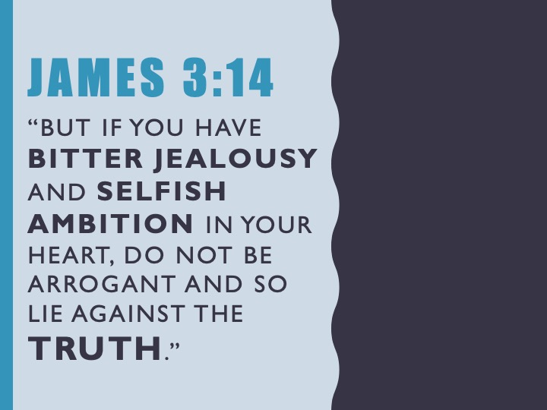

Slide 6
