Slide 1
Psalm 9:7-10 (ESV)
⁷ But the Lord sits enthroned forever; he has established his throne for justice, ⁸ and he judges the world with righteousness; he judges the peoples with uprightness.
⁹ The Lord is a stronghold for the oppressed, a stronghold in times of trouble. ¹⁰ And those who know your name put their trust in you, for you, O Lord, have not forsaken those who seek you.

Slide 2
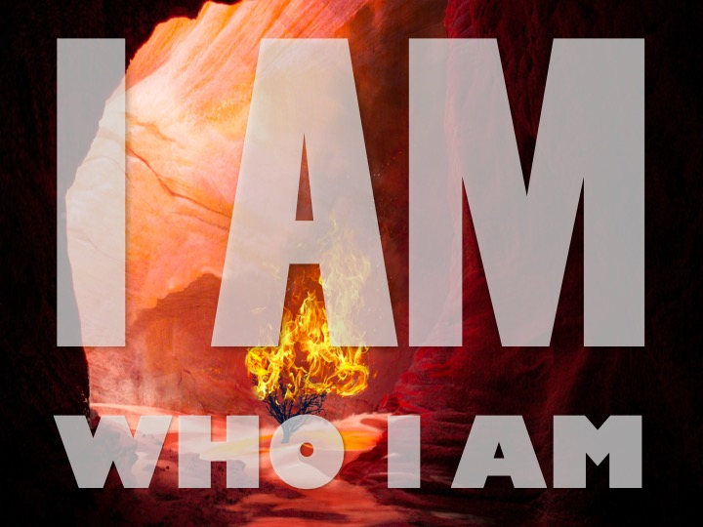

Slide 7
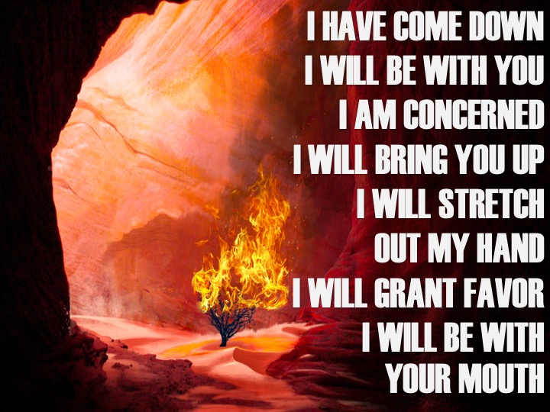

Slide 14
