Slide 1
1 Thessalonians 1:8-10 (ESV)
⁸ For not only has the word of the Lord sounded forth from you in Macedonia and Achaia, but your faith in God has gone forth everywhere, so that we need not say anything. ⁹ For they themselves report concerning us the kind of reception we had among you, and how you turned to God from idols to serve the living and true God, ¹⁰ and to wait for his Son from heaven, whom he raised from the dead, Jesus who delivers us from the wrath to come.

Slide 2
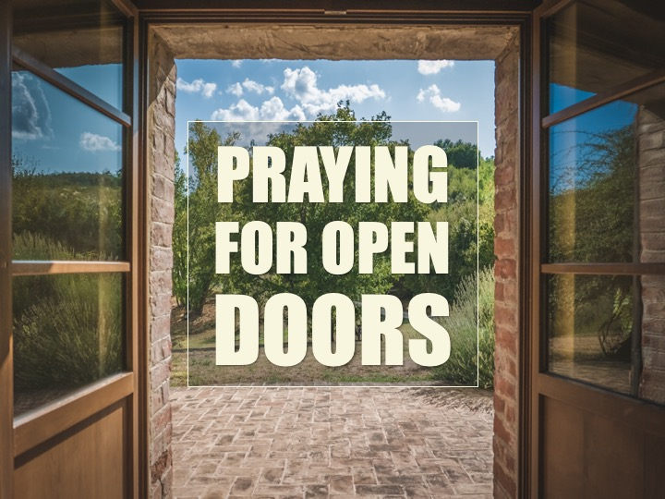

Slide 7
