Slide 1
Psalm 103:19-22
¹⁹ The Lord has established his throne in the heavens, and his kingdom rules over all.
²⁰ Bless the Lord, O you his angels, you mighty ones who do his word, obeying the voice of his word! ²¹ Bless the Lord, all his hosts, his ministers, who do his will! ²² Bless the Lord, all his works, in all places of his dominion. Bless the Lord, O my soul!

Slide 3
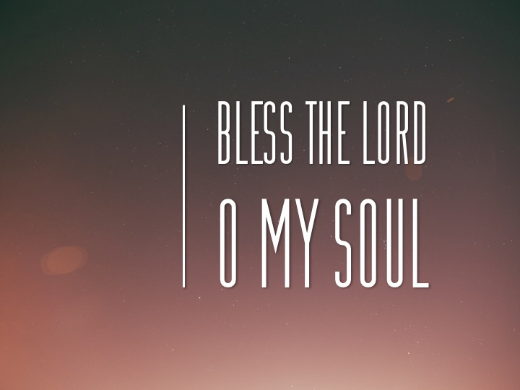

Slide 7
