Slide 1
Proverbs 4:23-27 (ESV)
²³ Keep your heart with all vigilance,
for from it flow the springs of life.
²⁴ Put away from you crooked speech,
and put devious talk far from you.
²⁵ Let your eyes look directly forward,
and your gaze be straight before you.
²⁶ Ponder the path of your feet;
then all your ways will be sure.
²⁷ Do not swerve to the right or to the left;
turn your foot away from evil.

Slide 2


Slide 3


Slide 4


Slide 5
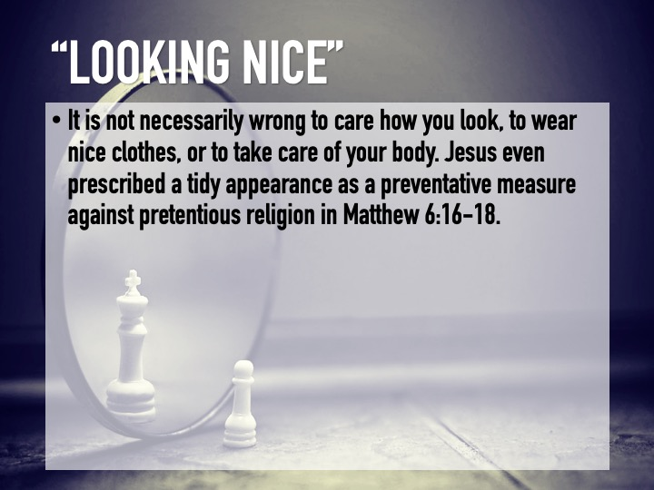

Slide 6
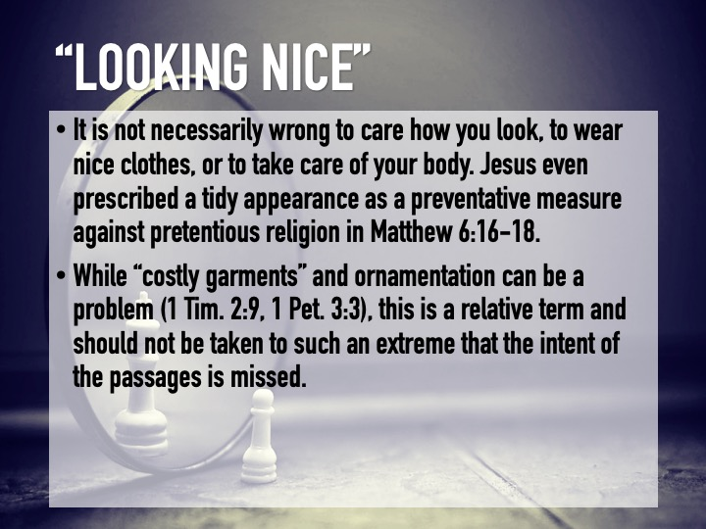

Slide 7
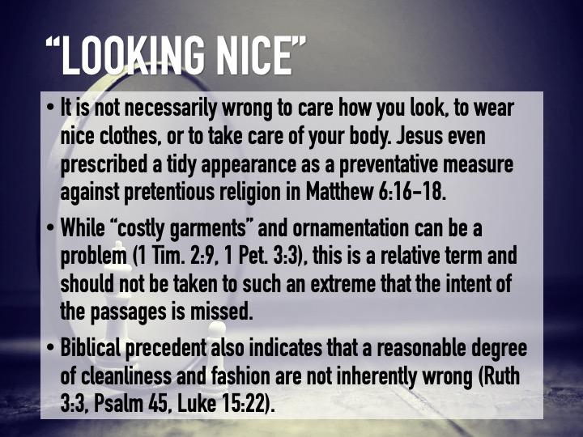

Slide 8
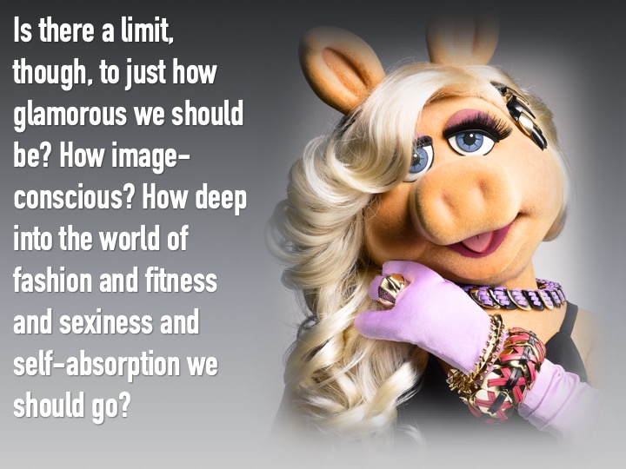

Slide 9


Slide 10


Slide 11


Slide 12


Slide 13


Slide 14


Slide 15


Slide 16


Slide 17


