Slide 1
Colossians 3:5-10 ESV
⁵ Put to death therefore what is earthly in you: sexual immorality, impurity, passion, evil desire, and covetousness, which is idolatry. ⁶ On account of these the wrath of God is coming. ⁷ In these you too once walked, when you were living in them. ⁸ But now you must put them all away: anger, wrath, malice, slander, and obscene talk from your mouth. ⁹ Do not lie to one another, seeing that you have put off the old self with its practices ¹⁰ and have put on the new self, which is being renewed in knowledge after the image of its creator.

Slide 2
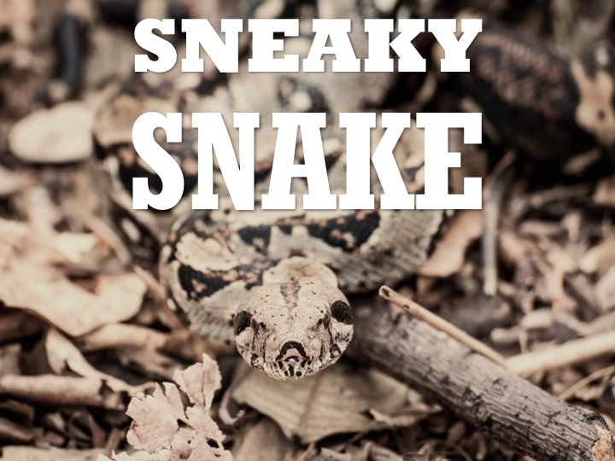

Slide 3
From the very beginning, as Jesus puts it, the devil has been a liar. Deception and trickery are an essential part of his nature (John 8:44). His first lie, in Genesis 3, is filled with bold claims but made out of God’s sight (at least, as he supposes).
The devil likes to find the “back door”, but even this doesn’t trick God – who expected Cain to be perceptive enough to also know that sin’s trap was set (Gen. 4:7).
“…in order that no advantage be taken of us by Satan; for we are not ignorant of his schemes” (2 Corinthians 2:11). Sadly, even with this knowledge many Christians are still caught up in sin (often secret and sneaky).

Slide 4
Satan “prowls”, but also “roars” (1 Pet. 5:8). Some temptations are really obvious. The danger is easy to identify. Other sins are more opaque, harder to recognize.
1 Timothy 5:24
Acts 20:28-30
Psalm 19:11-14 – The writer mentions “hidden faults” and “sins of presumption.” Other versions say “secret sins.” What does he mean by this? What kinds of sins are secret?

Slide 6
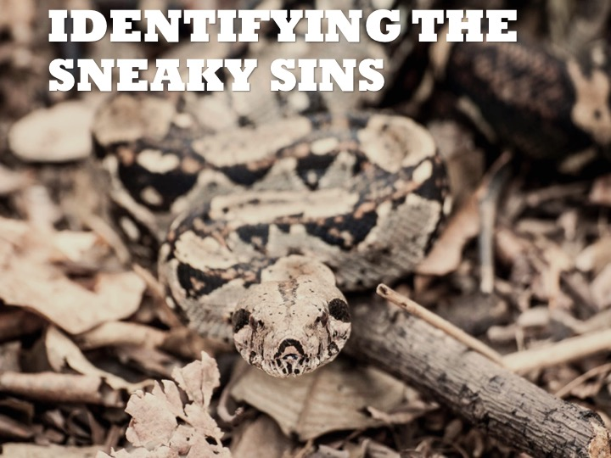
Be careful not to normalize sin, becoming desensitized to its severity, ugliness, and consequences (Jeremiah 6:13-15). Sin has a naturally desensitizing effect on us (2 Timothy 3:13). Remember the examples of Ahab (1 Kings 16:29-34) and Ahaz (2 Chronicles 28:4,19).
Re-labeling or “sanitizing” sin – A bad temper is just “passion for what I believe”, rudeness is just “a sarcastic personality”, gossip is just “I’m worried about him; have you heard…?”, disrespecting authority is just being “independent-minded”, or racism is waved off with a dismissive “Learn how to take a joke!” God takes sin seriously and so should we (Prov. 26:18-19, 22:24-25, Colossians 3:5-8).

Slide 7
Sins that are wrapped in non-sinful packaging – We justify our sins by carefully pointing out that what we’re doing isn’t “inherently” sinful, or “there’s no Bible verse.” Becoming instantly defensive is never a good sign! Also see 1 Cor. 6:12, 10:23.
For example, social media can be either a wholesome, useful tool or an instrument of the devil. Far too many Christians have become indiscreet in their behaviors and are emboldened to the point of sharing it all over the internet. How many of us casually respond with OMG! (Eph. 4:29, 5:11-12)? How often do we “like” and share pictures and videos with immodest apparel? How many of us have used Instagram as a portal for lust? Remember Romans 1:32.

Slide 8
The sneaky sins keep us from maturing (Ephesians 4:14-15), so a sure sign that you’ve got secret sins is your lack of personal, spiritual growth. Sin is like having a lot of holes in your budget – you’re always behind financially, always wondering where your money goes, but unwilling to root out the problem and stop up the holes (Haggai 1:6).
We might be unaware of the secret sins because their consequences have a time delay. Jehoshaphat, for example, planted the seeds of his son’s/grandson’s failure in his own lifetime (allied with Ahab and Ahaziah, his son married Athaliah, etc.) See 2 Chronicles 20:35, 22:3. Don’t be the conduit through which future sin destroys your family!

Slide 9
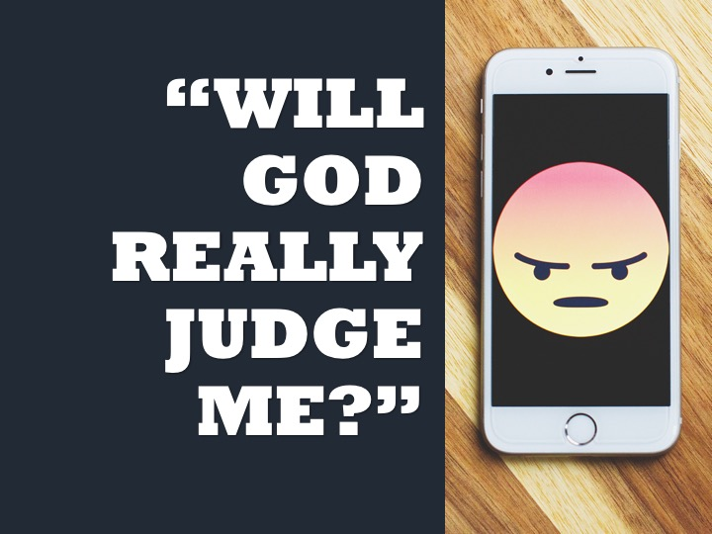

Slide 10
