Slide 1
11 Let such a person understand that what we say by letter when absent, we do when present. 12 Not that we dare to classify or compare ourselves with some of those who are commending themselves. But when they measure themselves by one another and compare themselves with one another, they are without understanding.

Slide 3
Putting On Airs

Slide 4
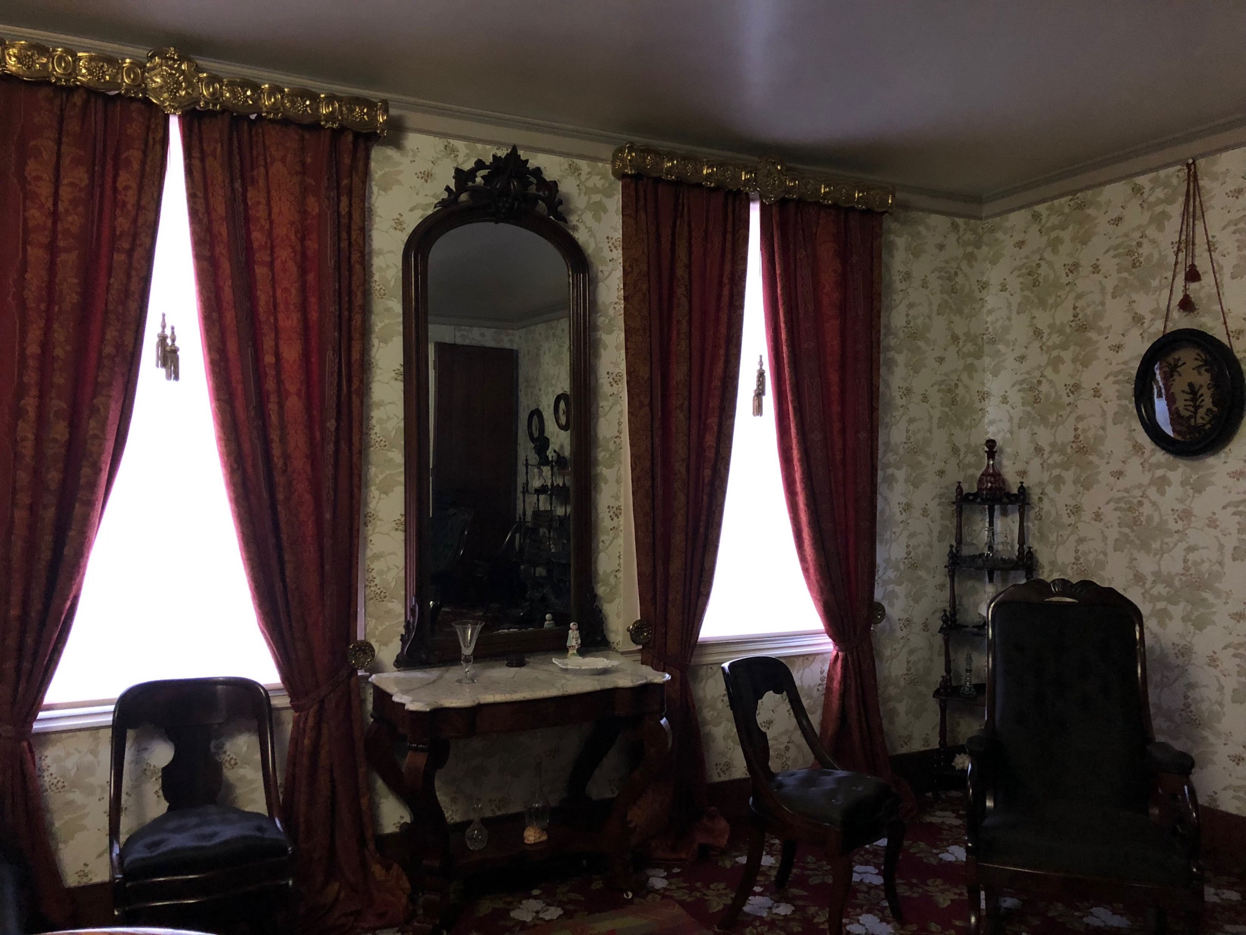
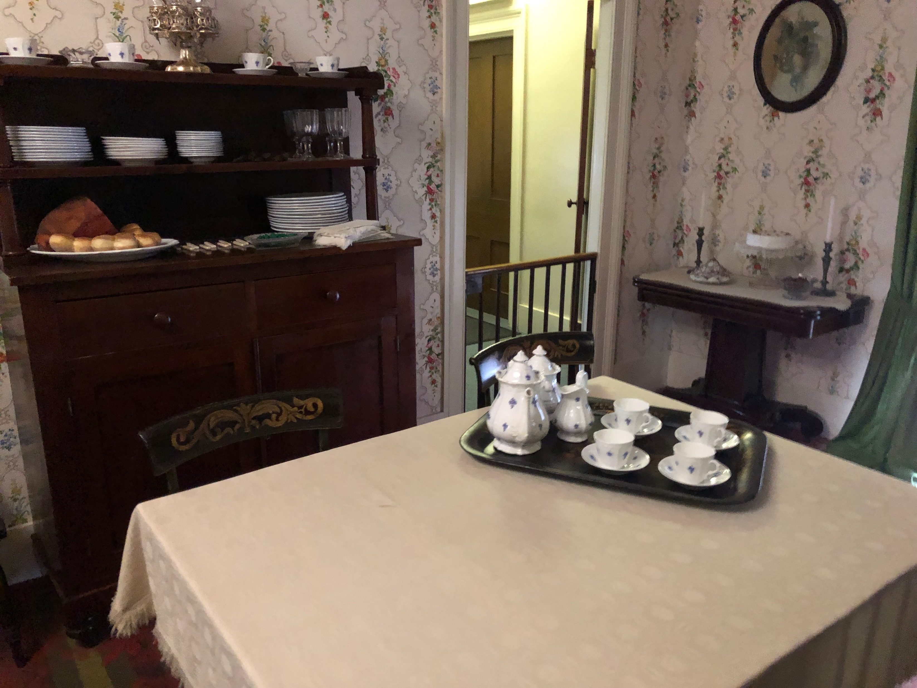
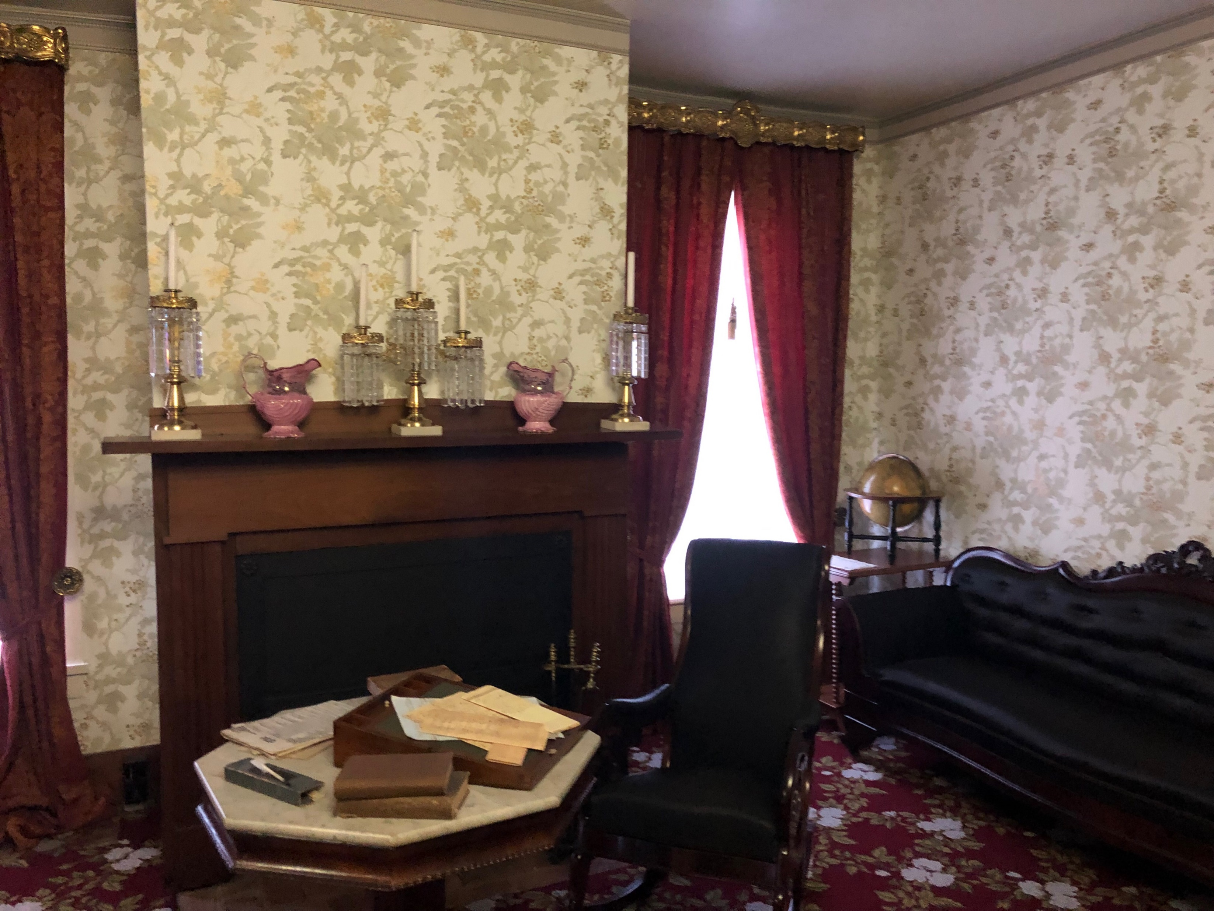
Putting On Airs

Slide 5
Putting On Airs

Slide 6
Putting on Airs
Humans have always attempted to impress others
Genesis 3.6; 1 John 2.15-17
Lamech (Genesis 4.23-24)
Tower of Babel (Genesis 11.3-4)
Ananias and Sapphira (Acts 5.1-11)
Gehazi (2 Kings 5)
In every case, it leads to disaster
In an attempt to look good, each person looked foolish, ugly, or evil
Putting On Airs

Slide 7
Putting on Airs
Even churches can be guilty of putting on airs
Korah’s rebellion
Israel’s stubbornness
Corinthian negligence
Again, in each case, putting on airs leads to the opposite result
We have to learn to look into the right mirror
Not the mirror of self
The mirror of God’s word (James 1.22-25)
Putting On Airs
Notes:
Scariest room in the Douthitt’s home is to the left when you walk in
Mirrored bathroom
Mirrors are important
Imagine life without a mirror
Imagine not knowing what you look like
Imagine thinking you look like one thing when you really look like something else.
This is the case with too many of us
We think we are spiritual, religious, righteous, when all it is is a dog and pony show!
WE HAVE TO LOOK IN THE RIGHT MIRROR!
THIS IS WHY WE NEED HUMILITY

Slide 8
Humility is the Goal
James 4.6
“Humility is not thinking less of yourself; it’s thinking of yourself less” (CS Lewis)
“To even get near [humility], even for a moment, is like a drink of cold water in the desert. Do not imagine that if you meet really humble man he will be what most people call “humble” nowadays: he will not be a sort of greasy, smarmy person, who is always telling you that, of course, he is nobody. Probably all you will think about him is that he seemed a cheerful, intelligent chap who took a real interest in what you said to him. If you do dislike him it will be because you feel a little envious of anyone who seems to enjoy life so easily. He will not be thinking about humility; he will not be thinking of himself at all” (CS Lewis, Mere Christianity).
Putting On Airs

Slide 9
What stares back?
Focused on seeing less of self
Focused on seeing Christ
His character
His morality
His purpose
Focused on seeing love for God
Focused on seeing love for others
Focused on equality and togetherness
Putting On Airs

