Slide 1
Psalm 38:17-22 ESV
¹⁷ For I am ready to fall, and my pain is ever before me. ¹⁸ I confess my iniquity; I am sorry for my sin. ¹⁹ But my foes are vigorous, they are mighty, and many are those who hate me wrongfully. ²⁰ Those who render me evil for good accuse me because I follow after good.
²¹ Do not forsake me, O Lord! O my God, be not far from me! ²² Make haste to help me, O Lord, my salvation!

Slide 4
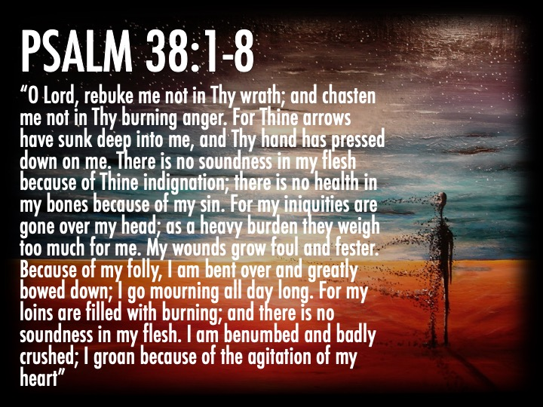

Slide 7
