Slide 1
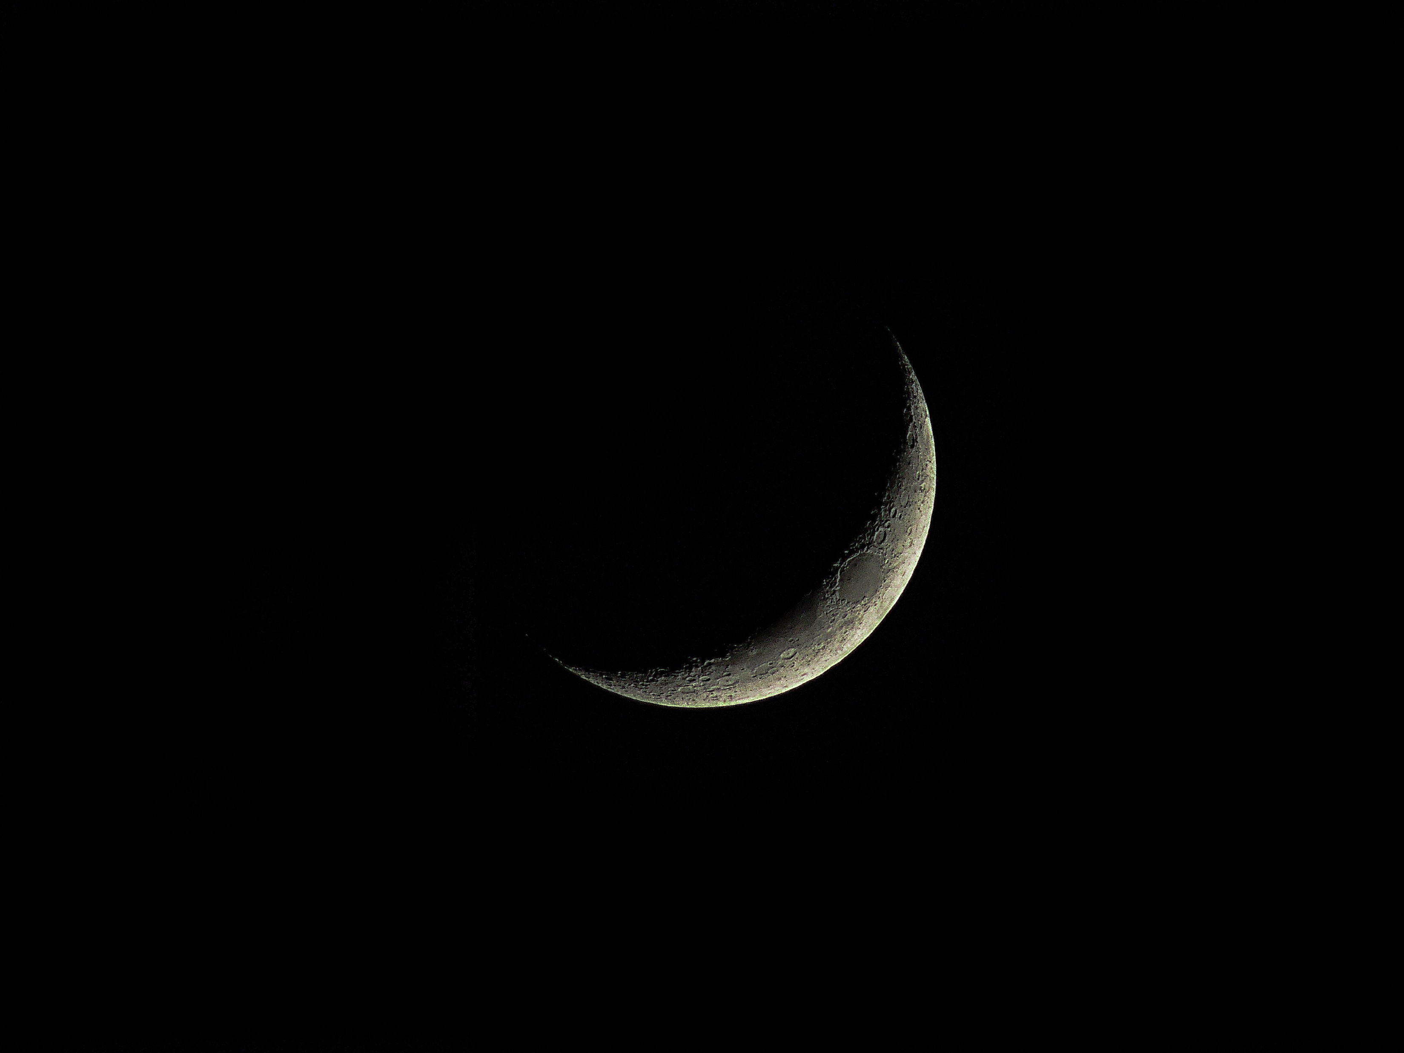
Psalm 16.9-11
⁹ Therefore my heart is glad, and my whole being rejoices;
my flesh also dwells secure.
¹⁰ For you will not abandon my soul to Sheol,
or let your holy one see corruption.
¹¹ You make known to me the path of life;
in your presence there is fullness of joy;
at your right hand are pleasures forevermore.

Slide 3
3
Dark
Days
Notes:
Phil Ford has been asking me to preach this lesson for no less than a year and a half – have to fit it in before I go!
We are familiar with:
Events leading up to the crucifixion
Events after the resurrection
What happened to Jesus during those 3 dark days in the grave?
We often wonder what happens to us when we are in the grave
There obviously is no “narrative” that tells us the answer, but we can piece it together with other details of Scripture

Slide 4
Fulfillment of Prophecy
Jesus would die
Isaiah 53.4-6; 2 Corinthians 5.21
He would be pierced
Zechariah 12.10; John 19.34-37
He would be buried for 3 days
Matthew 12.40
Psalm 16.9-11; Acts 2.31
Notes:
Fulfillment of Prophecy
Fulfilling prophecy was no accident
This was a huge part of what identified Jesus as the Messiah
Identified Him to John the Baptist
Identified Him to the religious leaders (Nicodemus)
Identified Him to us as readers of the Old and New Testament
Many of the prophecies were uncontrollable and clearly were guided by God
Jesus would die
Isaiah 53.4-6; 2 Corinthians 5.21
He would be pierced
Zechariah 12.10; John 19.34-37
He would be buried for 3 days
Why three days? It actually was not prophecied (in the OT) that Jesus would be buried for three days
Jonah in belly of whale - Matthew 12.40
“Therefore my heart is glad and my whole being rejoices; my body also rests securely. For you will not abandon me to Sheol, you will not allow your faithful one to see decay. You reveal the path of life to me; in your presence is abundant joy, at your right hand are eternal pleasures (Psalm 16.9-11)
Seeing what was to come, he spoke concerning the resurrection of the Messiah: He was not abandoned in Hades, and his flesh did not experience decay. (Acts 2.31)
For I delivered to you as of first importance what I also received, that Christ died for our sins according to the Scripture, and that He was buried, and that He was raised on the third day according to Scriptures, and that He appeared to Cepheus, then to the twelve (1 Cor 15.3-5).
Maybe the three day reference is to Jesus’ words about the temple? (Jn 2.19)
While three days is not mentioned in Scripture, the idea that there would be no decay demanded three days or less in the minds of the Jews:
“Mourning retains its power over the mourner for only three days (Bar Qappara)
“For the first three days after death, the soul flutters over the body, thinking that she will return to it. When she sees that the appearance of the corpse deteriorates, she leaves the body and goes her way (Ravi Abba)
“After three days, the belly explodes over the face and says to the deceased, ‘Here is what you have stoles and seized and given to me.’”
Also, there had to be an identification of the body within three days of death for the witness to be valid
“For it has been taught [in the Mishna] ‘They adduce evidence as to a corpse identity only from the features of the face, including the nose, and they give testimony only within three days [of the deceased’s death].’”
For Jesus to not experience decay as was prophecies, and for the apostles to have valid witness of his death, he had to resurrected within three days
Death on Friday
Grave on Saturday
Resurrection on Sunday

Slide 5
Fulfillment of Providence
He would end sin
Daniel 9.24; Galatians 1.3-5
He would suffer for other’s sins
Isaiah 53.8-9; Matthew 27.45-56
He would be the cornerstone
Zechariah 10.4; Ephesians 2.20
He would save the Gentiles
Isaiah 11.10; John 122.18-21
He would have a worldwide impact
Micah 5.4

Slide 6
Fulfillment of Proclamation
Jesus was not abandoned in Hades
Acts 2.29-31
He went down before He could come up (Ephesians 4.9-10)
He made proclamations to the spirits in prison (1 Peter 3.18-20; Luke 16.26; Luke 23.43; Jn 20.17)
It is possible Jesus went to Hades and redeemed the righteous who were there
Psalm 49.15; 89.48
Hebrews 11.39-40; 12.23

Slide 7
3
Dark
Days
Notes:
This gives us a clues as to what will happen to us when we die
Before the cross, we would “wait” in Hades
After the cross, we get to be assigned to our home in heaven
“Death is not extinguishing the light from the Christian; it is putting out the lamp because the dawn has come.”
1 Peter 3.21-22
Baptism saves us
Not because of the flesh
But because of what it does to our spirit
Does this through the resurrection of Jesus Christ
By His authority

