Slide 1
Luke 15.3-4
³ So he told them this parable: ⁴ "What man of you, having a hundred sheep, if he has lost one of them, does not leave the ninety-nine in the open country, and go after the one that is lost, until he finds it?

Slide 3
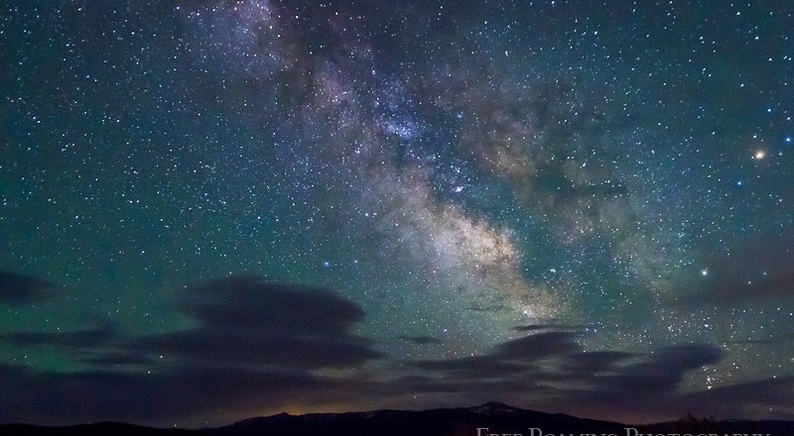
Notes:
There are at least 300 billion stars in our Milky Way Galaxy and around 10 trillion planets in our galaxy
There are over 100 billion galaxies in our universe at our latest count (estimate). Many are larger, many are smaller, but let’s use our estimate.
Multiply 10 trillion planets by 100 billion galaxies = 1,000,000,000,000,000,000,000,000 (one septillion) planets and God cares about ours!

Slide 4
Notes:
How many fish in a tank until you don’t care about it?
How many dogs can you have as a pet to no longer care about one of them?
How many kids can you have to no longer care about one?

Slide 5
Three Parables
A shepherd has lost a sheep
A woman has lost a coin
A father has lost a son

Slide 6
The Common Themes
The lost
The loss
The seeker
The unwillingness to give up
Notes:
Every Single One:
Of 7 billion peopled, every human is unique
Every human is unique and valuable
Because of it’s uniqueness
Because of God’s care (Matt 10; Psalm 139)
There are no “acceptable losses”
None of us could choose “which kid” to lose
Even if we had a dozen (like coin)
Even if we had a hundred (like sheep)
Every single one matters!

Slide 7
When Every Single One Matters
We realize what it means to be a child of God
We are cared for
We are disciplined
God cares about our behavior
Our sins become more offensive because we realize that we are damaging a relationship
We refuse to break rules because we know we are breaking His heart
Notes:
Romans 8.12-17
Why does it sometimes seem like God doesn’t care?
“In the Highlands of Scotland, a sheep would often wander off into the rocks and get into places that they couldn't get out of. The grass on these mountains is very sweet and the sheep like it, and they will jump down ten or twelve feet, and then they can't jump back again, and the shepherd hears them bleating in distress. They may be there for days, until they have eaten all the grass. The shepherd will wait until they are so faint they cannot stand, and then they will put a rope around him, and he will go over and pull that sheep up out of the jaws of death. "Why don't they go down there when the sheep first gets there?" I asked. "Ah!" He said, "they are so very foolish they would dash right over the precipice and be killed if they did!" And that is the way with men; they won't go back to God till they have no friends and have lost everything. If you are a wanderer I tell you that the Good Shepherd will bring you back the moment you have given up trying to save yourself and are willing to let Him save you His own way.

Slide 8
When Every Single One Matters
We realize that we belong to a family
Every one matters and contributes
Every person is liable for the whole
Every weakness must be fixed because it affects all
Every single new Christian must be strengthened to keep the family strong
Every single struggling Christian must be encouraged
Every single rebellious Christian must be straightened so the flock doesn’t go the wrong way
No one in this family is worth losing!
Notes:
Matthew 12.50 – Jesus calls us his family
1 John 4.11, 20-21 – must love brother like Christ loved us
1 John 3.10 – test of faithfulness
People who matter are most aware that everyone else does too. – Malcolm Forbes

Slide 9
When Every Single One Matters
You realize you matter
You are loved by God
You are loved by His people
You are needed
You can contribute
You are worth your place in this family
God’s plan was not just to save a people but to save you personally!

Slide 10
Notes:
John 10.1-6, 7-10, 11-15

