Slide 1
Psalms 39:1-3
¹ I said, “I will guard my ways, Lest I sin with my tongue; I will restrain my mouth with a muzzle, While the wicked are before me.” ² I was mute with silence, I held my peace even from good; And my sorrow was stirred up. ³ My heart was hot within me; While I was musing, the fire burned. Then I spoke with my tongue:

Slide 3
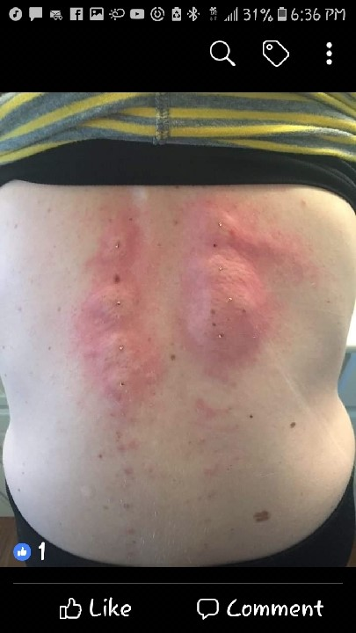

Slide 4
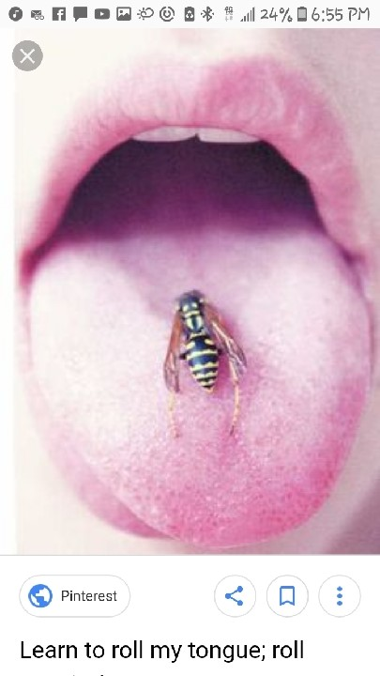
VENOM

Slide 5
James 3:2-4
² For we all stumble in many things. If anyone does not stumble in word, he is a perfect man, able also to bridle the whole body. ³ Indeed, we put bits in horses’ mouths that they may obey us, and we turn their whole body. ⁴ Look also at ships: although they are so large and are driven by fierce winds, they are turned by a very small rudder wherever the pilot desires.

Slide 6
James 3:5
⁵ Even so the tongue is a little member and boasts great things. See how great a forest a little fire kindles

Slide 7
James 3:6
⁶ And the tongue is a fire, a world of iniquity. The tongue is so set among our members that it defiles the whole body, and sets on fire the course of nature; and it is set on fire by hell.

Slide 8
James 3:7-8
⁷ For every kind of beast and bird, of reptile and creature of the sea, is tamed and has been tamed by mankind. ⁸ But no man can tame the tongue. It is an unruly evil, full of deadly poison.

Slide 9
James 3:9-10
⁹ With it we bless our God and Father, and with it we curse men, who have been made in the similitude of God. ¹⁰ Out of the same mouth proceed blessing and cursing. My brethren, these things ought not to be so.

Slide 10
James 3:11-12
¹¹ Does a spring send forth fresh water and bitter from the same opening? ¹² Can a fig tree, my brethren, bear olives, or a grapevine bear figs? Thus no spring yields both salt water and fresh

Slide 11
James 5:9
Do not grumble against one another, brethren, lest you be condemned. Behold the Judge is standing at the door!

Slide 12
James 1:26
²⁶ If anyone among you thinks he is religious, and does not bridle his tongue but deceives his own heart, this one’s religion is useless

Slide 13
Proverbs 18:21
²¹ Death and life are in the power of the tongue, And those who love it will eat its fruit.

Slide 15
Matt 12:33-35
³³ “Either make the tree good and its fruit good, or else make the tree bad and its fruit bad; for a tree is known by its fruit. ³⁴ Brood of vipers! How can you, being evil, speak good things? For out of the abundance of the heart the mouth speaks. ³⁵ A good man out of the good treasure of his heart brings forth good things, and an evil man out of the evil treasure brings forth evil things

Slide 16
Matt 12:36-37
³⁶ But I say to you that for every idle word men may speak, they will give account of it in the day of judgment. ³⁷ For by your words you will be justified, and by your words you will be condemned.”

Slide 17
VENOM

