Slide 1
2 Timothy 3.14-17
¹⁴ But as for you, continue in what you have learned and have firmly believed, knowing from whom you learned it ¹⁵ and how from childhood you have been acquainted with the sacred writings, which are able to make you wise for salvation through faith in Christ Jesus. ¹⁶ All Scripture is breathed out by God and profitable for teaching, for reproof, for correction, and for training in righteousness, ¹⁷ that the man of God may be complete, equipped for every good work.

Slide 3
2 Timothy 3.14-17

Slide 4
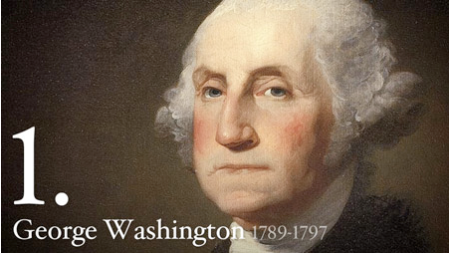
“It is impossible to rightly govern the world without God and the Bible.” –
Notes:
“It is impossible to rightly govern the world without God and the Bible.” – George Washington

Slide 5
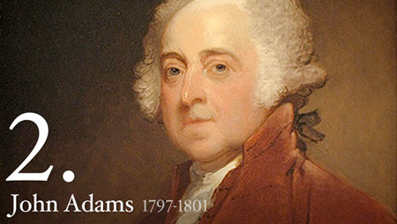
“I have examined all religions, and the result is that the Bible is the best book in the world.”

Slide 6
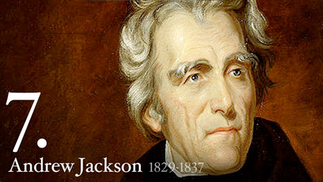
“[The Bible] is the rock on which our Republic rests.”

Slide 7
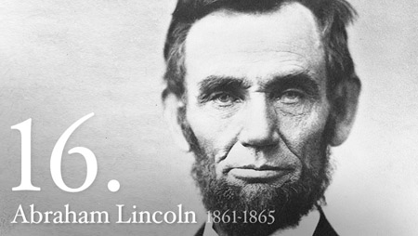
“But for this book we could not know right from wrong.”
Notes:
“It is impossible to rightly govern the world without God and the Bible.” – George Washington
“I have examined all religions, and the result is that the Bible is the best book in the world.” – John Adams
“[The Bible] is the rock on which our Republic rests.” – Andrew Jackson
Abraham Lincoln:
“But for this book we could not know right from wrong.”
“I believe the Bible is the best gift God has ever given to man. All the good from The Savior of the world is communicated to us through this Book.”
“Take all that you can of this book upon reason, and the balance on faith, and you will live and die a happier man.” (When a skeptic expressed surprise to see him reading a Bible)
“A thorough knowledge of the Bible is worth more than a college education.” – Teddy Roosevelt
“Within the covers of the Bible are the answers for all the problems men face.” – Ronald Reagan
There is a book [the Bible] worth all the other books ever printed. - Patrick Henry
Education is useless without the Bible. The Bible was America’s basic text book in all fields. God’s Word, contained in the Bible, has furnished all necessary rules to direct our conduct. - Noah Webster

Slide 8
“I believe the Bible is the best gift God has ever given to man. All the good from The Savior of the world is communicated to us through this Book.”
Notes:
“It is impossible to rightly govern the world without God and the Bible.” – George Washington
“I have examined all religions, and the result is that the Bible is the best book in the world.” – John Adams
“[The Bible] is the rock on which our Republic rests.” – Andrew Jackson
Abraham Lincoln:
“But for this book we could not know right from wrong.”
“I believe the Bible is the best gift God has ever given to man. All the good from The Savior of the world is communicated to us through this Book.”
“Take all that you can of this book upon reason, and the balance on faith, and you will live and die a happier man.” (When a skeptic expressed surprise to see him reading a Bible)
“A thorough knowledge of the Bible is worth more than a college education.” – Teddy Roosevelt
“Within the covers of the Bible are the answers for all the problems men face.” – Ronald Reagan
There is a book [the Bible] worth all the other books ever printed. - Patrick Henry
Education is useless without the Bible. The Bible was America’s basic text book in all fields. God’s Word, contained in the Bible, has furnished all necessary rules to direct our conduct. - Noah Webster

Slide 9
“Take all that you can of this book upon reason, and the balance on faith, and you will live and die a happier man.
Notes:
“It is impossible to rightly govern the world without God and the Bible.” – George Washington
“I have examined all religions, and the result is that the Bible is the best book in the world.” – John Adams
“[The Bible] is the rock on which our Republic rests.” – Andrew Jackson
Abraham Lincoln:
“But for this book we could not know right from wrong.”
“I believe the Bible is the best gift God has ever given to man. All the good from The Savior of the world is communicated to us through this Book.”
“Take all that you can of this book upon reason, and the balance on faith, and you will live and die a happier man.” (When a skeptic expressed surprise to see him reading a Bible)
“A thorough knowledge of the Bible is worth more than a college education.” – Teddy Roosevelt
“Within the covers of the Bible are the answers for all the problems men face.” – Ronald Reagan
There is a book [the Bible] worth all the other books ever printed. - Patrick Henry
Education is useless without the Bible. The Bible was America’s basic text book in all fields. God’s Word, contained in the Bible, has furnished all necessary rules to direct our conduct. - Noah Webster

Slide 10
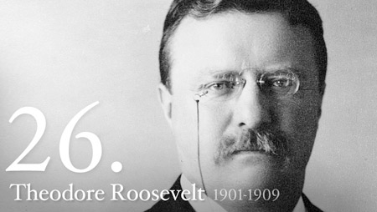
“A thorough knowledge of the Bible is worth more than a college education.”
Notes:
“It is impossible to rightly govern the world without God and the Bible.” – George Washington
“I have examined all religions, and the result is that the Bible is the best book in the world.” – John Adams
“[The Bible] is the rock on which our Republic rests.” – Andrew Jackson
Abraham Lincoln:
“But for this book we could not know right from wrong.”
“I believe the Bible is the best gift God has ever given to man. All the good from The Savior of the world is communicated to us through this Book.”
“Take all that you can of this book upon reason, and the balance on faith, and you will live and die a happier man.” (When a skeptic expressed surprise to see him reading a Bible)
“A thorough knowledge of the Bible is worth more than a college education.” – Teddy Roosevelt
“Within the covers of the Bible are the answers for all the problems men face.” – Ronald Reagan
There is a book [the Bible] worth all the other books ever printed. - Patrick Henry
Education is useless without the Bible. The Bible was America’s basic text book in all fields. God’s Word, contained in the Bible, has furnished all necessary rules to direct our conduct. - Noah Webster

Slide 11
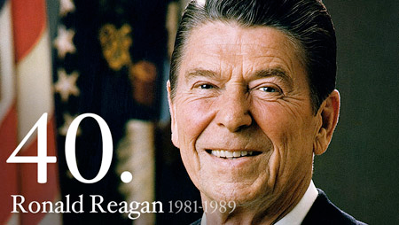
“Within the covers of the Bible are the answers for all the problems men face.
Notes:
There is a book [the Bible] worth all the other books ever printed. - Patrick Henry
Education is useless without the Bible. The Bible was America’s basic text book in all fields. God’s Word, contained in the Bible, has furnished all necessary rules to direct our conduct. - Noah Webster

Slide 12
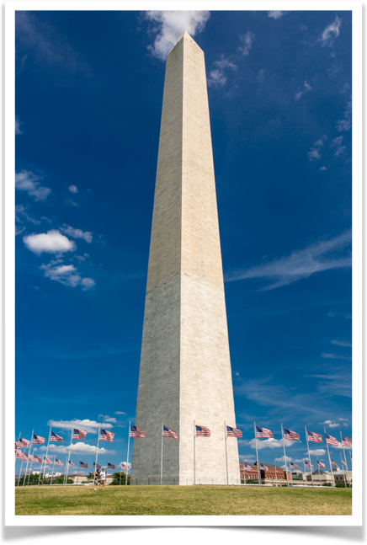
Holiness to the Lord
Search the Scriptures
The memory of the just is blessed
May Heaven to this Union continue its beneficence
In God We Trust
“Praise be to God”
Notes:
There is a book [the Bible] worth all the other books ever printed. - Patrick Henry
Education is useless without the Bible. The Bible was America’s basic text book in all fields. God’s Word, contained in the Bible, has furnished all necessary rules to direct our conduct. - Noah Webster
Washington Monument is covered in Scripture
Holiness to the Lord (Exodus 28:26, 30:30, Isaiah 23:18, Zechariah 14:20)
Search the Scriptures (John 5:39)
The memory of the just is blessed (Proverbs 10:7)
May Heaven to this Union continue its beneficence
In God We Trust
“Praise be to God” (engraved on the monument’s capstone in Latin as “Laus Deo”)

Slide 13
The Gospel At Work
What Works:
We are to learn — requires teaching!
We are to be convinced — requires motivating!
What Fails:
Only teaching does not save souls
Only motivating does not save souls
Notes:
What has happened to our LOVE OF THE BIBLE?

Slide 14
The Gospel Is Throughout
Timothy was taught the Gospel with the Old Testament
Timothy was convinced of the Gospel by his mother and grandmother (1.5)
All Scriptures can be used to share the Gospel and change lives

Slide 15
The Goal of Scripture
Convert (1 Tim 1.5, 8-11)
Teach
Reprove
Correct
Train in righteousness
Completeness
Equip completely
Cause us to work good works

Slide 16
2 Timothy 3.14-17

