Slide 1
Navigating
Through This
Life

Slide 2
2 Timothy 3:10-15
¹⁰ You, however, have followed my teaching, my conduct, my aim in life, my faith, my patience, my love, my steadfastness, ¹¹ my persecutions and sufferings that happened to me at Antioch, at Iconium, and at Lystra —which persecutions I en- dured; yet from them all the Lord rescued me. ¹² Indeed, all who desire to live a godly life in Christ Jesus will be persecuted, ¹³ while evil people and impostors will go on from bad to worse, deceiving and being deceived. ¹⁴ But as for you, continue in what you have learned and have firmly believed, knowing from whom you learned it ¹⁵ and how from childhood you have been acquainted with the sacred writings, which are able to make you wise for salvation through faith in Christ Jesus.

Slide 3
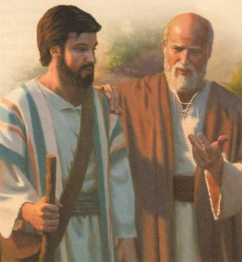
Having a Mentor Like Paul
2 Timothy 3:10-11
¹⁰ You, however, have followed my teaching, my conduct, my aim in life, my faith, my patience, my love, my steadfastness, ¹¹ my persecutions and sufferings that happened to me at Antioch, at Iconium, and at Lystra —which persecutions I endured; yet from them all the Lord rescued me.

Slide 4
Keep Learning
2 Timothy 3:10-11

Slide 5
Remember those
who taught you
Educating the mind without educating the heart is no education at all.
Aristotle

Slide 6
Serve Our Fellow Man
Galatians 6:9-10
⁹ And let us not grow weary of doing good, for in due season we will reap, if we do not give up. ¹⁰ So then, as we have opportunity, let us do good to everyone, and especially to those who are of the household of faith.

Slide 8
Keep Our Principles in Place
Joshua 24:14-15
¹⁴ ”Now therefore fear the LORD and serve him in sincerity and in faithfulness. Put away the gods that your fathers served beyond he River and in Egypt, and serve the LORD. ¹⁵ And if it is evil in your eyes to serve the LORD choose this day whom you will serve, whether the gods your fathers served in the region beyond the River, or the gods your fathers served in the region beyond the River, or the gods if the Amorites in whose land you dwell. But as for me and my house, we will serve the LORD.”

Slide 9
Choose
This Day…

