Slide 1
Psalm 24.7-10
⁷ Lift up your heads, O gates! And be lifted up, O ancient doors, that the King of glory may come in. ⁸ Who is this King of glory? The LORD, strong and mighty, the LORD, mighty in battle! ⁹ Lift up your heads, O gates! And lift them up, O ancient doors, that the King of glory may come in. ¹⁰ Who is this King of glory? The LORD of hosts, he is the King of glory! Selah

Slide 4
The Battle
The battle is real
The battle is revolting
The battle is raging
The battle is recruiting
The battle is revealing

Slide 5
The Victory
The victory is secured
The victory is sure
The victory is salvation
The victory is sharable

Slide 6
Your Role in the Ranks
Tend the wounded
Train the troops
Stay alert, always
Fight the enemy
Recruit the deceived
Trust your captain

Slide 7
1-1 O Church Arise
O Church, Arise

Slide 8
1-2 O Church Arise
O Church, Arise

Slide 9
1-3 O Church Arise
O Church, Arise

Slide 10
1-4 O Church Arise
O Church, Arise

Slide 11
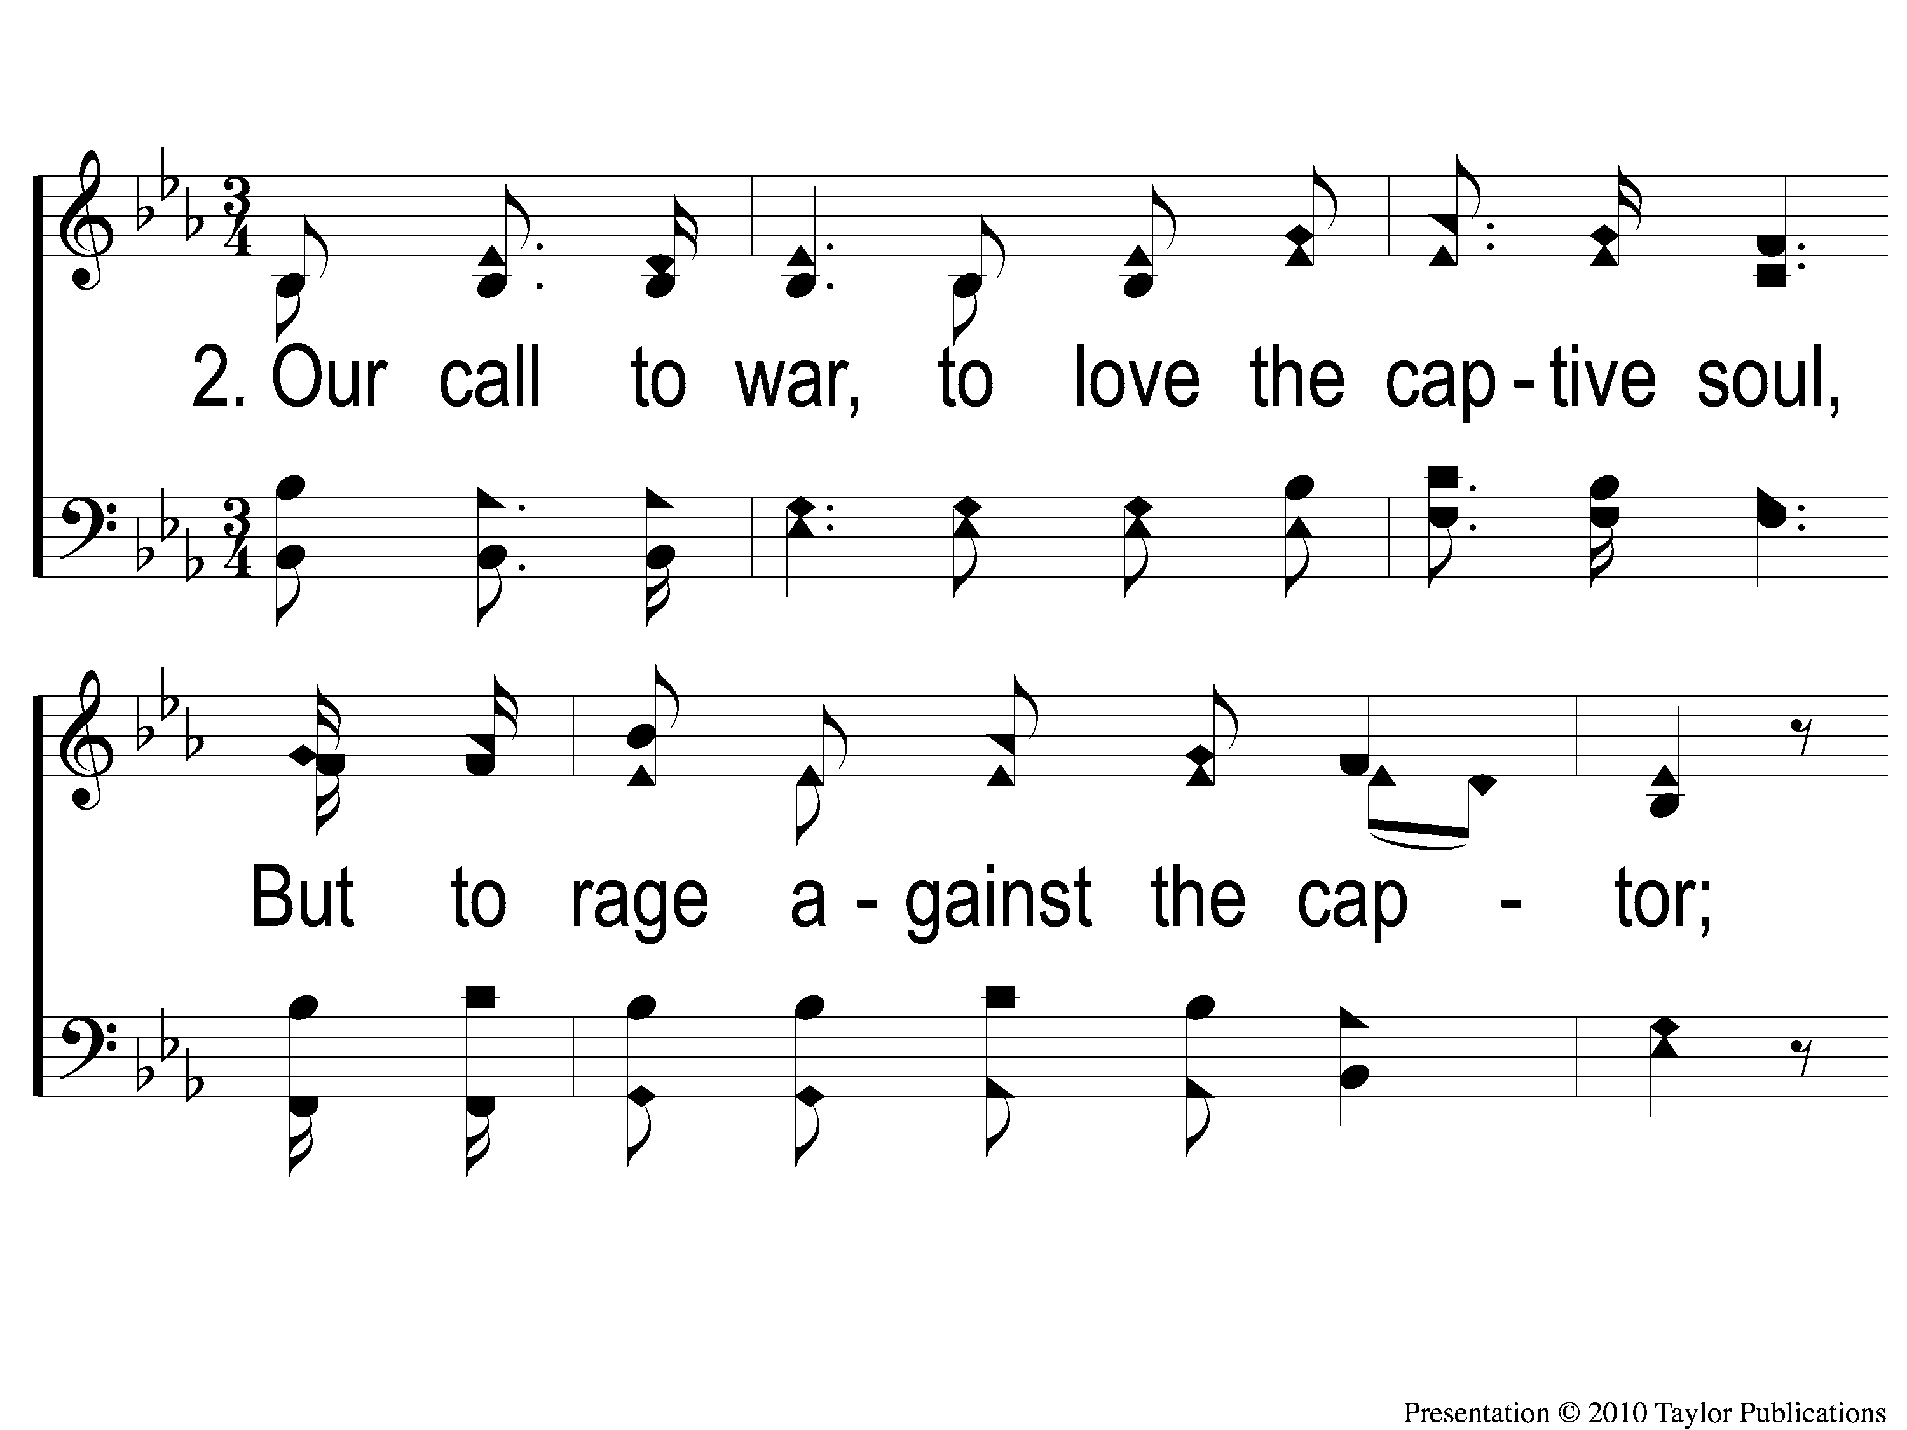
2-1 O Church Arise
O Church, Arise

Slide 12
2-2 O Church Arise
O Church, Arise

Slide 13
2-3 O Church Arise
O Church, Arise

Slide 14
2-4 O Church Arise
O Church, Arise

Slide 15
3-1 O Church Arise
O Church, Arise

Slide 16
3-2 O Church Arise
O Church, Arise

Slide 17
3-3 O Church Arise
O Church, Arise

Slide 18
3-4 O Church Arise
O Church, Arise

Slide 19
4-1 O Church Arise
O Church, Arise

Slide 20
4-2 O Church Arise
O Church, Arise

Slide 21
4-3 O Church Arise
O Church, Arise

Slide 22
4-4 O Church Arise
O Church, Arise

