Slide 1
Luke 1.35
³⁴ And Mary said to the angel, "How will this be, since I am a virgin?” ³⁵ And the angel answered her, "The Holy Spirit will come upon you, and the power of the Most High will overshadow you; therefore the child to be born will be called holy-- the Son of God.

Slide 3
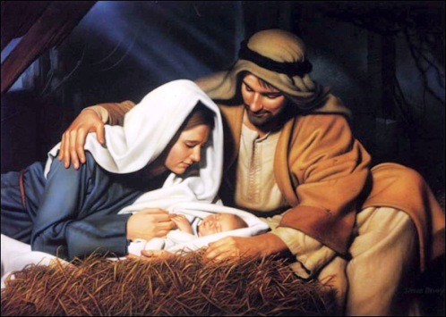
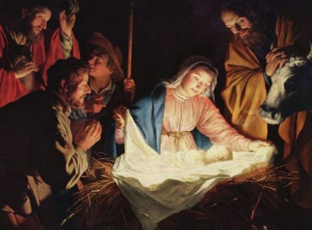
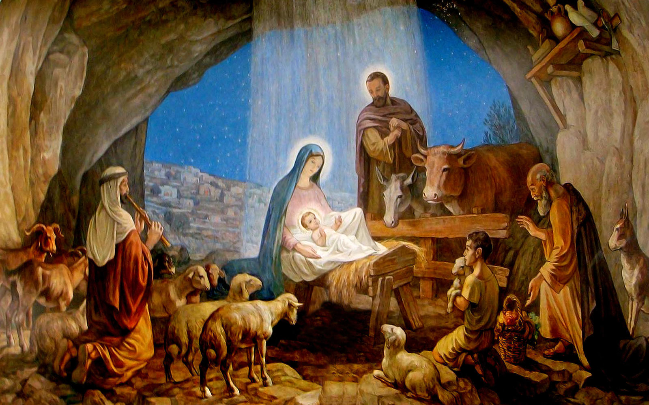
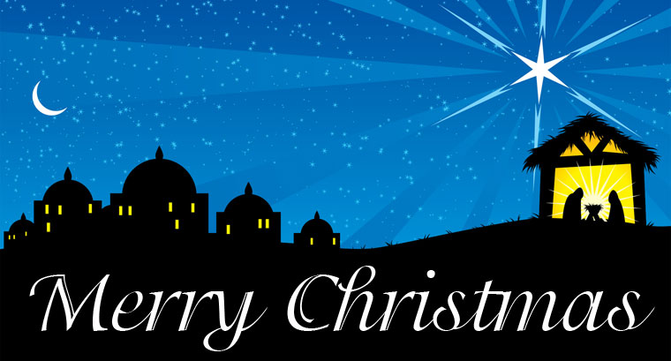
Notes:
Typical Birth Story
We have beautiful depictions of how it would have been
Everyone looks at peace
Everyone has a look of awe
There is constant worship of the baby
The baby glows with a beautiful light
The baby is a Caucasian baby, lovely hair, no crying

Slide 4
Notes:
Silent night, holy night! All is calm, all is bright. Round yon Virgin, Mother and Child. Holy infant so tender and mild, Sleep in heavenly peace, Sleep in heavenly peace Silent night, holy night! Shepherds quake at the sight. Glories stream from heaven afar. Heavenly hosts sing Alleluia, Christ the Savior is born! Christ the Savior is born Silent night, holy night! Son of God love's pure light. Radiant beams from Thy holy face With dawn of redeeming grace, Jesus Lord, at Thy birth. Jesus Lord, at Thy birth

Slide 5
The Reality of Jesus’ Birth
A virgin is with child
Mary is rejected by everyone
They traveled a long distance at the worst timing
They stayed in less than ideal circumstances
Notes:
The Reality of Jesus’ Birth
A virgin is with child
Mary would be assumed to be a sinful woman – promiscuous
The child would be rejected as illegitimate
Mary is rejected by everyone
Joseph wants to put her away (Matt 1.19)
Probably both families reject Mary and Joseph for taking her as his wife
The community probably shunned her
This is likely why she goes to stay with Elizabeth about the time she would start showing (Lk 1.39)
This is likely why Joseph takes her with him to Bethlehem (Lk 2.4-5)
This is likely why they stay in Bethlehem after child is born (Matt 2.1, 7, 16)
The unmarried couple raveled 80 miles from Nazareth to Bethlehem while very pregnant (Le 2.4-5)
They had to stay in the public room of a friend or relative (Lk 2.7)
Word for “inn” is kataluma, means inn or guest room (often an upper room or raised area)
If no room there, they could stay in common area where animals were brought in at night – night was warm, animals stayed outside, Joseph and Mary stay there.
They had to lay the baby in a feeding trough
All of this while facing the distaste of family or friends

Slide 6
The Rejoicing about Jesus’ Birth
Parents rejoiced
The angels of heaven rejoiced
The shepherds rejoiced
Some wise men show up at least a year later and rejoice
Most people ignored his birth
Herod wanted to kill him

Slide 7
The Prophecies About Jesus
Jesus fulfilled over 350 prophecies
16+ dealt with birth or heritage
Fulfilling that amount of prophecies is statistically impossible
Notes:
Jesus fulfilled 365 prophecies
Prophecies concerning Jesus’ birth:
Be the offspring of the woman; shall bruise the serpent’s head(Gen 3.14-15)
All nations shall be blessed through Abraham (Gen 18.17-18)
Be of the tribe of Judah (Gen 49.8-10; Mic 5.2)
Be born in the town of Bethlehem of Judea (Mic 5.2-5)
Be born a king of the line of David (Is 9.7; 2 Sam 7.12-13; Jer 23.5)
A child to be born (Is 9.6)
Be born of a virgin (Is 7.13-14)
Kings shall bring him gifts, fall down before him (Ps 72.10-11)
Be born of the seed of Abraham (Gen 17.7-8; 26.3-4)
Be born of the seed of Isaac (Gen 17.19; 21.12; 26.2-4)
Be of the seed of Jacob; a star out of Jacob (Gen 28.13-14; Num 24.17-19)
Be a firstborn son, sanctified (Ex 13.2; Num 3.13; 8.17)
Be a rod out of the stem of Jesse (Is 11.1-2)
Massacre of children (Jer 31.15)
Have eternal existence (Mic 5.2)
Be called out of Egypt (Hos 11.1)
Odds of Jesus fulfilling just 61 prophecies is “one chance in a trillion, trillion, trillion, trillion, trillion, trillion, trillion, trillion, trillion, trillion, trillion, trillion, trillion.

Slide 8
One chance in a
One chance in a 1,000,000,000,000,000,000,000,000,000,000,000,000,000,000,000,000,000,000,000,000,000,000,000,000,000,000,000,000,000,000,000,000,000,000,000,000,000,000,000,000,000,000,000,000,000,000,000,000,000,000,000,000,000,000,000,000,000,000,000,000,000,000,000,000,000
So far in history, less than 108,000,000,000 people have ever lived.
Notes:
This is 165 0s
This number is astronomical.
There have only been 108 billion people to ever live on earth
There are only 200 billion stars in our Milky Way Galaxy
There are 300 sextillion stars in the universe – that’s 300 with 21 zeros after it
We are talking 1 chance in 1 with 165 zeros behind it.

Slide 9
The Impact of Jesus
Nearly two thousand years ago in an obscure village, a child was born of a peasant woman. He grew up in another village where He worked as a carpenter until He was thirty. Then for three years He became an itinerant preacher.
This man never went to college or seminary. He never wrote a book. He never held a public office. He never had a family nor owned a home. He never put His foot inside a big city nor traveled even 200 miles from His birthplace. And though He never did any of the things that usually accompany greatness, throngs of people followed Him. He had no credentials but Himself.

Slide 10
While He was still young, the tide of public opinion turned against Him. His followers ran away. He was turned over to His enemies and sentenced to death on a cross between two thieves. While He was dying, His executioners gambled for the only piece of property He had on earth – the simple coat He had worn. His body was laid in a borrowed grave provided by a compassionate friend.
But three days later this Man arose from the dead – living proof that He was, as He had claimed, the Savior whom God had sent, the Incarnate Son of God.

Slide 11
Nineteen centuries have come and gone and today the risen Lord Jesus Christ is the central figure of the human race. On our calendars His birth divides history into two eras. One day of every week is set aside in remembrance of Him. And our two most important holidays celebrate His birth and resurrection. On church steeples around the world, His cross has become the symbol of victory over sin and death.
This one Man’s life has furnished the theme for more songs, books, poems and paintings than any other person or event in history. Thousands of colleges, hospitals, orphanages and other institutions have been founded in honor of this One who gave His life for us.
All the armies that ever marched, all the navies that ever sailed, all the governments that ever sat, all the kings that ever reigned have not changed the course of history as much as this One Solitary Life.

Slide 12
God Gave Us Jesus
So we might know Him (Jn 1.18)
So we might have an example (Jn 13.15; 1 Pet 2.21)
That He might sacrifice Himself (Jn 10.15-18)
That we might know salvation (Lk 19.10)
That we might repent (Mk 1.14-15)
That we might know love (1 Jn 4.7, 9-11)
To give us abundant life (Jn 10.10)
To be our King (Jn 18.37)

