Slide 1
Isaiah 53:1–3
¹ Who has believed what he has heard from us? And to whom has the arm of the Lord been revealed? ² For he grew up before him like a young plant, and like a root out of dry ground; he had no form or majesty that we should look at him, and no beauty that we should desire him.

Slide 2
Isaiah 53:1–3
³ He was despised and rejected by men, a man of sorrows and acquainted with grief; and as one from whom men hide their faces he was despised, and we esteemed him not.

Slide 4
Jesus was God.
Sometimes “God” is used as a name.
Sometimes “God is used as a classification.
Jesus was and is divine.
John 1:1–4, 14

Slide 5
Jesus was man.
John 1:14
Jesus was the Son of God and the son of David.
Romans 1:3–4
Jesus’ existence as God and man qualifies Him to be our mediator.
1 Timothy 2:5
Colossians 1:18–23
John 14:6

Slide 6
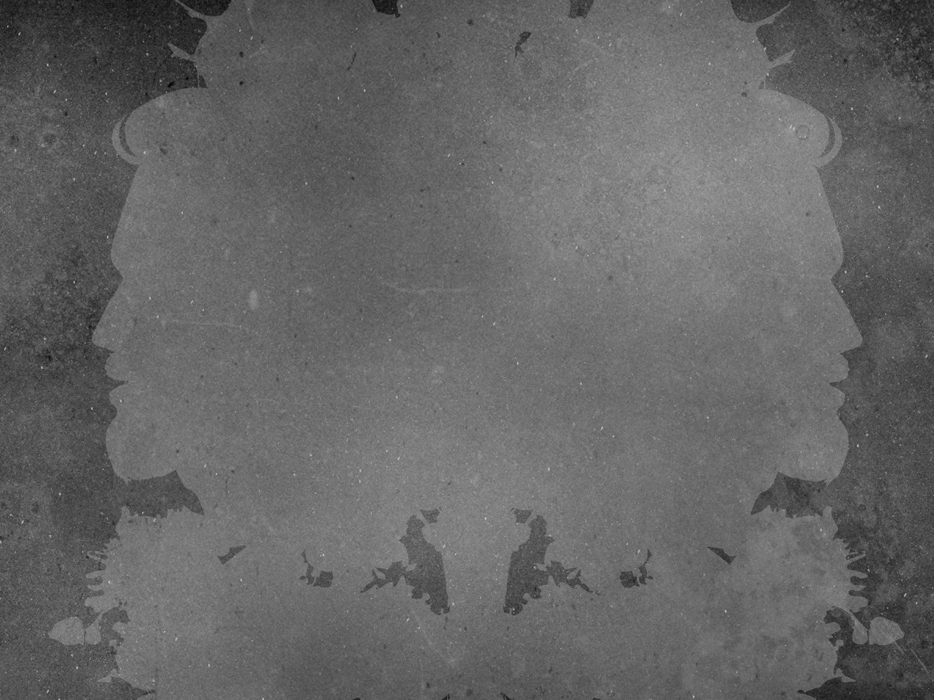
He is a tall man, well shaped and of an amiable and reverend aspect; his hair is of a color that can hardly be matched, falling into graceful curls … parted on the crown of his head, running as a stream to the front after the fashion of the Nazarites; his forehead high, large and imposing; his cheeks without spot or wrinkle, beautiful with a lovely red; his nose and mouth formed with exquisi te symmetry, his beard, and of a color suitable to his hair, reaching below his chin and parted in the middle like a fork; his eyes bright, blue, clear and serene …

Slide 7
But could we recognize Jesus?
Our glamorization about Jesus reflects more about us than it does about Him.
Isaiah 53:2–3
Isaiah 52:14

Slide 8
He was not at all like the psychologist's picture of the integrated, balanced, adjusted, happily married, employed, popular citizen. You can’t really be very well ‘adjusted’ to your world if it says ‘you have a devil’ and ends by nailing you up naked to a stake of wood.
—C.S. Lewis

Slide 9
Why did He come as a servant?
Hebrews 2:9–10
He did it for us.
Hebrews 2:14–18
Hebrews 4:14–16
His success made Him sympathetic, not arrogant.

