Slide 1
¹⁴ Do all things without grumbling or questioning, ¹⁵ that you may be blameless and innocent, children of God without blemish in the midst of a crooked and twisted generation, among whom you shine as lights in the world, ¹⁶ holding fast to the word of life, so that in the day of Christ I may be proud that I did not run in vain or labor in vain (Philippians 2.14-16).

Slide 3
A Cultural Problem
We have too much bad stuff
We always want less
We have too little good stuff
We always want more

Slide 4
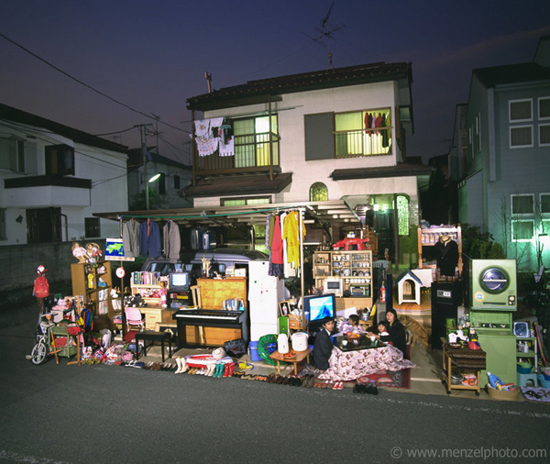
Tokyo

Slide 5
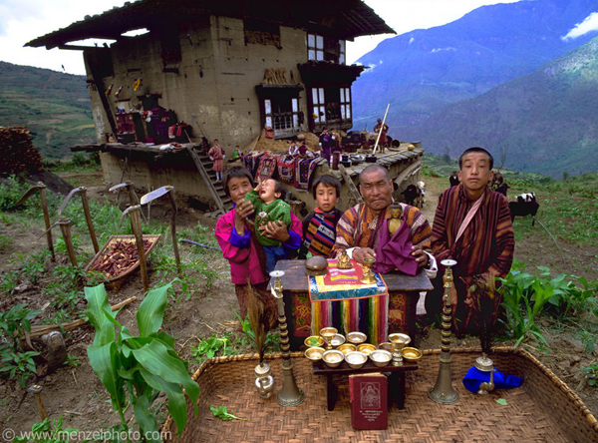
Bhutan

Slide 6
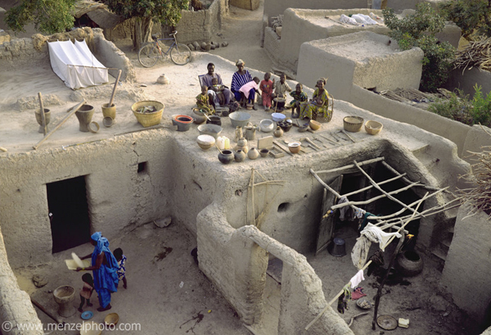
Mali

Slide 7
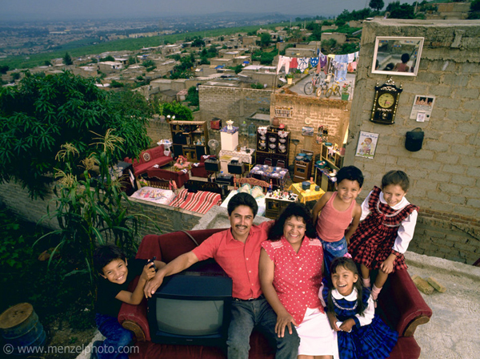
Mexico

Slide 8
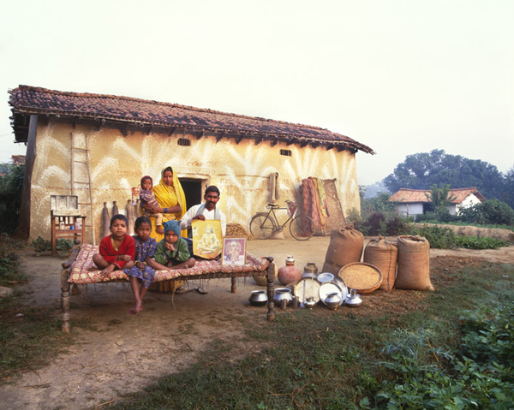
India

Slide 9
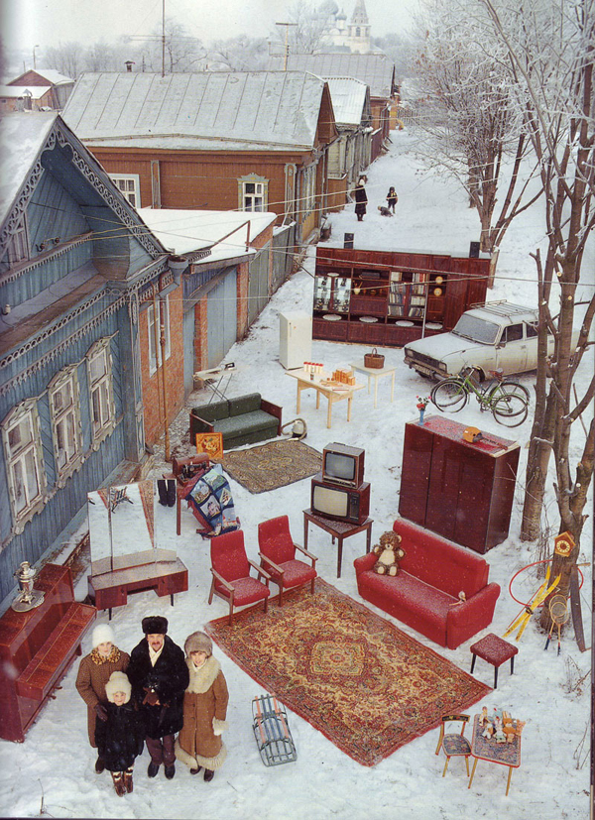
Russia

Slide 10
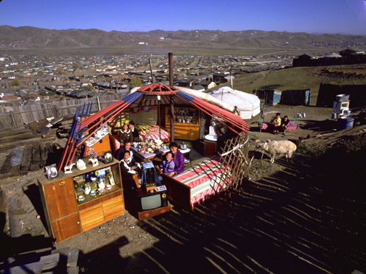
Mongolia

Slide 11
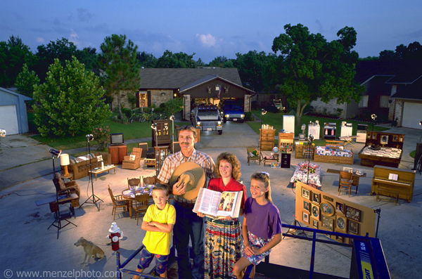
Texas

Slide 14
The Real Problem
We don’t have a stuff problem
We have an attitude problem
We complain when things are bad.
Phil 2.14
We have a gratitude problem
We complain when things are good.
1 Thess 5.16-18
We have a contentment problem
Phil 4.10-12

Slide 15
The Real Problem
We have a trust problem
“I can do all things through him who strengthens me” (Philippians 4.13).
We fail to trust when things are good or bad
Proverbs 30.7-10
Psalm 23
The answer to dealing with life is to quit thinking this life has the answers (Colossians 3.2-5).

Slide 16
The Solution to Too Many Toos
Psalm 142
Complain to God
Tell Him your trouble
Trust His knowledge
Trust His provision
Give thanks
Surround yourself with His people
Notes:
We are concerned with how things turn out – God is concerned with how we turn out.

