Slide 1
Psalm 32:3–5
³For when I kept silent, my bones wasted away through my groaning all day long. ⁴
For day and night your hand was heavy upon me; my strength was dried up[a] as by the heat of summer. ⁵ I acknowledged my sin to you, and I did not cover my iniquity I said, “I will confess my transgressions to the Lord,” and you forgave the iniquity of my sin.

Slide 3
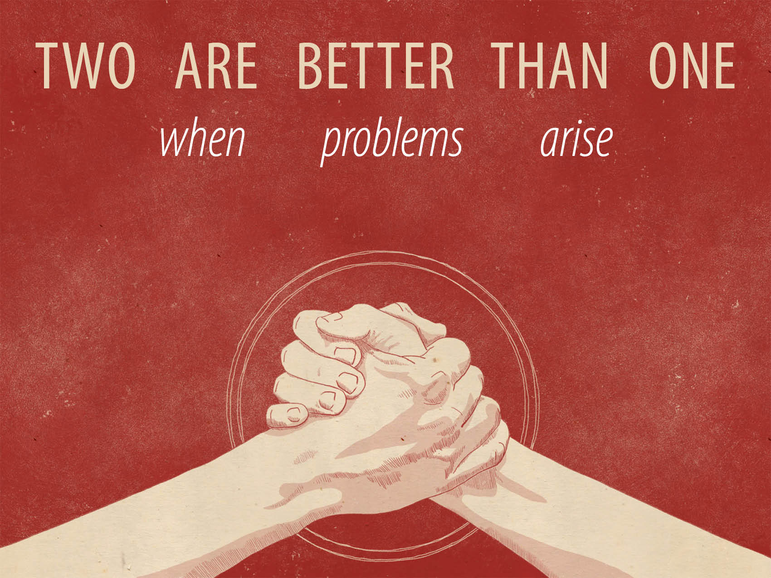

Slide 4
Reasons fellowship breaks down…
Suffering and Sickness
Burnout and Fatigue
Personal Turmoil
Friction Between People
Defiance to God

Slide 5
The questions to ask…
What is wrong?
Joshua 7:1–5
What has happened?
Joshua 7:6–15
Who is involved?
Joshua 7:6–21
What is needed?
Joshua 7:22–26

Slide 6
What does that mean to me?
Get involved.
Start now.
Don’t stop.

