Slide 1
James 4:1–2
¹ What causes quarrels and what causes fights among you? Is it not this, that your passions are at war within you? ² You desire and do not have, so you murder. You covet and cannot obtain, so you fight and quarrel. You do not have, because you do not ask.

Slide 3
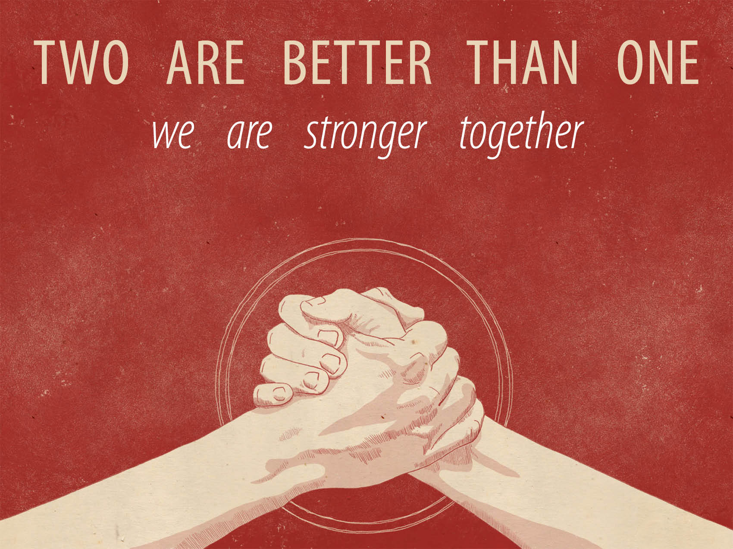

Slide 4
They rallied around the Lord and their leader.
Joshua 1:16–18
We are better at criticizing than encouraging.

Slide 5
They accepted an unusual plan without resistance.
Joshua 6:1–2
Joshua 6:6–11
Joshua 6:14–16, 20–31

Slide 6
They worked as a team.
Joshua 8:1–9, 13–17, 19–21
No one gets more glory than anyone else.

Slide 7
They trusted the Lord to deliver them.
Joshua 10:9–11
Joshua 10:11–14
Philippians 4:13

Slide 8
What does this say to us?
Unity is hard, but it is worth it.
Humility is of highest value but rarely seen.

