Slide 1
Ecclesiastes 4:9–12
⁹ Two are better than one, because they have a good reward for their toil. ¹⁰ For if they fall, one will lift up his fellow. But woe to him who is alone when he falls and has not another to lift him up! ¹¹ Again, if two lie together, they keep warm, but how can one keep warm alone? ¹² And though a man might prevail against one who is alone, two will withstand him—a threefold cord is not quickly broken.

Slide 3
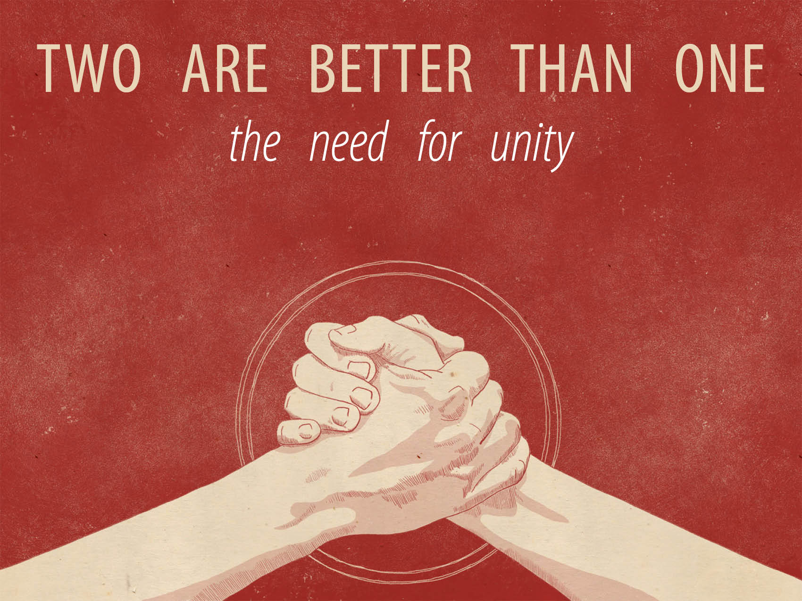

Slide 4
Isolation is unhealthy.
“Total isolation is virtually always an intolerable situation for the human adult even when physical needs are provided for.”
1 Kings 18:22; 19:10, 14

Slide 5
Relationships are necessary.
Ecclesiastes 4:9–12
1 Kings 19:9–17
Matthew 28:20
Hebrews 13:5
Hebrews 10:24–25

Slide 6
Unity is vital.
Joshua 1:1–5
They focused on God.
Joshua 1:9; Romans 8:31
They accepted the challenge.
Joshua 1:16–18
They focused on victory.
Joshua 1:16–18; 1:10–11

