Slide 1
Acts 26:26–29 (ESV)
²⁶ For the king knows about these things, and to him I speak boldly. For I am persuaded that none of these things has escaped his notice, for this has not been done in a corner. ²⁷ King Agrippa, do you believe the prophets? I know that you believe.” ²⁸ And Agrippa said to Paul, “In a short time would you persuade me to be a Christian?” ²⁹ And Paul said, “Whether short or long, I would to God that not only you but also all who hear me this day might become such as I am—except for these chains.”

Slide 3
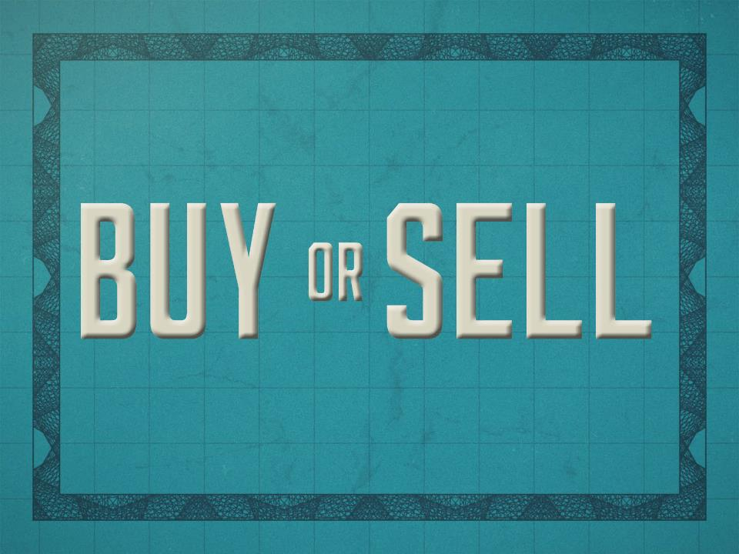

Slide 4
Why do people refuse to buy the truth?
Because of their relationships.
Matthew 14:1–12
Because they procrastinate.
Acts 17:32–34
Acts 26:28

Slide 5
Why do people refuse to buy the truth?
Because they aren’t willing to pay the cost.
Mark 10:17–22
Luke 14:25–33
Because they don’t like what it says about them.
Acts 7:51–53
James 1:23–25

Slide 6
Why do people sell the truth?
Because of the world.
2 Timothy 4:10
Luke 8:14
1 John 2:15–17
Because it requires too much.
1 Peter 5:8
Philippians 1:29
Luke 8:13

Slide 7
Why do people sell the truth?
Because of other people.
Galatians 2:11–14
Acts 15:7–12
1 Peter 4:3–4

