Slide 1
Galatians 1:6–9
⁶ I am astonished that you are so quickly deserting him who called you in the grace of Christ and are turning to a different gospel— ⁷ not that there is another one, but there are some who trouble you and want to distort the gospel of Christ. ⁸ But even if we or an angel from heaven should preach to you a gospel contrary to the one we preached to you, let him be accursed. ⁹ As we have said before, so now I say again: If anyone is preaching to you a gospel contrary to the one you received, let him be accursed.

Slide 4
What is a denomination?
“Denominations are associations of congregations – Though sometimes it might be said that congregations are localized subdivisions of denominations –that have a common heritage. Moreover, a true denomination does not claim to be the only legitimate expression of the church.”
Donald G. Tinder, Evangelical Dictionary of Theology

Slide 5
What is a denomination?
“Denominationalism – A term for the continuation of the organizations and emphasis on the divisions and distinctions of Protestantism.”
Donald T. Kauffman, The Dictionary of Religious Terms
Money provides a good illustration of what the word denomination means.

Slide 6
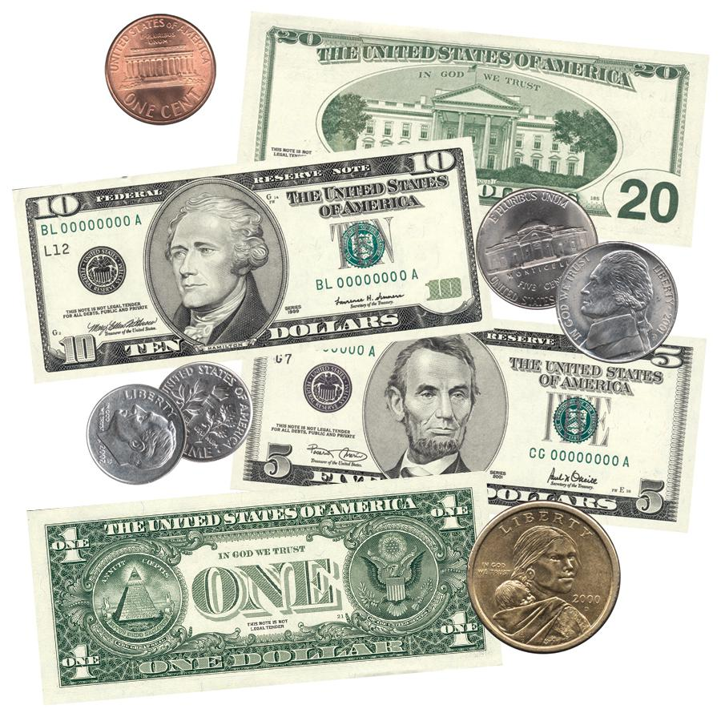

Slide 7
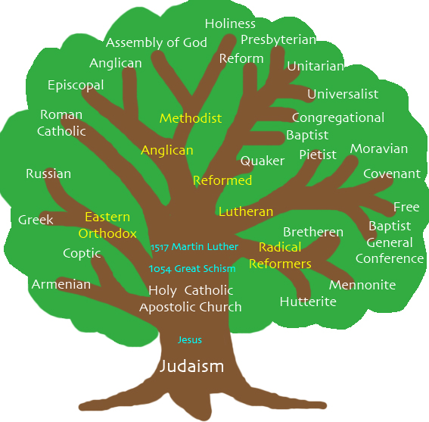

Slide 8
Common characteristics of a denomination…
Statements of faith in addition to the Bible.
Organizational hierarchy beyond the local church.
A name, or title, used to distinguish the group from other denominations.

Slide 9
What does the Bible say?
The Bible shows us the universal church and local congregations.
Matthew 16:18
Romans 16:16
But there is no intermediate organization.
There are no statements of faith apart from the Word of God.
2 Timothy 3:16–17

Slide 10
What does the Bible say?
There is no organization beyond the local congregation except for Christ as the head.
Acts 14:23
1 Peter 5:1–4
No official name is given.
Romans 16:16
1 Corinthians 1:1
Galatians 1:2
Hebrews 12:22–24

Slide 11
What about us?
We are not a denomination.
We are not part of some “Church of Christ” denomination.
We are simply a local body of Christ.

