Slide 1
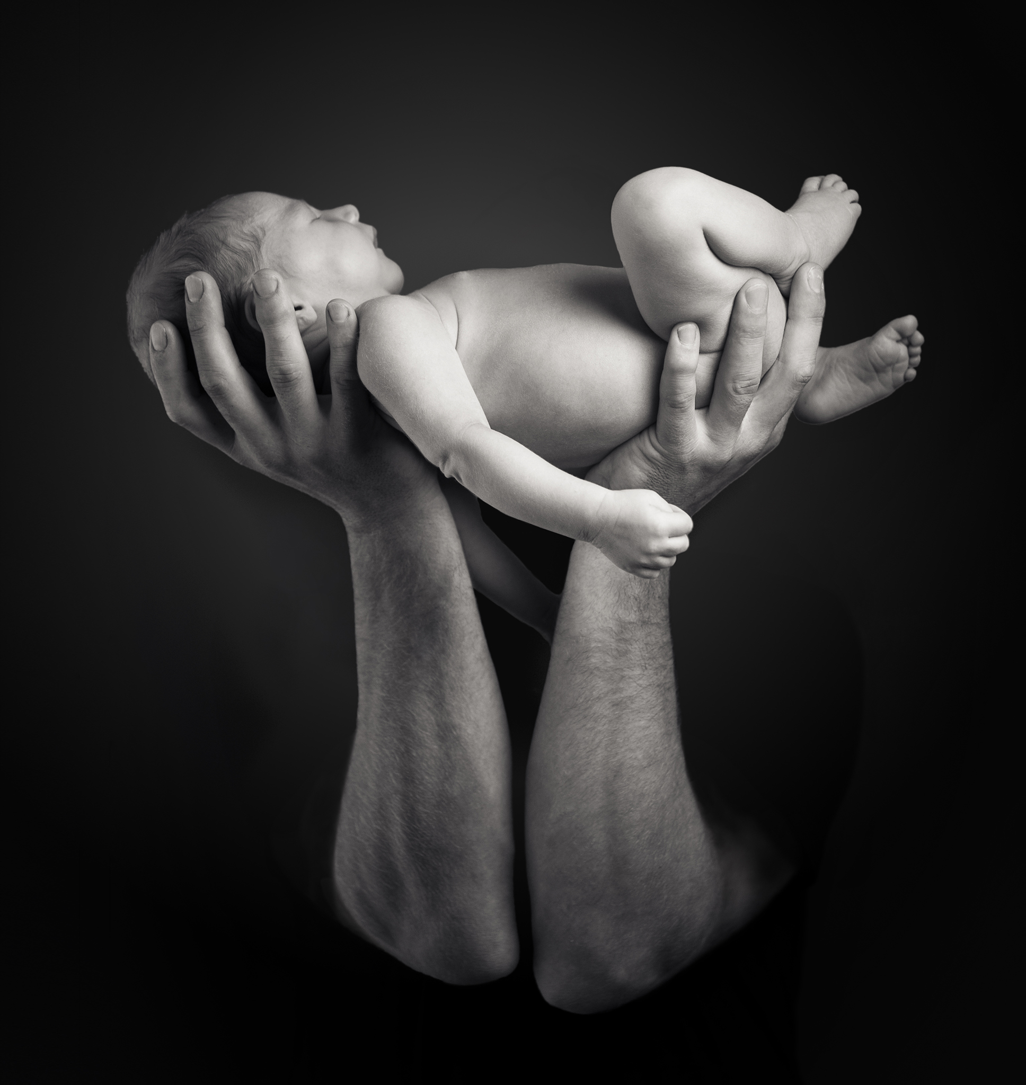
1 Peter 2.2-3
² Like newborn infants, long for the pure spiritual milk, that
by it you may grow
up into salvation-- ³ if indeed you have tasted that the Lord is good.

Slide 12
New Christians are described as newborns
John 3.1-7
Romans 6.3-4
Romans 15.1-2
1 Corinthians 3.1-5
2 Corinthians 5.17
1 Timothy 1.2
Titus 1.4
Hebrews 5.11-14
1 Peter 2.2
Spiritual infancy recognized as acceptable for new Christians
It is condemned for those who should be mature

Slide 13
This is not a derogatory comparison
It deals with our treatment of them
It deals with our expectation of them
There are dos and don’ts for how we treat “newborn babies”
Been a Christian less than 2 years
Been a Christian without a nurturing environment
Let’s go through some obvious (but sometimes forgotten) rules

Slide 14
Newborns don’t make good decisions yet. They are new!
Romans 6.3-4
2 Corinthians 5.17
Ephesians 4.22-24
Don’t have unrealistic expectations.
They have repented, confessed, and been baptized
They still must learn to develop the new habits
Many new Christians have many aspects of life they are working on

Slide 15
Newborns tend to be weak
Romans 15.1-2
1 Thessalonians 5.14
We must hold them up, even if that means changing our own behavior
We must admonish when unruly
We must encourage the fainting
We must help the weak
We must be patient

Slide 16
Newborns need milk, not meat
1 Corinthians 3.1-5
Hebrews 5.11-14
Don’t put them in classes they cannot understand.
Don’t use “church speech.”
Don’t expect them to have a thorough knowledge of the Bible.

Slide 17
We must realize the uniqueness of our relationship with them
1 Timothy 1.2
Titus 1.4
We must treat them as family
Takes time
Takes familiarity
Takes compassion
Takes constancy

Slide 18
Newborns long for their next feeding or connection
1 Peter 2.2
Hebrews 10.24-25
We must help them see the value in being fed and loved in family gatherings
We come from a habit they have not yet developed
We must be a source for relationships
They are forsaking much
We must stand in that gap

Slide 19
1 Thessalonians 2.7-12
⁷ But we were gentle among you, like a nursing mother taking care of her own children. ⁸ So, being affectionately desirous of you, we were ready to share with you not only the gospel of God but also our own selves, because you had become very dear to us. ⁹ For you remember, brothers, our labor and toil: we worked night and day, that we might not be a burden to any of you, while we proclaimed to you the gospel of God. ¹⁰ You are witnesses, and God also, how holy and righteous and blameless was our conduct toward you believers. ¹¹ For you know how, like a father with his children, ¹² we exhorted each one of you and encouraged you and charged you to walk in a manner worthy of God, who calls you into his own kingdom and glory.

Slide 20
Lessons from 1 Thessalonians 2.7-12
We must be gentle as a nursing mother
We must have fond affection
We must give our lives for them
We must not overburden them
We must behave uprightly and blamelessly as an example
We must exhort, encourage, and implore them in their faithfulness as a father would his children

