Slide 1
Philippians 3.20-21
²⁰ But our citizenship is in heaven, and from it we await a Savior, the Lord Jesus Christ, ²¹ who will transform our lowly body to be like his glorious body, by the power that enables him even to subject all things to himself.

Slide 4
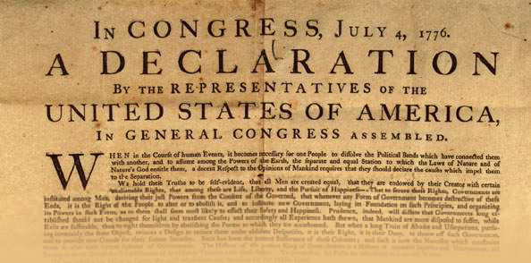

Slide 5
The Declaration of Independence
IN CONGRESS, July 4, 1776.
The unanimous Declaration of the thirteen united States of America,
When in the Course of human events, it becomes necessary for one people to dissolve the political bands which have connected them with another, and to assume among the powers of the earth, the separate and equal station to which the Laws of Nature and of Nature's God entitle them, a decent respect to the opinions of mankind requires that they should declare the causes which impel them to the separation.
We hold these truths to be self-evident, that all men are created equal, that they are endowed by their Creator with certain unalienable Rights, that among these are Life, Liberty and the pursuit of Happiness.--That to secure these rights, Governments are instituted among Men, deriving their just powers from the consent of the governed,

Slide 6
The Values of America
Unalienable means “rights that cannot be repealed or restrained by human law.”
Unalienable rights include:
Life
Liberty
The pursuit of happiness
Yet these very statements were hypocritical and indefensible by any higher standard

Slide 7
The Values of Modern America
Spirit of individuality
Tolerance and acceptance
Right to personal choice
Equality
Right to own, even without owning
Right to self-exaltation
Right to create own standard

Slide 8
The Values of Christianity
Slavery, not freedom (Lk 17.7-10; Rom 6.18)
Holiness, not happiness (1 Pet 1.16)
Eternal life, not earthly life (Rom 6.23)
Image of Christ, not individuality (2 Cor 3.16-18)
Obedience, not personal choice (Gal 2.20)
Righteousness, not tolerance (Eph 5.10-12)

Slide 9
Making Opposites Coexist
We must make very opposite cultures coexist if we are to be a citizen of two kingdoms
Prioritization (Matt 6.33)
Focus (Col 3.1-2)
Expectation (Phil 3.20-21)
We are not of this world
In the world but not of the world (Jn 17.14-16)
We were chosen out of the world (Jn 15.19)
The world hates us (1 Jn 3.13)

Slide 10
In the World But Not Part of the World
We are in the world
We can take part
We can affect change
We can work to make things better
But we are not part of the world
We must keep a mental/emotional distance
We must remember our allegiance
We must maintain our true citizenship

Slide 11
Why This Matters
Kingdom citizens always have hope
Kingdom citizens have a higher standard
Kingdom citizens follow the King

