Slide 1
Hebrews 11:13–16
¹³ These all died in faith, not having received the things promised, but having seen them and greeted them from afar, and having acknowledged that they were strangers and exiles on the earth. ¹⁴ For people who speak thus make it clear that they are seeking a homeland. ¹⁵ If they had been thinking of that land from which they had gone out, they would have had opportunity to return. ¹⁶ But as it is, they desire a better country, that is, a heavenly one. Therefore God is not ashamed to be called their God, for he has prepared for them a city.

Slide 3
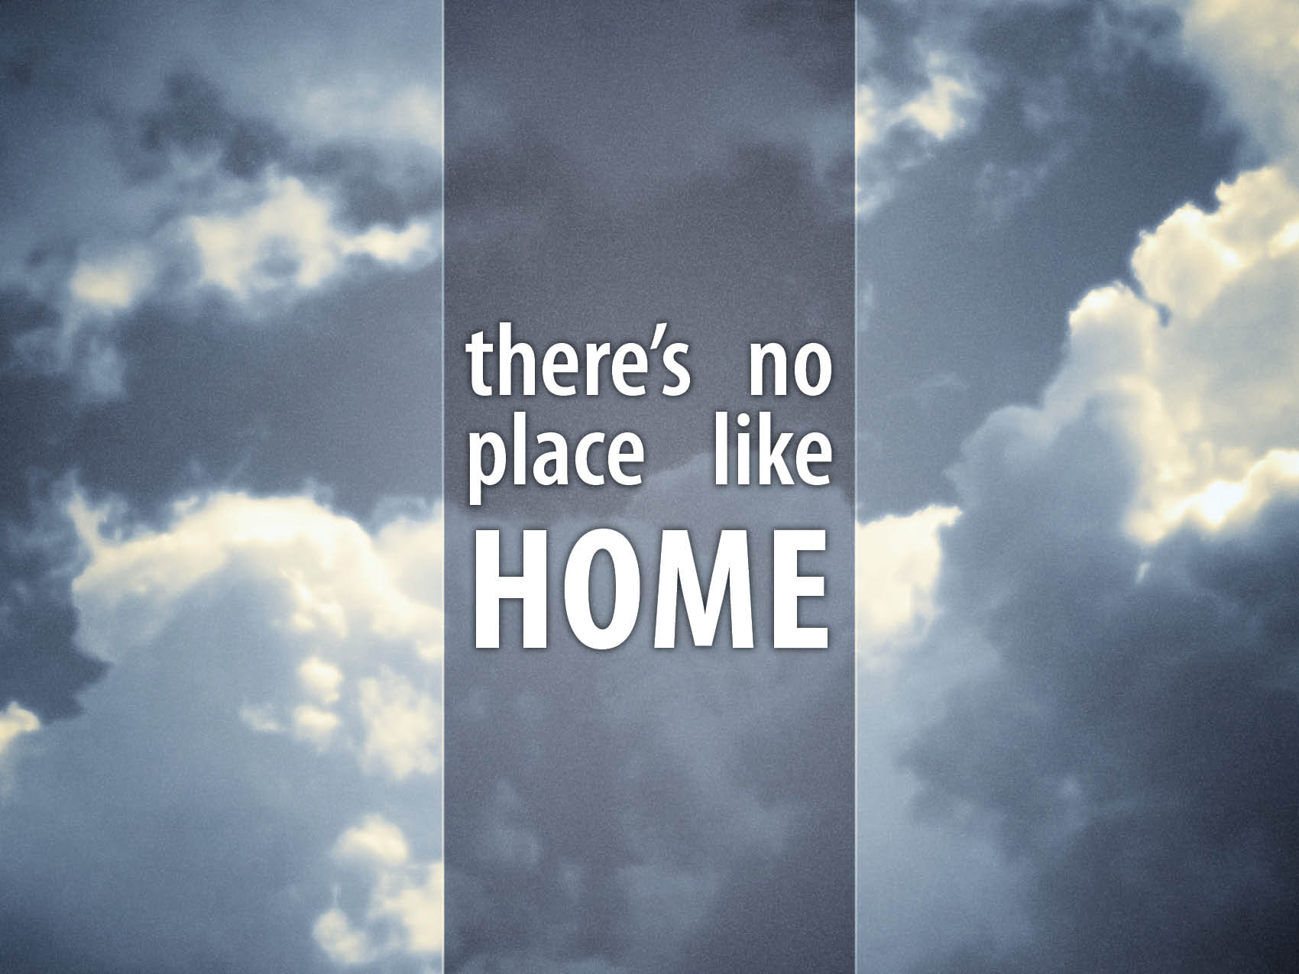

Slide 4
We are strangers.
Hebrews 11:8–10
Hebrews 11:13–16
Philippians 3:20–21

Slide 5
We need to remember our hope.
Hebrews 11:13–14
Hebrews 12:1–2
Hebrews 11:13
We must see God’s promises.
We must welcome the promises.
We can only see the promises from a distance.
When we see and welcome the promises, it causes us to be aliens in this world.

Slide 6
Are you obsessed with heaven?
Hebrews 11:15–16
Colossians 3:1–4
Philippians 3:12–14

