Slide 1
Hebrews 5:12–14
¹² For though by this time you ought to be teachers, you need someone to teach you again the basic principles of the oracles of God. You need milk, not solid food, ¹³ for everyone who lives on milk is unskilled in the word of righteousness, since he is a child. ¹⁴ But solid food is for the mature, for those who have their powers of discernment trained by constant practice to distinguish good from evil.

Slide 3
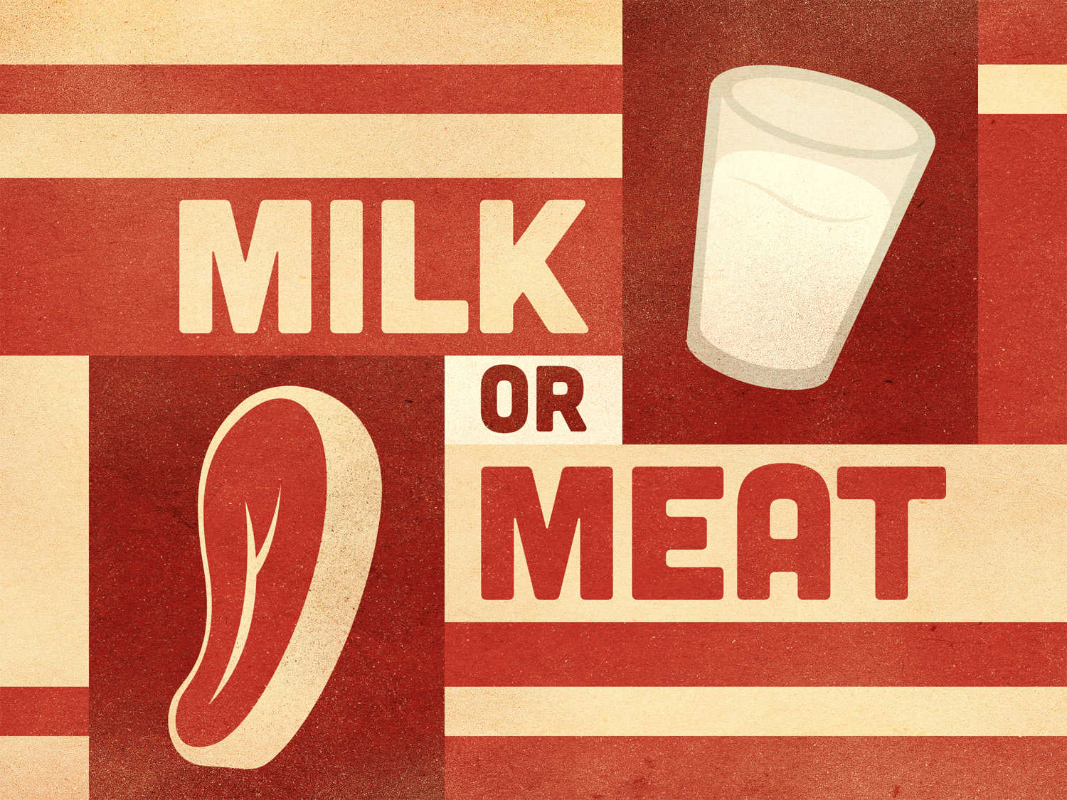

Slide 4
Milk and meat are similar.
Physical forms both contain protein and fat.
Spiritual milk and meat have the same core nutrients.
2 Timothy 3:16–17

Slide 5
Milk and meat are different.
Milk is a liquid—meat is a solid.
Spiritual milk and meat are different.
Hebrews 6:1–2
2 Peter 3:15–16
1 Thessalonians 2:7; 2 Thessalonians 3:10

Slide 6
We eat milk and meat differently.
Meat is easily drunk—meat is hard to eat.
Spiritual food is similar.
1 Peter 2:2–3
Hebrews 5:12–14
1 Corinthians 3:1–3

Slide 7
Application…
Be hungry.
Eat the right food.
Teachers, know who needs milk and who needs meat.

