Slide 1
James 1:14–15
¹⁴ But each person is tempted when he is lured and enticed by his own desire. ¹⁵ Then desire when it has conceived gives birth to sin, and sin when it is fully grown brings forth death.

Slide 5
Smoking
Statistics
18% of adults smoke (42.1 million)
Smoking is the leading cause of preventable disease and deaths in the U.S.
480,000 people die each year from smoking related diseases.
1 Corinthians 6:18–20

Slide 6
Pornography
Statistics
More than 1 in 5 mobile searches are for pornography.
70% of teens hide their online behavior.
35% of boys have viewed too many pornographic videos to count.

Slide 8
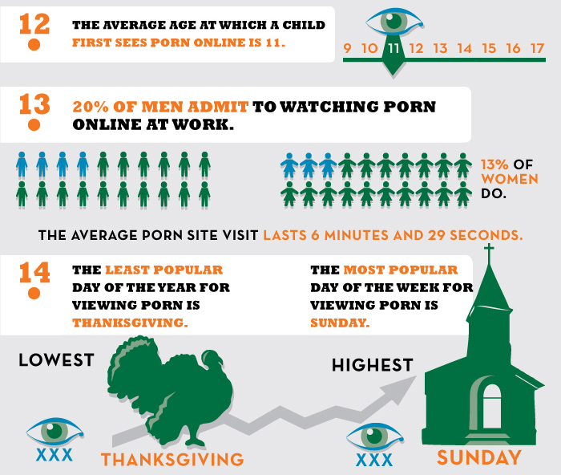

Slide 9
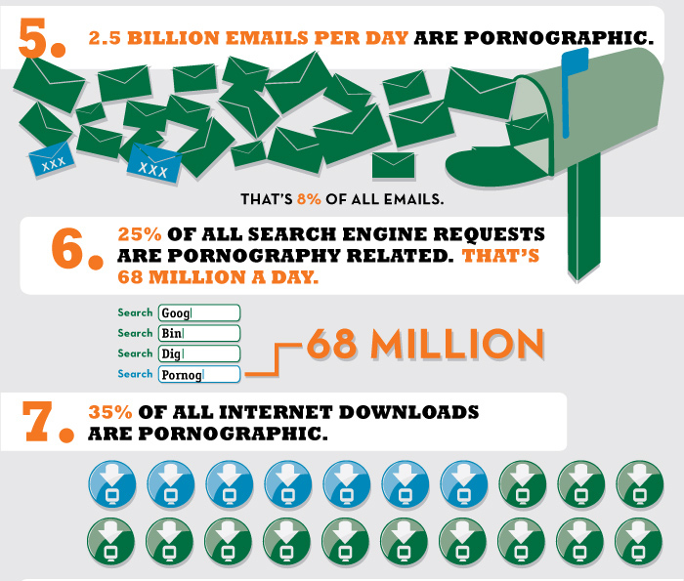

Slide 10
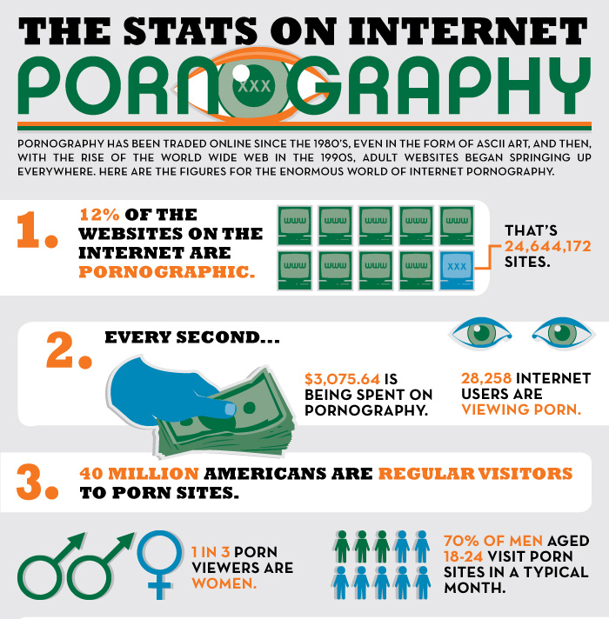

Slide 11
Pornography
Matthew 5:27–28
James 1:14–15
1 John 2:15–17

Slide 12
Gambling
Statistics
80% of Americans gamble annually.
750,000 young people age 14 to 21 are addicted to gambling.
Gambling is a $40 billion industry.
Cross-addiction:
78% alcohol
38% drugs
60% smoking

Slide 13
Gambling
1 Timothy 6:6–10
Matthew 7:12

Slide 14
Addiction is always a bad thing.
1 Corinthians 6:12–20
1 Corinthians 9:24–27

Slide 15
Overcoming Addiction
Jesus is the answer.
Romans 7:15–25
Sacrifice your old life.
Romans 12:1–2
Seek fellowship.
James 5:16; Galatians 6:1–2
Trust God.
Mark 10:27; Ephesians 3:20–21

