Slide 1
1 Timothy 2:8–10
⁸ I desire then that in every place the men should pray, lifting holy hands without anger or quarreling; ⁹ likewise also that women should adorn themselves in respectable apparel, with modesty and self-control, not with braided hair and gold or pearls or costly attire, ¹⁰ but with what is proper for women who profess godliness —with good works.

Slide 4
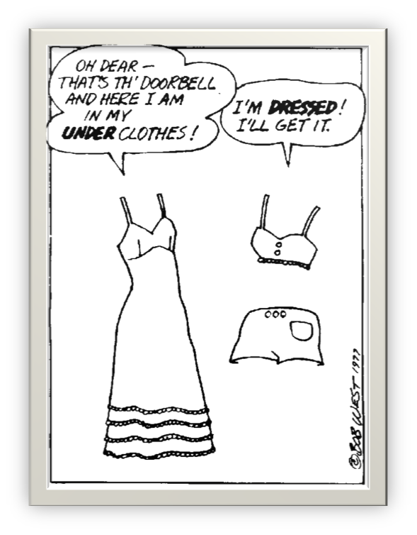

Slide 5
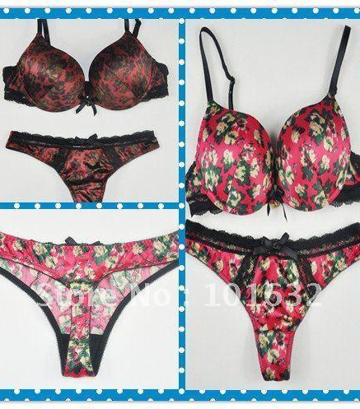
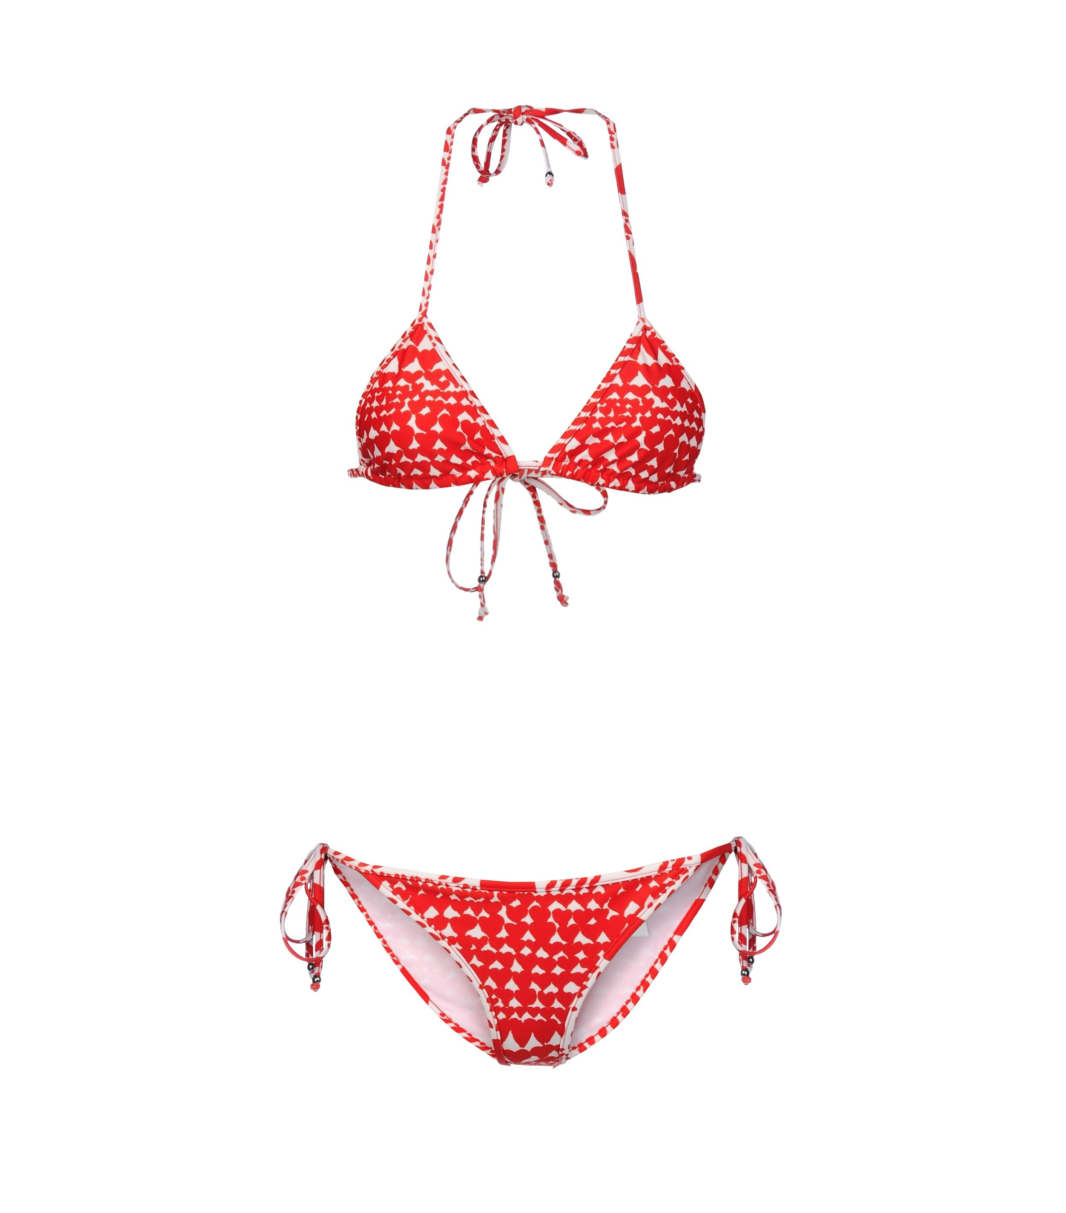

Slide 6
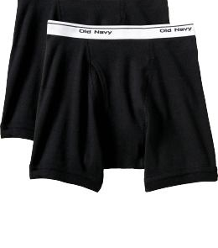
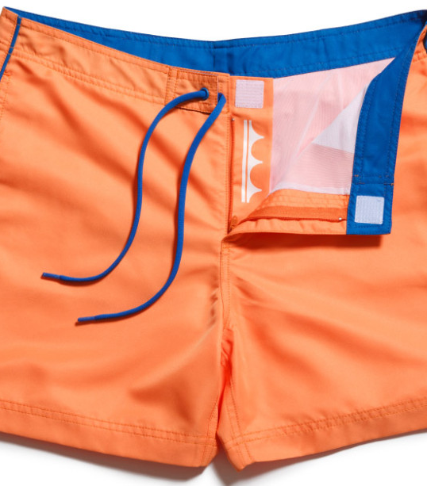

Slide 8
Modesty…
Sexual Modesty
Proverbs 5:15–20
Economic Modesty
1 Timothy 2:8–10
James 2:1–6, 15–16
Circumstantial Modesty
1 Timothy 2:8–10

Slide 9
Understanding Modesty
Modesty is not anti-pretty.
Modesty is about who you worship.
Modesty is about attitude— not just clothing.
Modesty shows a sensitivity to sin.
Modesty is about true freedom, not repression.

