Slide 1
Hebrews 12.1-2
Therefore, since we are surrounded by so great a cloud of witnesses, let us also lay aside every weight, and sin which clings so closely, and let us run with endurance the race that is set before us, looking to Jesus, the founder and perfecter of our faith, who for the joy that was set before him endured the cross, despising the shame, and is seated at the right hand of the throne of God.

Slide 4
Renaissance Jesus

Slide 5
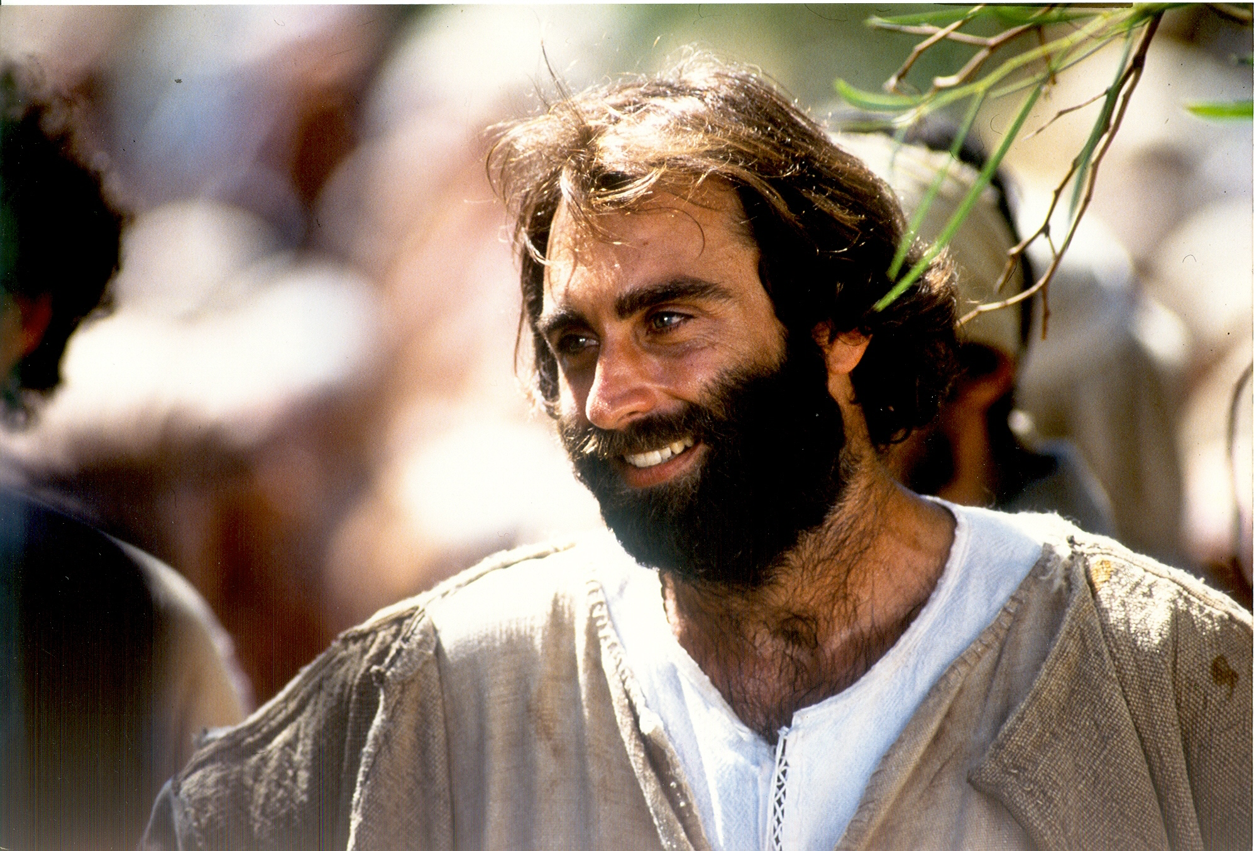
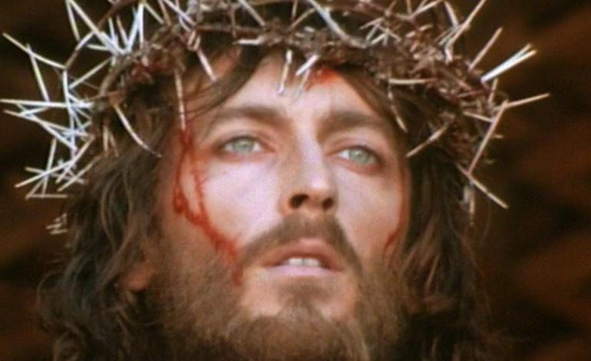
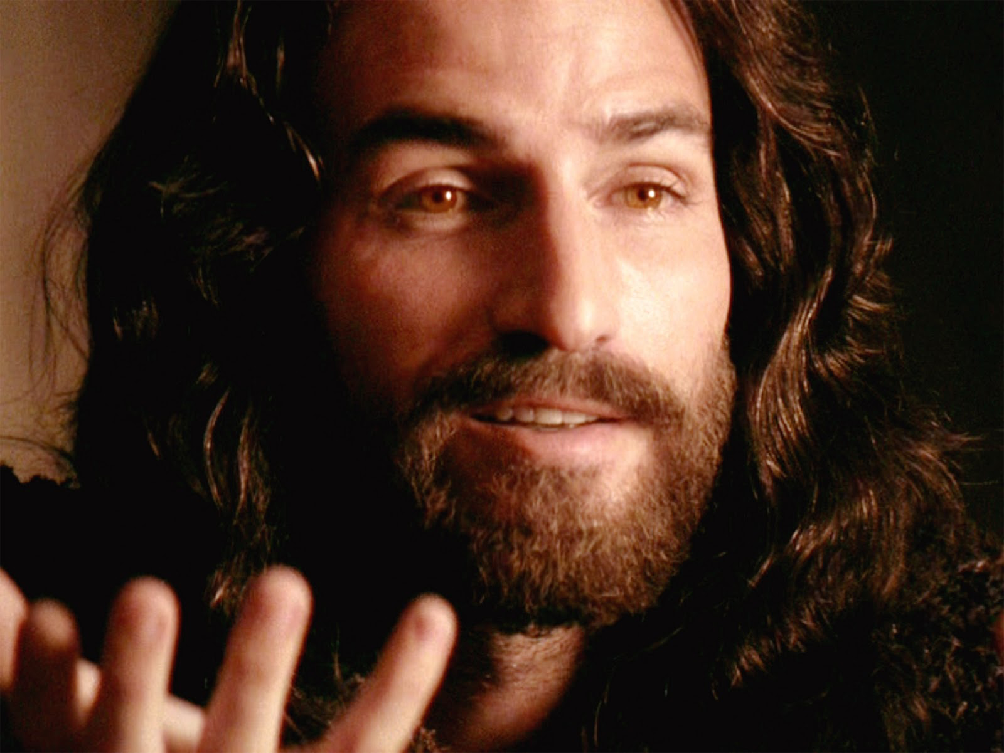
Modern Jesus

Slide 6
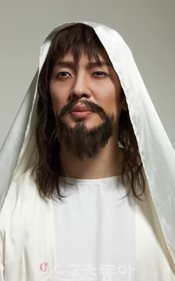
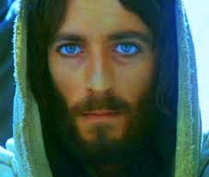
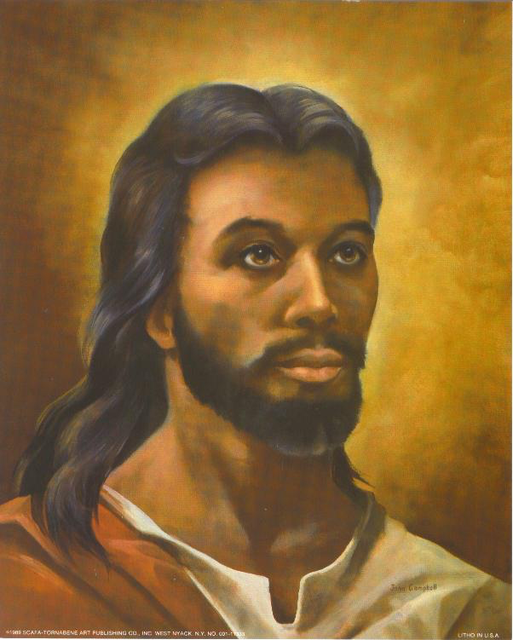
Racial Jesus

Slide 7
Isaiah 53.1-3
Who has believed what he has heard from us? And to whom has the arm of the LORD been revealed? For he grew up before him like a young plant, and like a root out of dry ground; he had no form or majesty that we should look at him, and no beauty that we should desire him. He was despised and rejected by men; a man of sorrows, and acquainted with grief; and as one from whom men hide their faces he was despised, and we esteemed him not.

Slide 8
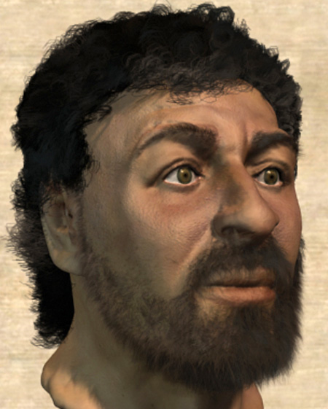
A Likely Jesus
Not one of the gospels tells us anything about the physical appearance of Jesus
Possibly Luke 19.3
God is placing the importance on the inward man of Jesus (1 Sam 16.6-7)

Slide 9
In Revelation
Yet in the book of Revelation, we have Jesus’ appearance described
The message was “communicated” or “signified”
This book is John describing what images he was given to see
Each of these pictures has a meaning

Slide 10
Revelation 1.12-18
Then I turned to see the voice that was speaking to me, and on turning I saw seven golden lampstands, and in the midst of the lampstands one like a son of man, clothed with a long robe and with a golden sash around his chest. The hairs of his head were white, like white wool, like snow. His eyes were like a flame of fire, his feet were like burnished bronze, refined in a furnace, and his voice was like the roar of many waters. In his right hand he held seven stars, from his mouth came a sharp two-edged sword, and his face was like the sun shining in full strength.
When I saw him, I fell at his feet as though dead. But he laid his right hand on me, saying, "Fear not, I am the first and the last, and the living one. I died, and behold I am alive forevermore, and I have the keys of Death and Hades.

Slide 11
John’s Reaction
John was the beloved disciple, he took care of Jesus’ mother, and was traditionally the last living apostle.
This is the same John that leaned on Christ’ chest at the last supper
In this instance, he fell at Jesus’ feet

Slide 12
Jesus’ Location
In the middle of the lampstands (1.20)
We tend to think of Jesus in heaven
The Bible depicts Jesus “walking among” His churches (2.1)
Matthew 18.20
Matthew 28.20
Acts 17.27

Slide 13
Jesus’ Appearance
“One like a son of man”
“Clothed in a robe… to the feet… golden sash”
“Hair was white, like white wool, like snow”
“Eyes were like a flame of fire”
“Feet were like glowing bronze”
“Voice like the sound of many waters”
“Held seven stars in His right hand”
“Two-edged sword out of His mouth”
“Face shining like the sun”

Slide 14
Fix Your Eyes on Jesus
He is described like His Father
He is described as being active with mankind
He is described as a mighty, powerful, holy King

Slide 15
Fall at His feet today!

