Slide 1
Ephesians 6:10–12
¹⁰ Finally, be strong in the Lord and in the strength of his might. ¹¹ Put on the whole armor of God, that you may be able to stand against the schemes of the devil. ¹² For we do not wrestle against flesh and blood, but against the rulers, against the authorities, against the cosmic powers over this present darkness, against the spiritual forces of evil in the heavenly places.

Slide 3
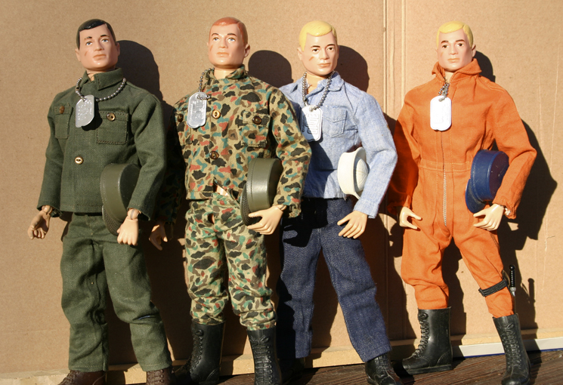

Slide 4
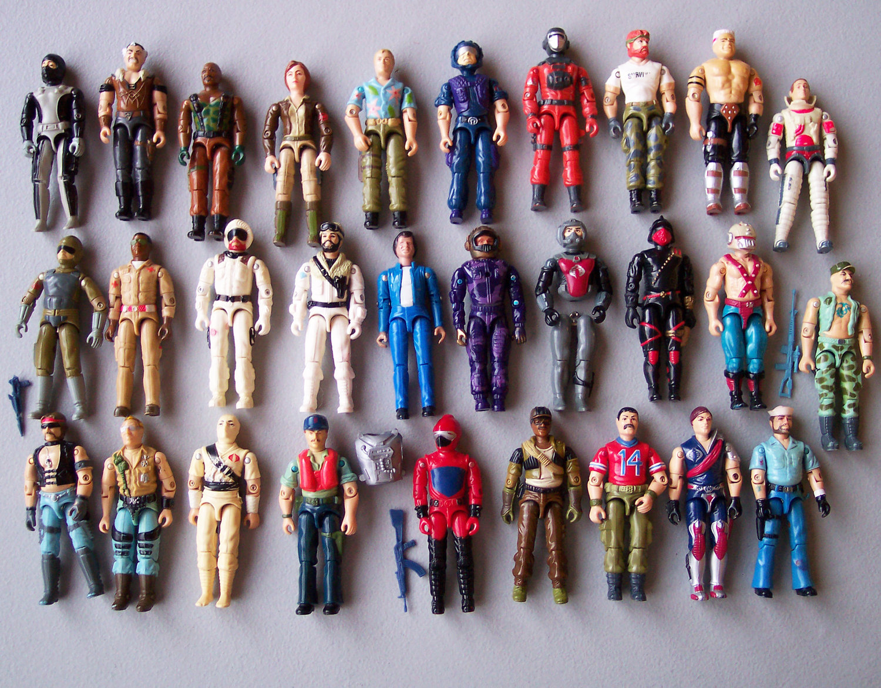

Slide 5
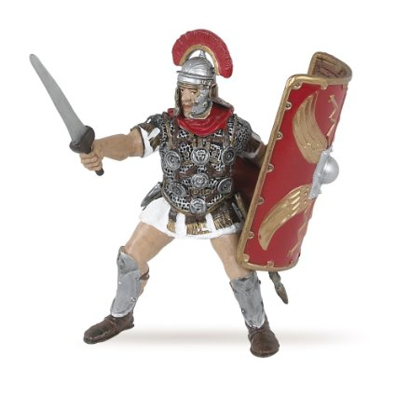
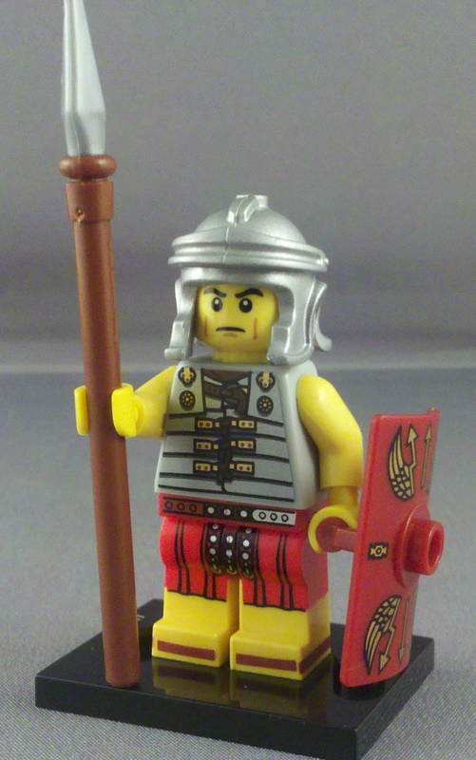

Slide 7
A call to choose.

Slide 8
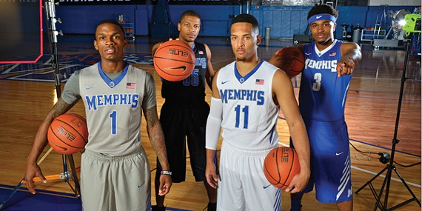

Slide 9
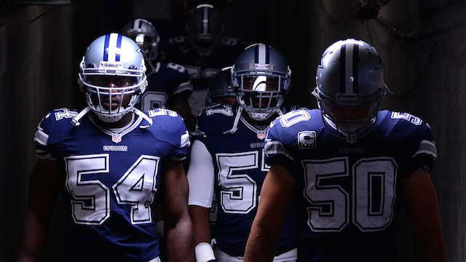

Slide 10
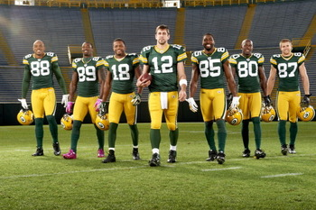

Slide 11
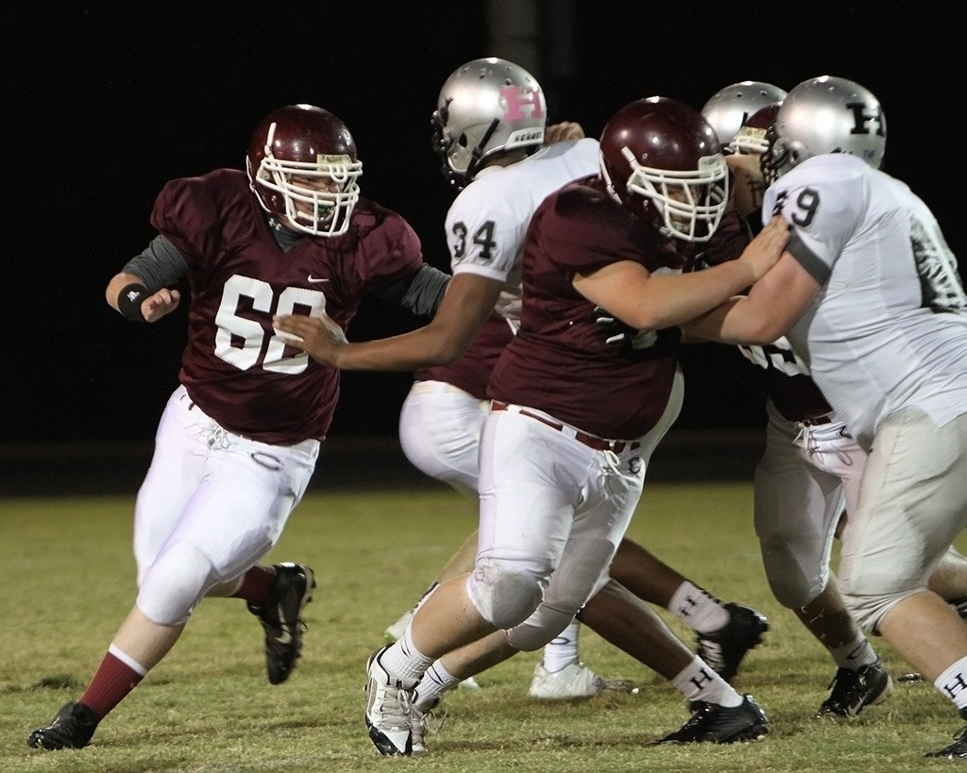

Slide 12
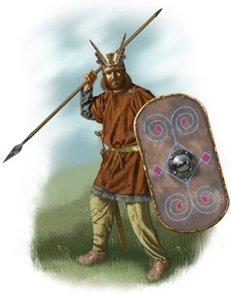

Slide 13
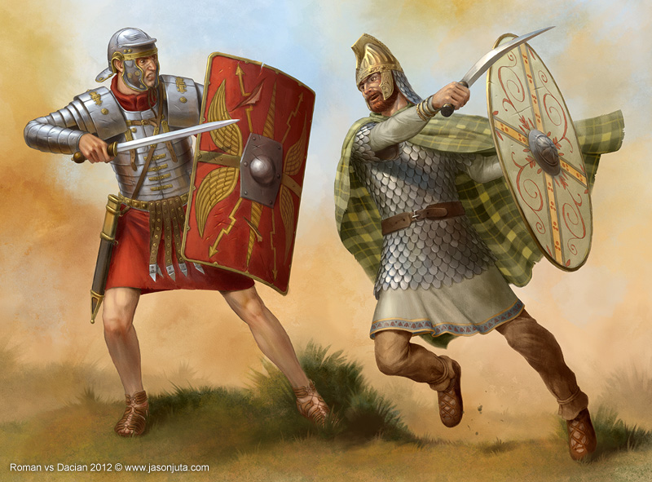

Slide 14
A call to choose.
Choose who you fight for!
Ephesians 6:10–13

Slide 15
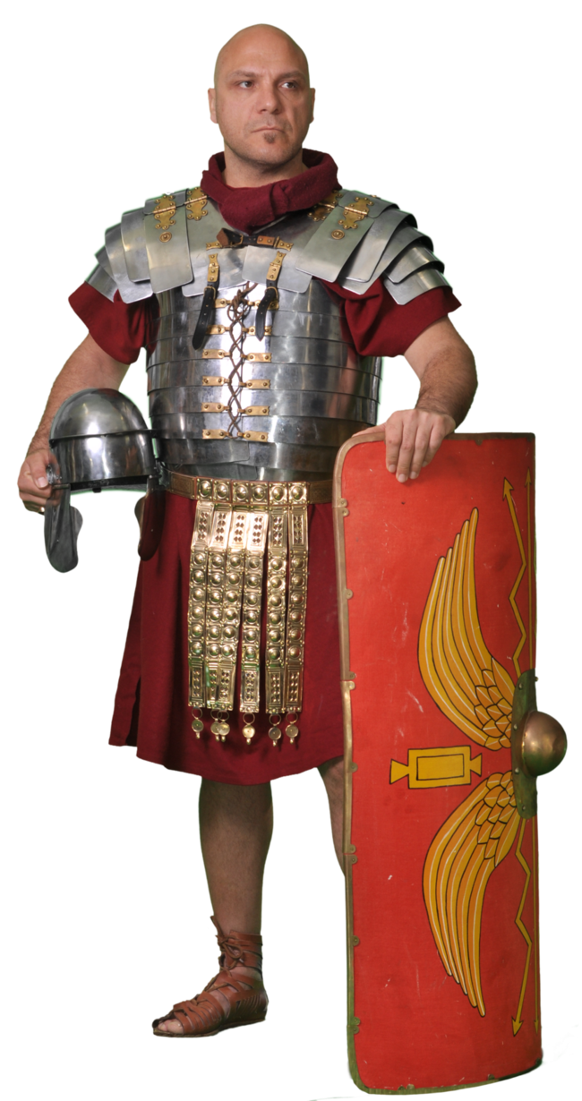

Slide 16
A call to train.
1 Samuel 17:38–39
“I can’t walk in these… I’m not used to them” (1 Samuel 17:39, HCSB).
Every part of God’s armor requires training.
Hebrews 4:12

Slide 17
A call to fight together.

Slide 18
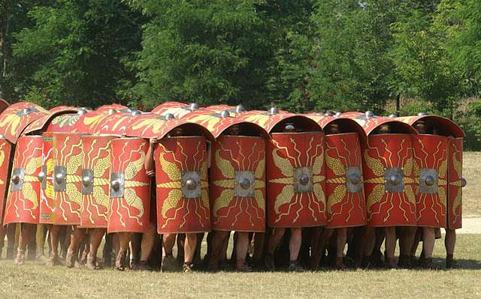

Slide 19
A call to fight together.
Ephesians 6:12
Matthew 28:18–20
Hebrews 13:5

