Slide 1
Romans 1:16
For I am not ashamed of the gospel of Christ, for it is the power of God to salvation for everyone who believes, for the Jew first and also for the Greek

Slide 3
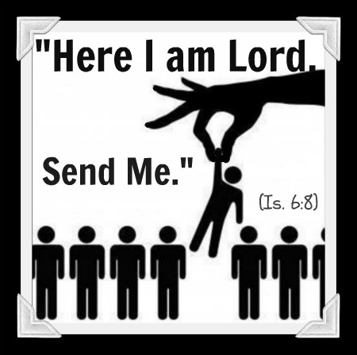

Slide 4
Jonah 1:1-3
Now the word of the Lord came to Jonah the son of Amittai, saying, ² “Arise, go to Nineveh, that great city, and cry out against it; for their wickedness has come up before Me.” ³ But Jonah arose to flee to Tarshish from the presence of the Lord. He went down to Joppa, and found a ship going to Tarshish; so he paid the fare, and went down into it, to go with them to Tarshish from the presence of the Lord.

Slide 5
Moses: Exodus 3:10
Come now, therefore, and I will send you to Pharaoh that you may bring My people, the children of Israel, out of Egypt.”

Slide 6
Exodus 4:10-13
Then Moses said to the Lord, “O my Lord, I am not eloquent, neither before nor since You have spoken to Your servant; but I am slow of speech and slow of tongue.”
¹¹ So the Lord said to him, “Who has made man’s mouth? Or who makes the mute, the deaf, the seeing, or the blind? Have not I, the Lord? ¹² Now therefore, go, and I will be with your mouth and teach you what you shall say.”
¹³ But he said, “O my Lord, please send by the hand of whomever else You may send.”

Slide 7
ISAIAH 6:8-9
Also I heard the voice of the Lord, saying:
“Whom shall I send, And who will go for Us?”
Then I said, “Here am I! Send me.”
⁹ And He said, “Go, and tell this people:
‘Keep on hearing, but do not understand; Keep on seeing, but do not perceive

Slide 8
ISAIAH 5:14
Therefore HELL hath enlarged herself, and opened her mouth without measure: and their glory, and their multitude, and their pomp, and he that rejoiceth, shall descend into it

Slide 10
MATTHEW 9:37-38
Then He said to His disciples, “The harvest truly is Plentiful, but the laborers are FEW. ³⁸ Therefore pray the Lord of the harvest to send out laborers into His harvest.”

Slide 11
MATTHEW 7:14
Enter by the narrow gate; for wide is the gate and broad is the way that leads to destruction, and there are many who go in by it. ¹⁴ Because narrow is the gate and difficult is the way which leads to life, and there are Few who find it.

Slide 12
MATTHEW 28:18-20
And Jesus came and spoke to them, saying, “All authority has been given to Me in heaven and on earth. ¹⁹ Go therefore and make disciples of all the nations, baptizing them in the name of the Father and of the Son and of the Holy Spirit, ²⁰ teaching them to observe all things that I have commanded you; and lo, I am with you always, even to the end of the age.” Amen

Slide 13
MATTHEW 28
All Authority = Every Right
GO
With You
NO Won’t Go = Jonah
NO Can’t Go = Moses
Here I am send Me = Isaiah

Slide 14
ROMANS 1:16
For I am not ashamed of the gospel of Christ, for it is the power of God to salvation for everyone who believes, for the Jew first and also for the Greek

