Slide 1
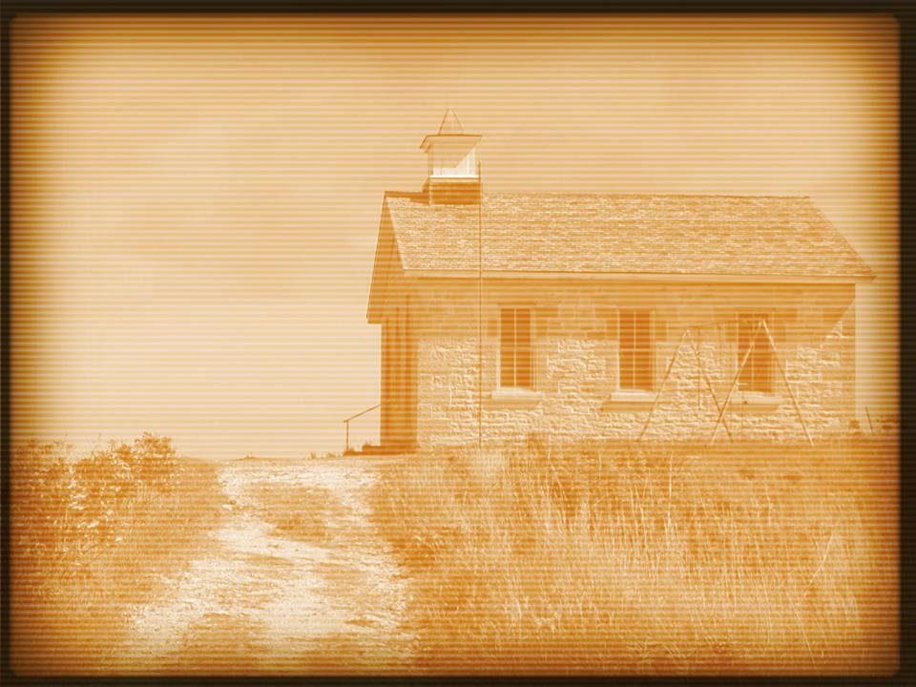
Luke 10:38–40
³⁸ Now as they went on their way, Jesus entered a village. And a woman named Martha welcomed him into her house. ³⁹ And she had a sister called Mary, who sat at the Lord’s feet and listened to his teaching. ⁴⁰ But Martha was distracted with much serving. And she went up to him and said, “Lord, do you not care that my sister has left me to serve alone? Tell her then to help me.”

Slide 2
Luke 10:41–42
⁴¹ But the Lord answered her, “Martha, Martha, you are anxious and troubled about many things, ⁴² but one thing is necessary. Mary has chosen the good portion, which will not be taken away from her.”

Slide 4
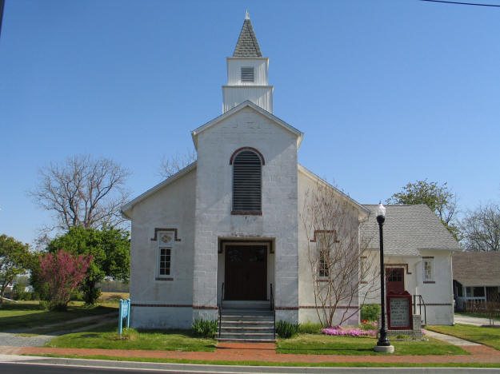

Slide 6
The Jerusalem church had a widespread enthusiasm.
Mark 13:10–11
Revelation 2:1–7

Slide 7
The Jerusalem church was free from any traditions.
Acts 6:1–6
No where in Acts do we you see someone say, “That’s not how we do things here.”

Slide 8
The Christians in Jerusalem spent time with each other.
Acts 2:46–47
Colossians 3:1–2
Luke 10:38–42

