Slide 1
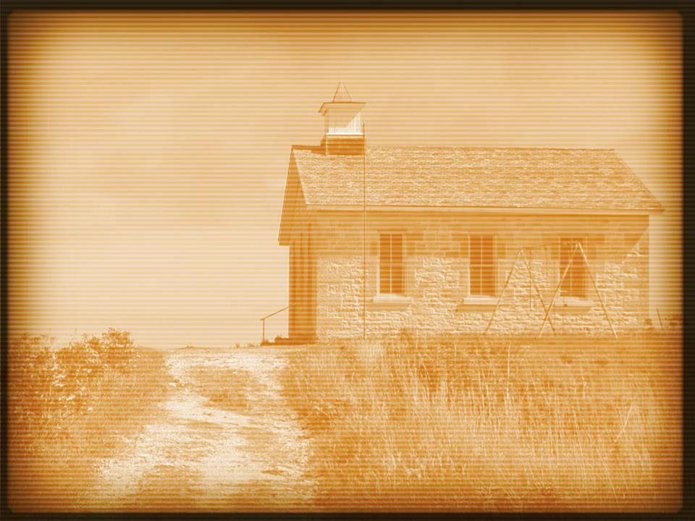
Acts 15:30–32
³⁰ So when they were sent off, they went down to Antioch, and having gathered the congregation together, they delivered the letter. ³¹ And when they had read it, they rejoiced because of its encouragement. ³² And Judas and Silas, who were themselves prophets, encouraged and strengthened the brothers with many words.

Slide 4
The vision is not one of a mother church—it is an exemplary church.
Acts 15:1–2
Galatians 1:11–17
Acts 15:24

Slide 5
The vision is not having 10,000 members—it’s having consistent growth.
Acts 2:41 = 3,000
Acts 4:4 = 5,000 men

Slide 6
The vision is not hiring hands to work—it is having all hands working.
Acts 2:14 Acts 13:1
Acts 8:4 Acts 2:44–47

Slide 7
The vision is not having 12 evangelists—it’s having the workers that are needed.
Ephesians 4:11–12 Acts 6:2–4 Acts 13:1
Acts 11:23–26

Slide 8
The vision is not becoming a corporation—it is becoming a family.
Acts 6:1–6
Acts 2:41–47 Acts 4:23–27

Slide 9
The vision is not communism—it is sacrificing to make the church successful.
Acts 4:34–37
Acts 5:4

Slide 10
The vision is not being problem free—it is being committed to overcoming problems.
Acts 3
Acts 5
Acts 6
Acts 15

