Slide 1
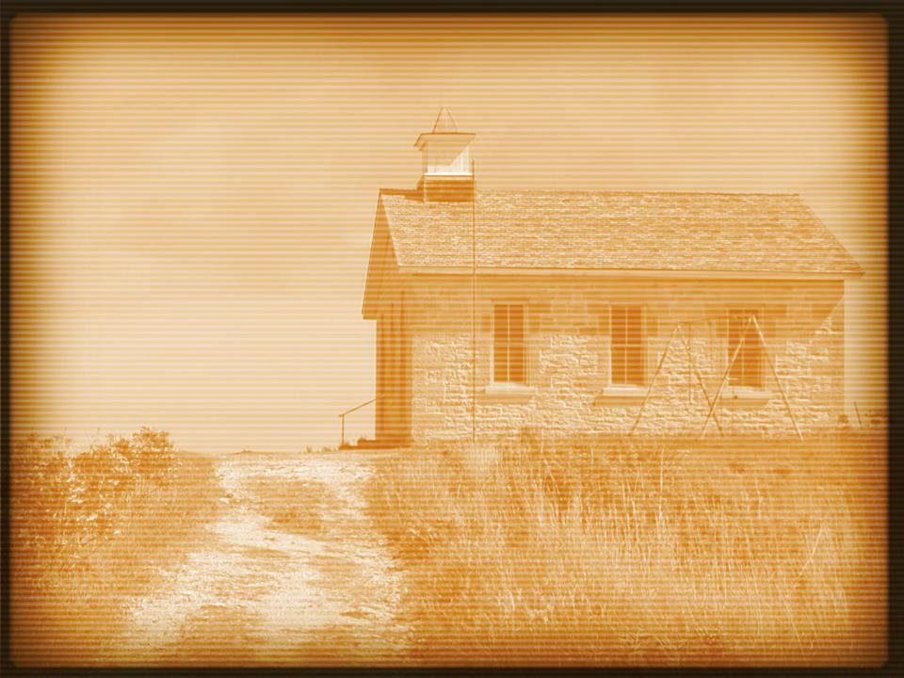
Acts 4:1–4
¹And as they were speaking to the people, the priests and the captain of the temple and the Sadducees came upon them, ²greatly annoyed because they were teaching the people and proclaiming in Jesus the resurrection from the dead. ³And they arrested them and put them in custody until the next day, for it was already evening. ⁴But many of those who had heard the word believed, and the number of the men came to about five thousand.

Slide 4
Expect rejection.
Acts 4:24–26
John 15:18–21

Slide 5
Pray for boldness.
Acts 4:24–30
Exodus 3:12

Slide 6
Realize people’s souls are at stake.
Acts 4:11–12

Slide 7
Realize your soul is a stake.
Acts 4:18–20
Acts 5:29

Slide 8
Stop being selfish.
Acts 4:18–20
Luke 9:23–27

Slide 9
Focus on those who do accept.
Acts 4:4

Slide 10
Lean on brethren.
Acts 4:23–24

Slide 11
Remember… God always wins.
Psalm 2
Matthew 12:30

