Slide 1
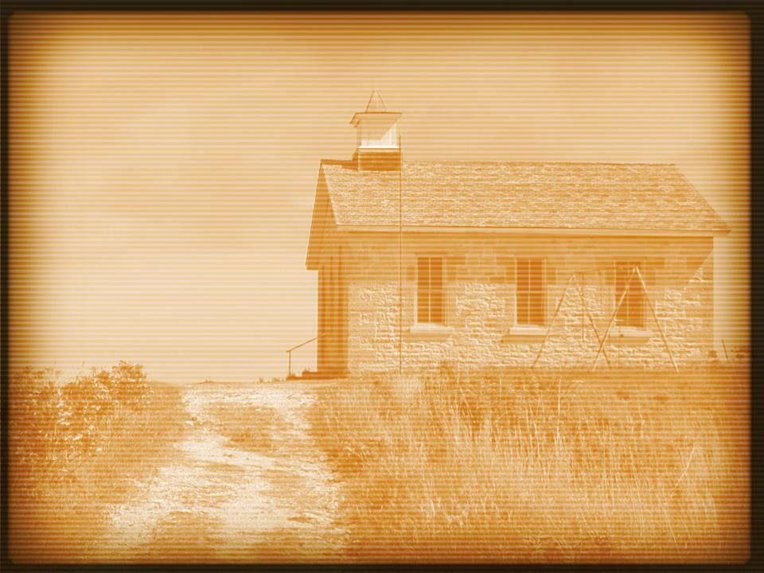
Acts 2:46–47
46 And day by day, attending the temple together and breaking bread in their homes, they received their food with glad and generous hearts, 47 praising God and having favor with all the people. And the Lord added to their number day by day those who were being saved.

Slide 4
Common attempts to keep from losing people in the crowd.
Don’t have a crowd.
Make it the preacher’s responsibility.
Divide the congregation among the eldership.
Use small groups.
Some use unscriptural programs.

Slide 5
How did the church in Jerusalem avoid losing people?
Leadership development.
Acts 6:1, 3
House-to-House relationships.
Acts 9:36–43
Acts 2:46–47

Slide 6
What this means to us…
The work of serving does not belong to others.
You cannot expect the preachers and elders to attend to all of your needs directly and personally.
Recognize you are a working part of this congregation.

