Slide 1
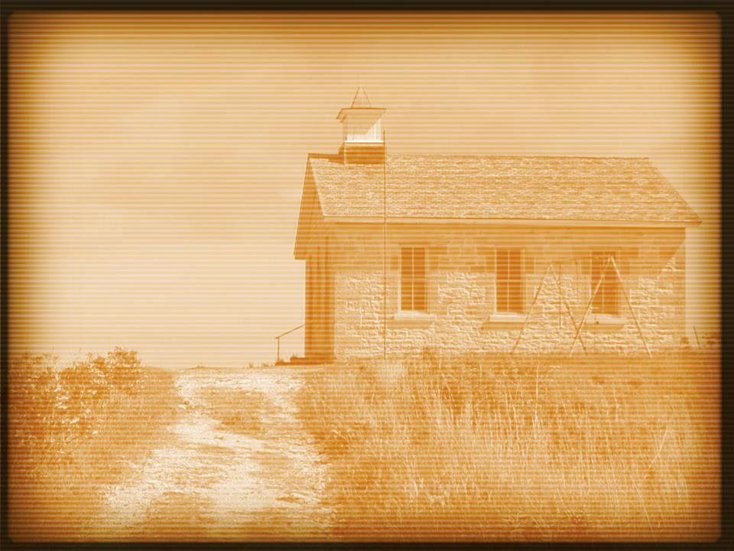
Acts 5:11–14
¹¹ And great fear came upon the whole church and upon all who heard of these things. ¹² Now many signs and wonders were regularly done among the people by the hands of the apostles. And they were all together in Solomon’s Portico. ¹³ None of the rest dared join them, but the people held them in high esteem. ¹⁴ And more than ever believers were added to the Lord, multitudes of both men and women,

Slide 3
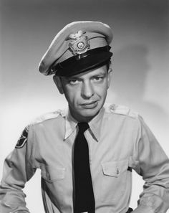

Slide 5
Sin Problems
Ananias and Sapphira
Acts 5:1–14
This is about a relationship with God.
Dealing with the problem of sin produced a stronger church.
Acts 5:11–14

Slide 6
People Problems
The Greek widows.
Acts 6:1–7
We need to know how to handle people problems.
No one was defensive.
The church grew (Acts 6:7).

Slide 7
Doctrine Problems
Circumcision.
Acts 15:4–35
They debated the issue (vv. 6–7).
They listened to the arguments presented.
At the end of the discussion, they were united (v. 22).

