Slide 1
1 Corinthians 11:17-20
Now in giving these instructions I do not praise you, since you come together not for the better but for the worse. ¹⁸ For first of all, when you come together as a church, I hear that there are divisions among you, and in part I believe it. ¹⁹ For there must also be factions among you, that those who are approved may be recognized among you. ²⁰ Therefore when you come together in one place, it is not to eat the Lord’s Supper

Slide 3


Slide 4
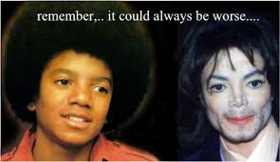

Slide 5


Slide 6
Reversed Spiritual Dimorphic Disorder

Slide 7
1 Corinthians 11:17-20
Now in giving these instructions I do not praise you, since you come together not for the better but for the worse. ¹⁸ For first of all, when you come together as a church, I hear that there are divisions among you, and in part I believe it. ¹⁹ For there must also be factions among you, that those who are approved may be recognized among you. ²⁰ Therefore when you come together in one place, it is not to eat the Lord’s Supper

Slide 8
1 Corinthians 11:26-27
For as often as you eat this bread and drink this cup, you proclaim the Lord’s death till He comes.
²⁷ Therefore whoever eats this bread or drinks this cup of the Lord in an unworthy manner will be guilty of the body and blood of the Lord.

Slide 9
1 Corinthians 11: 28-29
But let a man examine himself, and so let him eat of the bread and drink of the cup. ²⁹ For he who eats and drinks in an unworthy manner] eats and drinks judgment to himself, not discerning the Lord’s body

Slide 10
1 Corinthians 11:30
For this reason many are weak and sick among you, and many sleep

Slide 11
1 Corinthians 11:31-32
³¹ For if we would judge ourselves, we would not be judged. ³² But when we are judged, we are chastened by the Lord, that we may not be condemned with the world

Slide 12


