Slide 1
Luke 6:43-45
For a good tree does not bear bad fruit, nor does a bad tree bear good fruit. ⁴⁴ For every tree is known by its own fruit. For men do not gather figs from thorns, nor do they gather grapes from a bramble bush. ⁴⁵ A good man out of the good treasure of his heart brings forth good; and an evil man out of the evil treasure of his heart brings forth evil. For out of the abundance of the heart his mouth speaks.

Slide 3
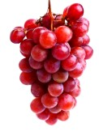

Slide 4
Abundant Fruit

Slide 5
John 15:1-6
I am the true vine, and My Father is the vinedresser. ² Every branch in Me that does not bear fruit He takes away; and every branch that bears fruit He prunes, that it may bear more fruit. ³ You are already clean because of the word which I have spoken to you. ⁴ Abide in Me, and I in you. As the branch cannot bear fruit of itself, unless it abides in the vine, neither can you, unless you abide in Me.
⁵ “I am the vine, you are the branches. He who abides in Me, and I in him, bears much fruit; for without Me you can do nothing. ⁶ If anyone does not abide in Me, he is cast out as a branch and is withered; and they gather them and throw them into the fire, and they are burned

Slide 6
John 15:5
I am the vine, you are the branches. He who abides in Me, and I in him, bears much fruit; for without Me you can do nothing

Slide 8
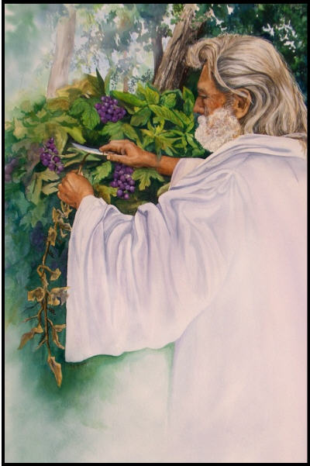
John 15:1
I am the true vine, and My Father is the vinedresser

Slide 9
John 15:2
Every branch in Me that does not bear fruit He takes away; and every branch that bears fruit He prunes, that it may bear more fruit

Slide 10
John 15:3
You are already clean because of the word which I have spoken to you.

Slide 11
John 15:4
Abide in Me, and I in you. As the branch cannot bear fruit of itself, unless it abides in the vine, neither can you, unless you abide in Me

Slide 12
John 15:5
I am the vine, you are the branches. He who abides in Me, and I in him, bears much fruit; for without Me you can do nothing

Slide 13
John 15:6
If anyone does not abide in Me, he is cast out as a branch and is withered; and they gather them and throw them into the fire, and they are burned

Slide 14
James 1:21
Wherefore lay apart all filthiness and superfluity of naughtiness, and receive with meekness the engrafted word, which is able to save your souls.

Slide 15
Galatians 3:27
For as many of you as were baptized into Christ have put on Christ

Slide 16
Galatians 5:22-26
But the fruit of the Spirit is love, joy, peace, longsuffering, kindness, goodness, faithfulness, ²³ gentleness, self-control. Against such there is no law. ²⁴ And those who are Christ’s have crucified the flesh with its passions and desires. ²⁵ If we live in the Spirit, let us also walk in the Spirit. ²⁶ Let us not become conceited, provoking one another, envying one another

