Slide 1
Jonah 1:1-3
Now the word of the Lord came to Jonah the son of Amittai, saying, ² “Arise, go to Nineveh, that great city, and cry out against it; for their wickedness has come up before Me.” ³ But Jonah arose to flee to Tarshish from the presence of the Lord. He went down to Joppa, and found a ship going to Tarshish; so he paid the fare, and went down into it, to go with them to Tarshish from the presence of the Lord.

Slide 3
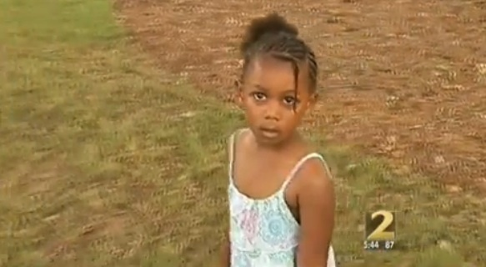

Slide 4
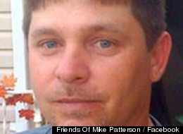

Slide 5
Life Preserver

Slide 7
Jonah 1:1-2
Now the word of the Lord came to Jonah the son of Amittai, saying, ² “Arise, go to Nineveh, that great city, and cry out against it; for their wickedness has come up before Me.”

Slide 8
Jonah 1:3
But Jonah arose to flee to Tarshish from the presence of the Lord. He went down to Joppa, and found a ship going to Tarshish; so he paid the fare, and went down into it, to go with them to Tarshish from the presence of the Lord.

Slide 9
Jonah 1:4-5
But the Lord sent out a great wind on the sea, and there was a mighty tempest on the sea, so that the ship was about to be broken up.
⁵ Then the mariners were afraid; and every man cried out to his god, and threw the cargo that was in the ship into the sea, to lighten the load. But Jonah had gone down into the lowest parts of the ship, had lain down, and was fast asleep.

Slide 10
Jonah 1:6-9
So the captain came to him, and said to him, “What do you mean, sleeper? Arise, call on your God; perhaps your God will consider us, so that we may not perish.”
⁷ And they said to one another, “Come, let us cast lots, that we may know for whose cause this trouble has come upon us.” So they cast lots, and the lot fell on Jonah. ⁸ Then they said to him, “Please tell us! For whose cause is this trouble upon us? What is your occupation? And where do you come from? What is your country? And of what people are you?”

Slide 11
Jonah 1:9-12
Then the men were exceedingly afraid, and said to him, “Why have you done this?” For the men knew that he fled from the presence of the Lord, because he had told them. ¹¹ Then they said to him, “What shall we do to you that the sea may be calm for us?”—for the sea was growing more tempestuous And he said to them, “Pick me up and throw me into the sea; then the sea will become calm for you. For I know that this great tempest is because of me.”

Slide 12
Jonah 2:10
So the Lord spoke to the fish, and it vomited Jonah onto dry land.

Slide 13
Jonah 3:1-2
Now the word of the Lord came to Jonah the second time, saying, ² “Arise, go to Nineveh, that great city, and preach to it the message that I tell you

Slide 14
Jonah 4:10-13
But the Lord said, “You have had pity on the plant for which you have not labored, nor made it grow, which came up in a night and perished in a night. ¹¹ And should I not pity Nineveh, that great city, in which are more than one hundred and twenty thousand persons who cannot discern between their right hand and their left—and much livestock

Slide 15
