Slide 1
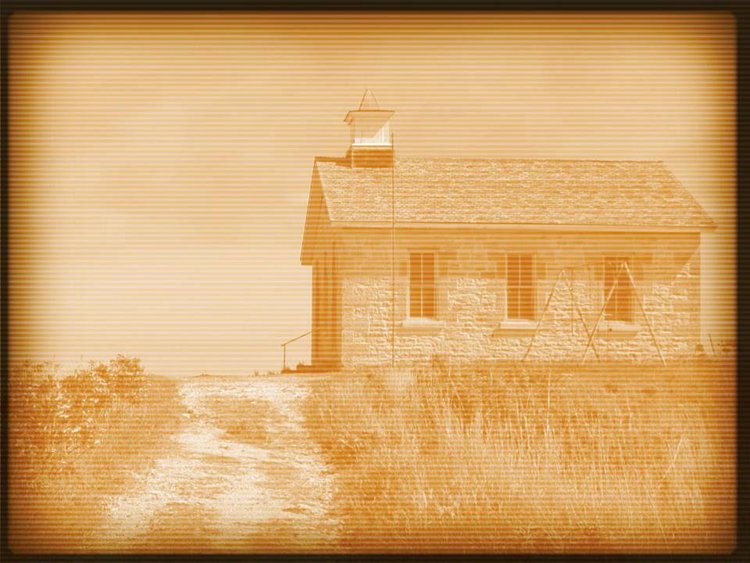
Hebrews 10:24–25
²⁴And let us consider how to stir up one another to love and good works, ²⁵not neglecting to meet together, as is the habit of some, but encouraging one another, and all the more as you see the Day drawing near.

Slide 4
They feared God.
Acts 2:43
Acts 5:5, 11; 9:31; 19:17
Acts 2:47

Slide 5
They wanted to serve others.
Acts 2:44–45
Hebrews 10:24–25
1 Corinthians 14:24–25

Slide 6
They were filled with gladness.
Acts 2:46
Psalm 122:1

Slide 7
They had a singleness of heart.
Acts 2:46
“What you see is what you get.”

Slide 8
They didn’t “keep it at church.”
Acts 2:46–47
This wasn’t just a Sunday thing.

