Slide 1
James 2:1–4
¹ My brothers, show no partiality as you hold the faith in our Lord Jesus Christ, the Lord of glory. ² For if a man wearing a gold ring and fine clothing comes into your assembly, and a poor man in shabby clothing also comes in, ³ and if you pay attention to the one who wears the fine clothing and say, “You sit here in a good place,” while you say to the poor man, “You stand over there,” or, “Sit down at my feet,” ⁴ have you not then made distinctions among yourselves and become judges with evil thoughts?

Slide 4
Do we really need a Guest Evangelism program?
James 2:1–4
Colossians 4:3–6
1 Corinthians 14:13–19

Slide 5
The Basics
A change in vocabulary…
Guests, not visitors.
A change in Guest Cards…
Only given to first-time guests.
Larger sized cards on clipboards.
A change in our post-assembly conversations…
Talk to Guests first.

Slide 6
Guest Evangelism 3.0
Greeters welcome all people at the door.
The Guest Evangelism team greets all guests—repeat or first-time.
Deacon: Chris Ford
Assisting: Philip Dees, John Ware, Matt Bishop, Jeremy Long
Data is gathered and recorded through the website.

Slide 7
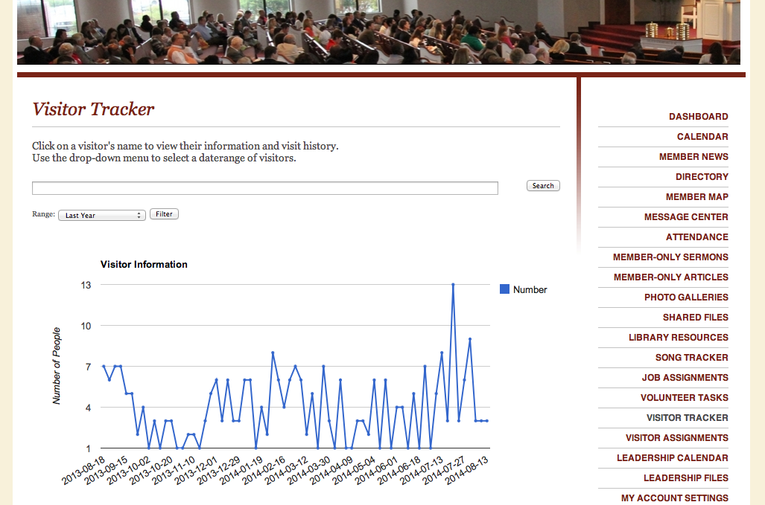

Slide 8
Guest Evangelism 3.0
Follow-up by Terry.
Letter including survey card, “7 Ways,” and an invitation to study with the first lesson.
A courtesy call later that week.
Cards from members.
Our weekly bulletin for three months.

Slide 9
What can you do?
Pray! (Colossians 4:2–5).
Be a greeter!
Write cards.

