Slide 1
1 Timothy 6:11–12
11 But as for you, O man of God, flee these things. Pursue righteousness, godliness, faith, love, steadfastness, gentleness.
12 Fight the good fight of the faith. Take hold of the eternal life to which you were called and about which you made the good confession in the presence of many witnesses.

Slide 3
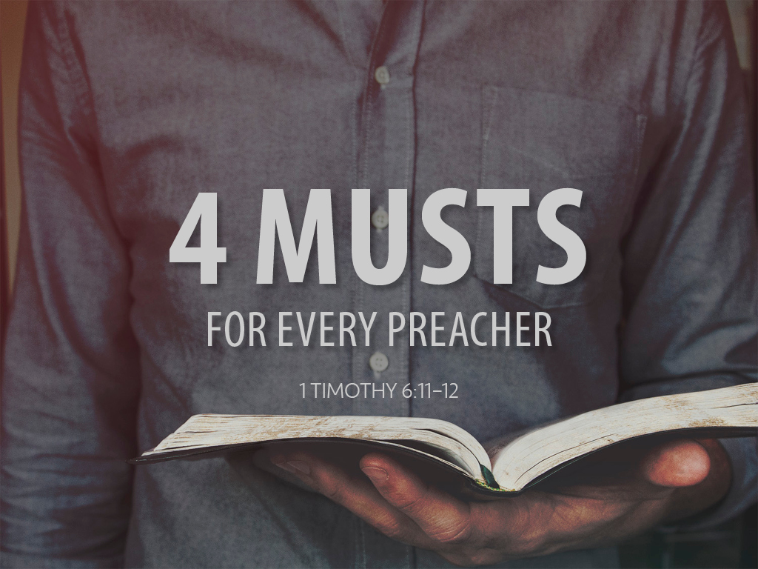

Slide 4
The Preacher Must Flee
1 Timothy 6:3–5, 9–10
1 Timothy 1:3–7
Matthew 6:19–21

Slide 5
The Preacher Must Pursue
The world sees the preacher as the face of the church.
Matthew 5:13–16
The preacher must live the righteous life he is preaching.
Romans 2:17–24

Slide 6
The Preacher Must Fight
Preachers must fight for truth.
Romans 16:17–19
2 Timothy 4:1–5
Preachers must fight for faith.
2 Timothy 4:6–7
2 Corinthians 11:16–29

Slide 7
The Preacher Must Take
2 Timothy 4:7–8

