Slide 1
1 Corinthians 8:5-6
5 For although there may be so-called gods in heaven or on earth—as indeed there are many “gods” and many “lords”— 6 yet for us there is one God, the Father, from whom are all things and for whom we exist, and one Lord, Jesus Christ, through whom are all things and through whom we exist.

Slide 3
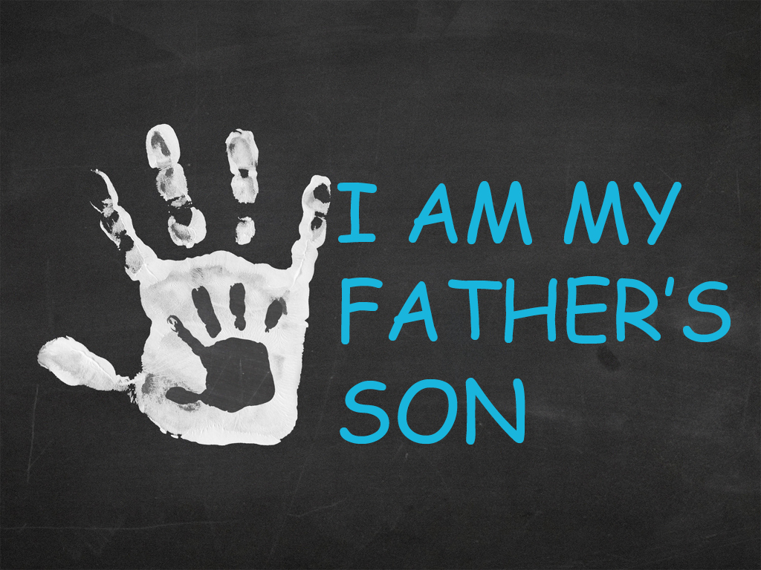

Slide 4
I must connect with my Father
Understand Jesus’ connection to the Father
Mark 14:32-36

Slide 5
I must praise my Father
We must praise Him during tough times
We must praise Him during great times

Slide 6
I must reflect my Father
We must let Him mold us
We must want what He wants
We must mirror His character
We must tell Him we love Him

Slide 7
I must trust my Father
Psalm 20:6-8
Listen to what He says
Run to Him in times of trouble

