Slide 1
2 Timothy 2:1–2
¹You then, my child, be strengthened by the grace that is in Christ Jesus, ²and what you have heard from me in the presence of many witnesses entrust to faithful men who will be able to teach others also.

Slide 4
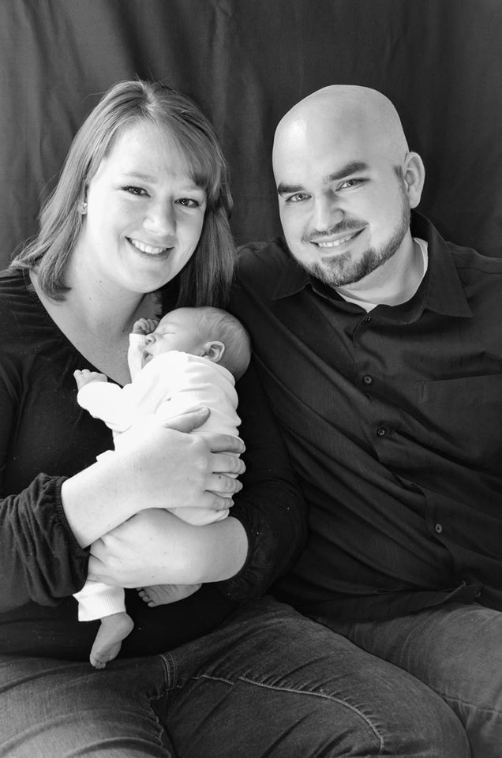
Dan, Kaitlin, and Henry Lankford

Slide 5
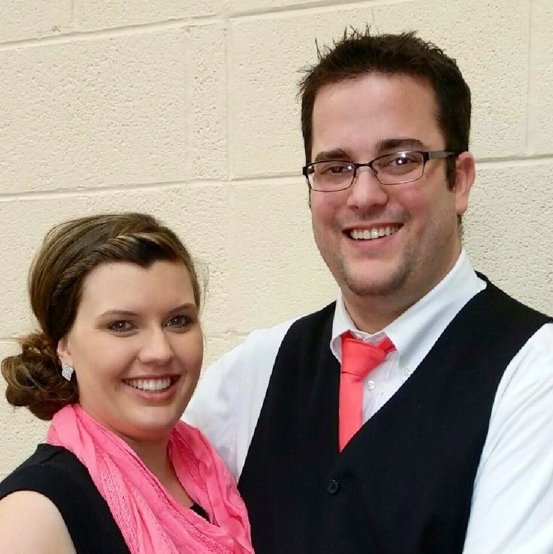
Tom and Amelia Morris

Slide 6
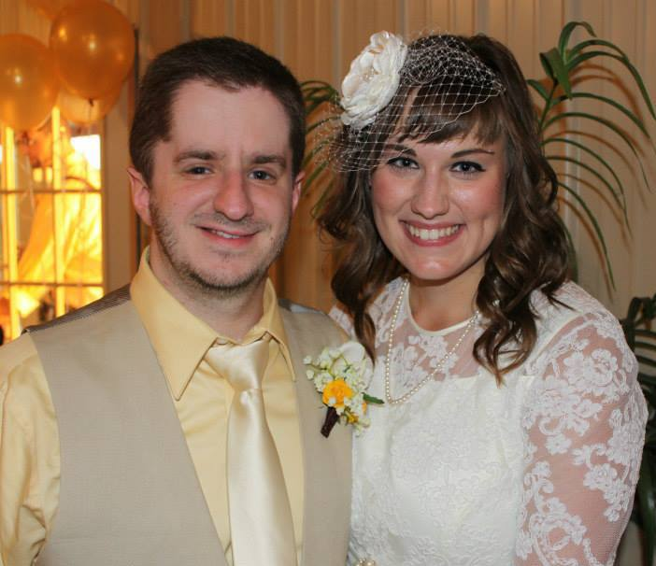
Justin and Amanda Mock

Slide 7
Greg and Kashka Kline

Slide 8
The Need for an Internship
Biblical Leadership Training:
Moses and Joshua
Paul and Timothy
Jesus and the Apostles

Slide 9
Our Internship
Office Hours and Dress Code.
Build Relationships

Slide 10
Weekly Schedule
Tuesday Morning
Sermon evaluation
Study through Timothy and Titus
Wednesday Morning
Book review
Article assignment
Sermon assignment

Slide 11
Weekly Schedule
Thursday Morning
Article review
Sermon discussion
Preacher interview discussion
Friday
Sermon review
PowerPoint discussion

Slide 12
Weekly Schedule
Sunday
Teaching class.
Preaching one lesson.

Slide 13
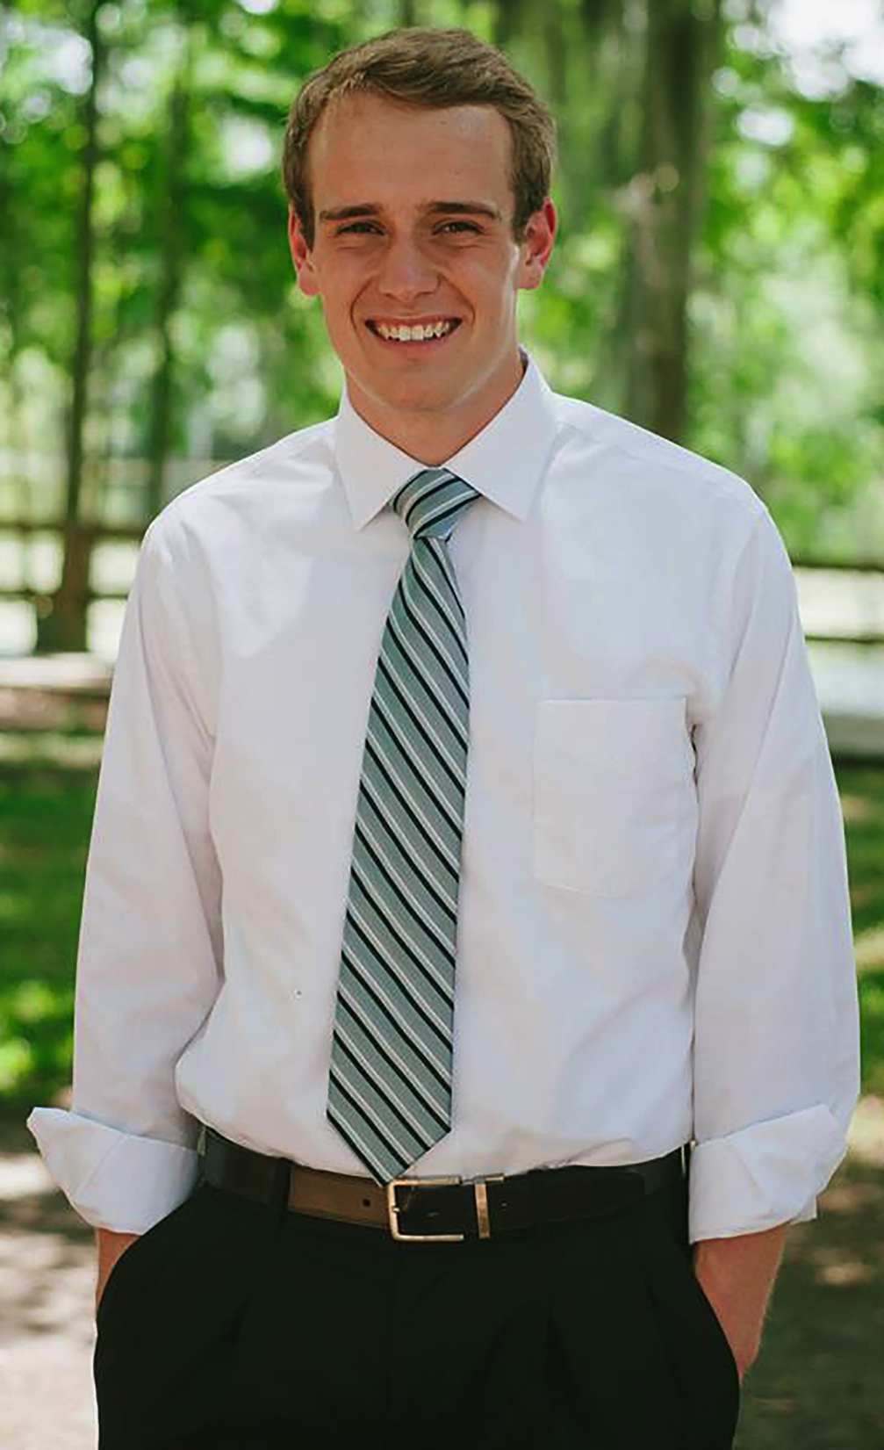
Luke Adams

Slide 14
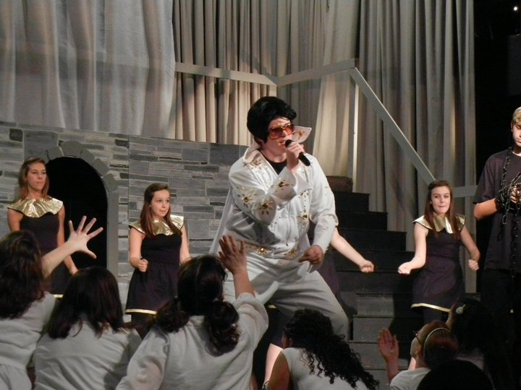

Slide 15
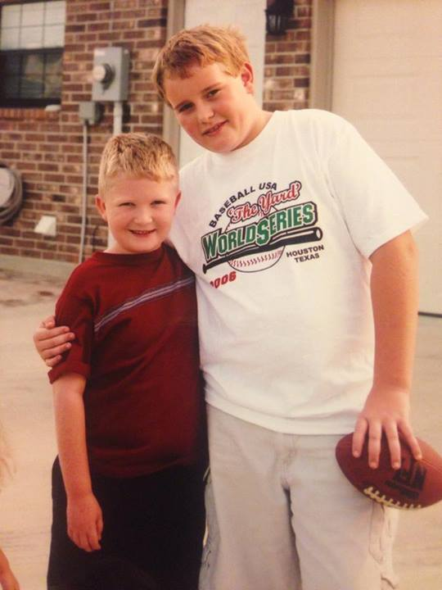

Slide 16
Your role…
Offer encouragement.
Show hospitality.
Build up one another.
Evaluation.

