Slide 1
1 Timothy 1:12-14
And I thank Christ Jesus our Lord who has enabled me, because He counted me faithful, putting me into the ministry, ¹³ although I was formerly a blasphemer, a persecutor, and an insolent man; but I obtained mercy because I did it ignorantly in unbelief. ¹⁴ And the grace of our Lord was exceedingly abundant, with faith and love which are in Christ Jesus.

Slide 3
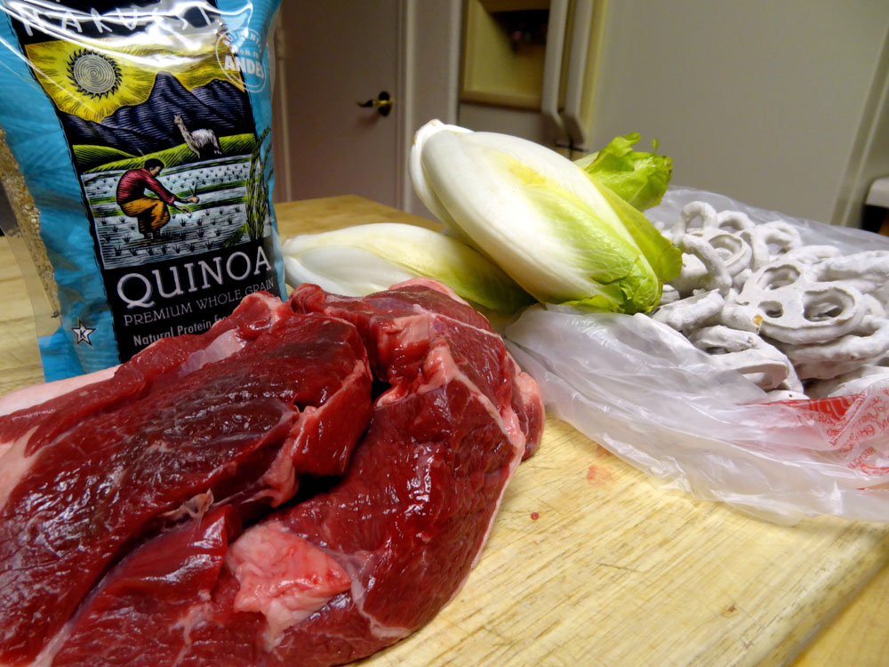

Slide 4
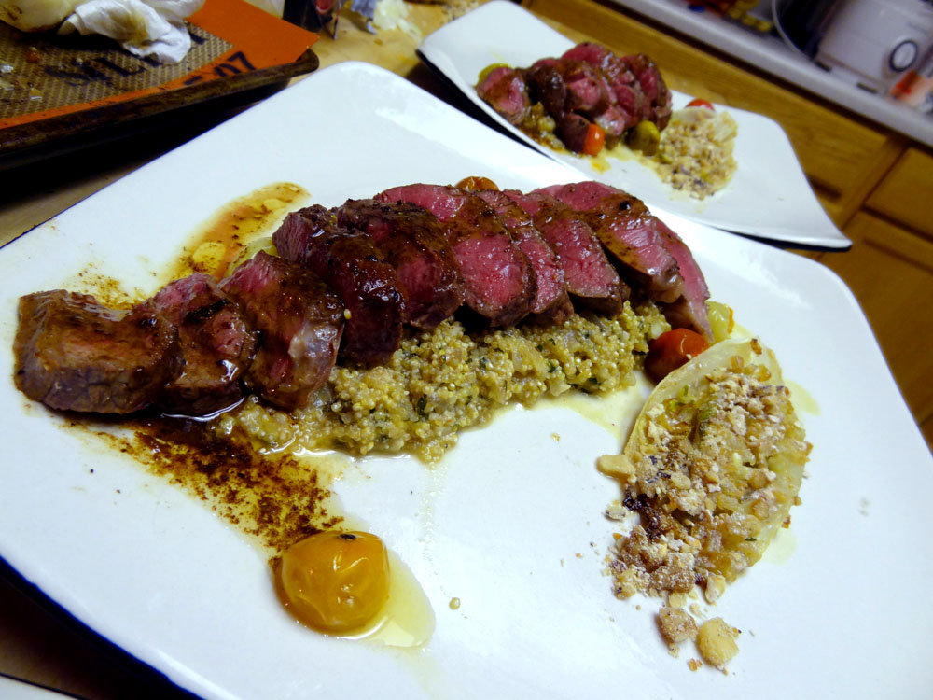

Slide 5
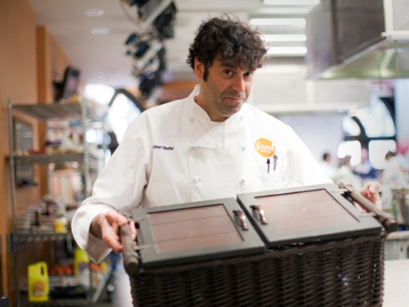
What would you make?

Slide 6
Romans 1: 18-19
For the wrath of God is revealed from heaven against all ungodliness and unrighteousness of men, who suppress the truth in unrighteousness, ¹⁹ because what may be known of God is manifest in them, for God has shown it to them

Slide 7
Romans 1:24
Therefore God also gave them up to uncleanness, in the lusts of their hearts, to dishonor their bodies among themselves,
God’s Response

Slide 8
Romans 1:28-32
And even as they did not like to retain God in their knowledge, God gave them over to a debased mind, to do those things which are not fitting; ²⁹ being filled with all unrighteousness, sexual immorality, wickedness, covetousness, maliciousness; full of envy, murder, strife, deceit, evil-mindedness; they are whisperers, ³⁰ backbiters, haters of God, violent, proud, boasters, inventors of evil things, disobedient to parents, ³¹ undiscerning, untrustworthy, unloving, unforgiving, unmerciful; ³² who, knowing the righteous judgment of God, that those who practice such things are deserving of death, not only do the same but also approve of those who practice them.
Result

Slide 9
Romans 6: 3-7
For if we have been united together in the likeness of His death, certainly we also shall be in the likeness of His resurrection, ⁶ knowing this, that our old man was crucified with Him, that the body of sin might be done away with, that we should no longer be slaves of sin. ⁷ For he who has died has been freed from sin

Slide 10
Romans 7:14-20
For we know that the law is spiritual, but I am carnal, sold under sin. ¹⁵ For what I am doing, I do not understand. For what I will to do, that I do not practice; but what I hate, that I do. ¹⁶ If, then, I do what I will not to do, I agree with the law that it is good. ¹⁷ But now, it is no longer I who do it, but sin that dwells in me. ¹⁸ For I know that in me (that is, in my flesh) nothing good dwells; for to will is present with me, but how to perform what is good I do not find. ¹⁹ For the good that I will to do, I do not do; but the evil I will not to do, that I practice. ²⁰ Now if I do what I will not to do, it is no longer I who do it, but sin that dwells in me.

Slide 11
Romans 7:23
But I see another law in my members, warring against the law of my mind, and bringing me into captivity to the law of sin which is in my members

Slide 12
Romans 12:2
And do not be conformed to this world, but be transformed by the renewing of your mind, that you may prove what is that good and acceptable and perfect will of God.

Slide 13
1 Corinthians 15:58
Therefore, my beloved brethren, be steadfast, immovable, always abounding in the work of the Lord, knowing that your labor is not in vain in the Lord.

Slide 14
What would you make

Slide 15
Romans 11:33-36
Oh, the depth of the riches both of the wisdom and knowledge of God! How unsearchable are His judgments and His ways past finding out!
³⁴ “For who has known the mind of the Lord? Or who has become His counselor?” ³⁵ “Or who has first given to Him And it shall be repaid to him?”
³⁶ For of Him and through Him and to Him are all things, to whom be glory forever.

