Slide 1
Psalm 97:10–12
¹⁰ O you who love the Lord, hate evil! He preserves the lives of his saints; he delivers them from the hand of the wicked. ¹¹ Light is sown for the righteous, and joy for the upright in heart. ¹² Rejoice in the Lord, O you righteous, and give thanks to his holy name!

Slide 3
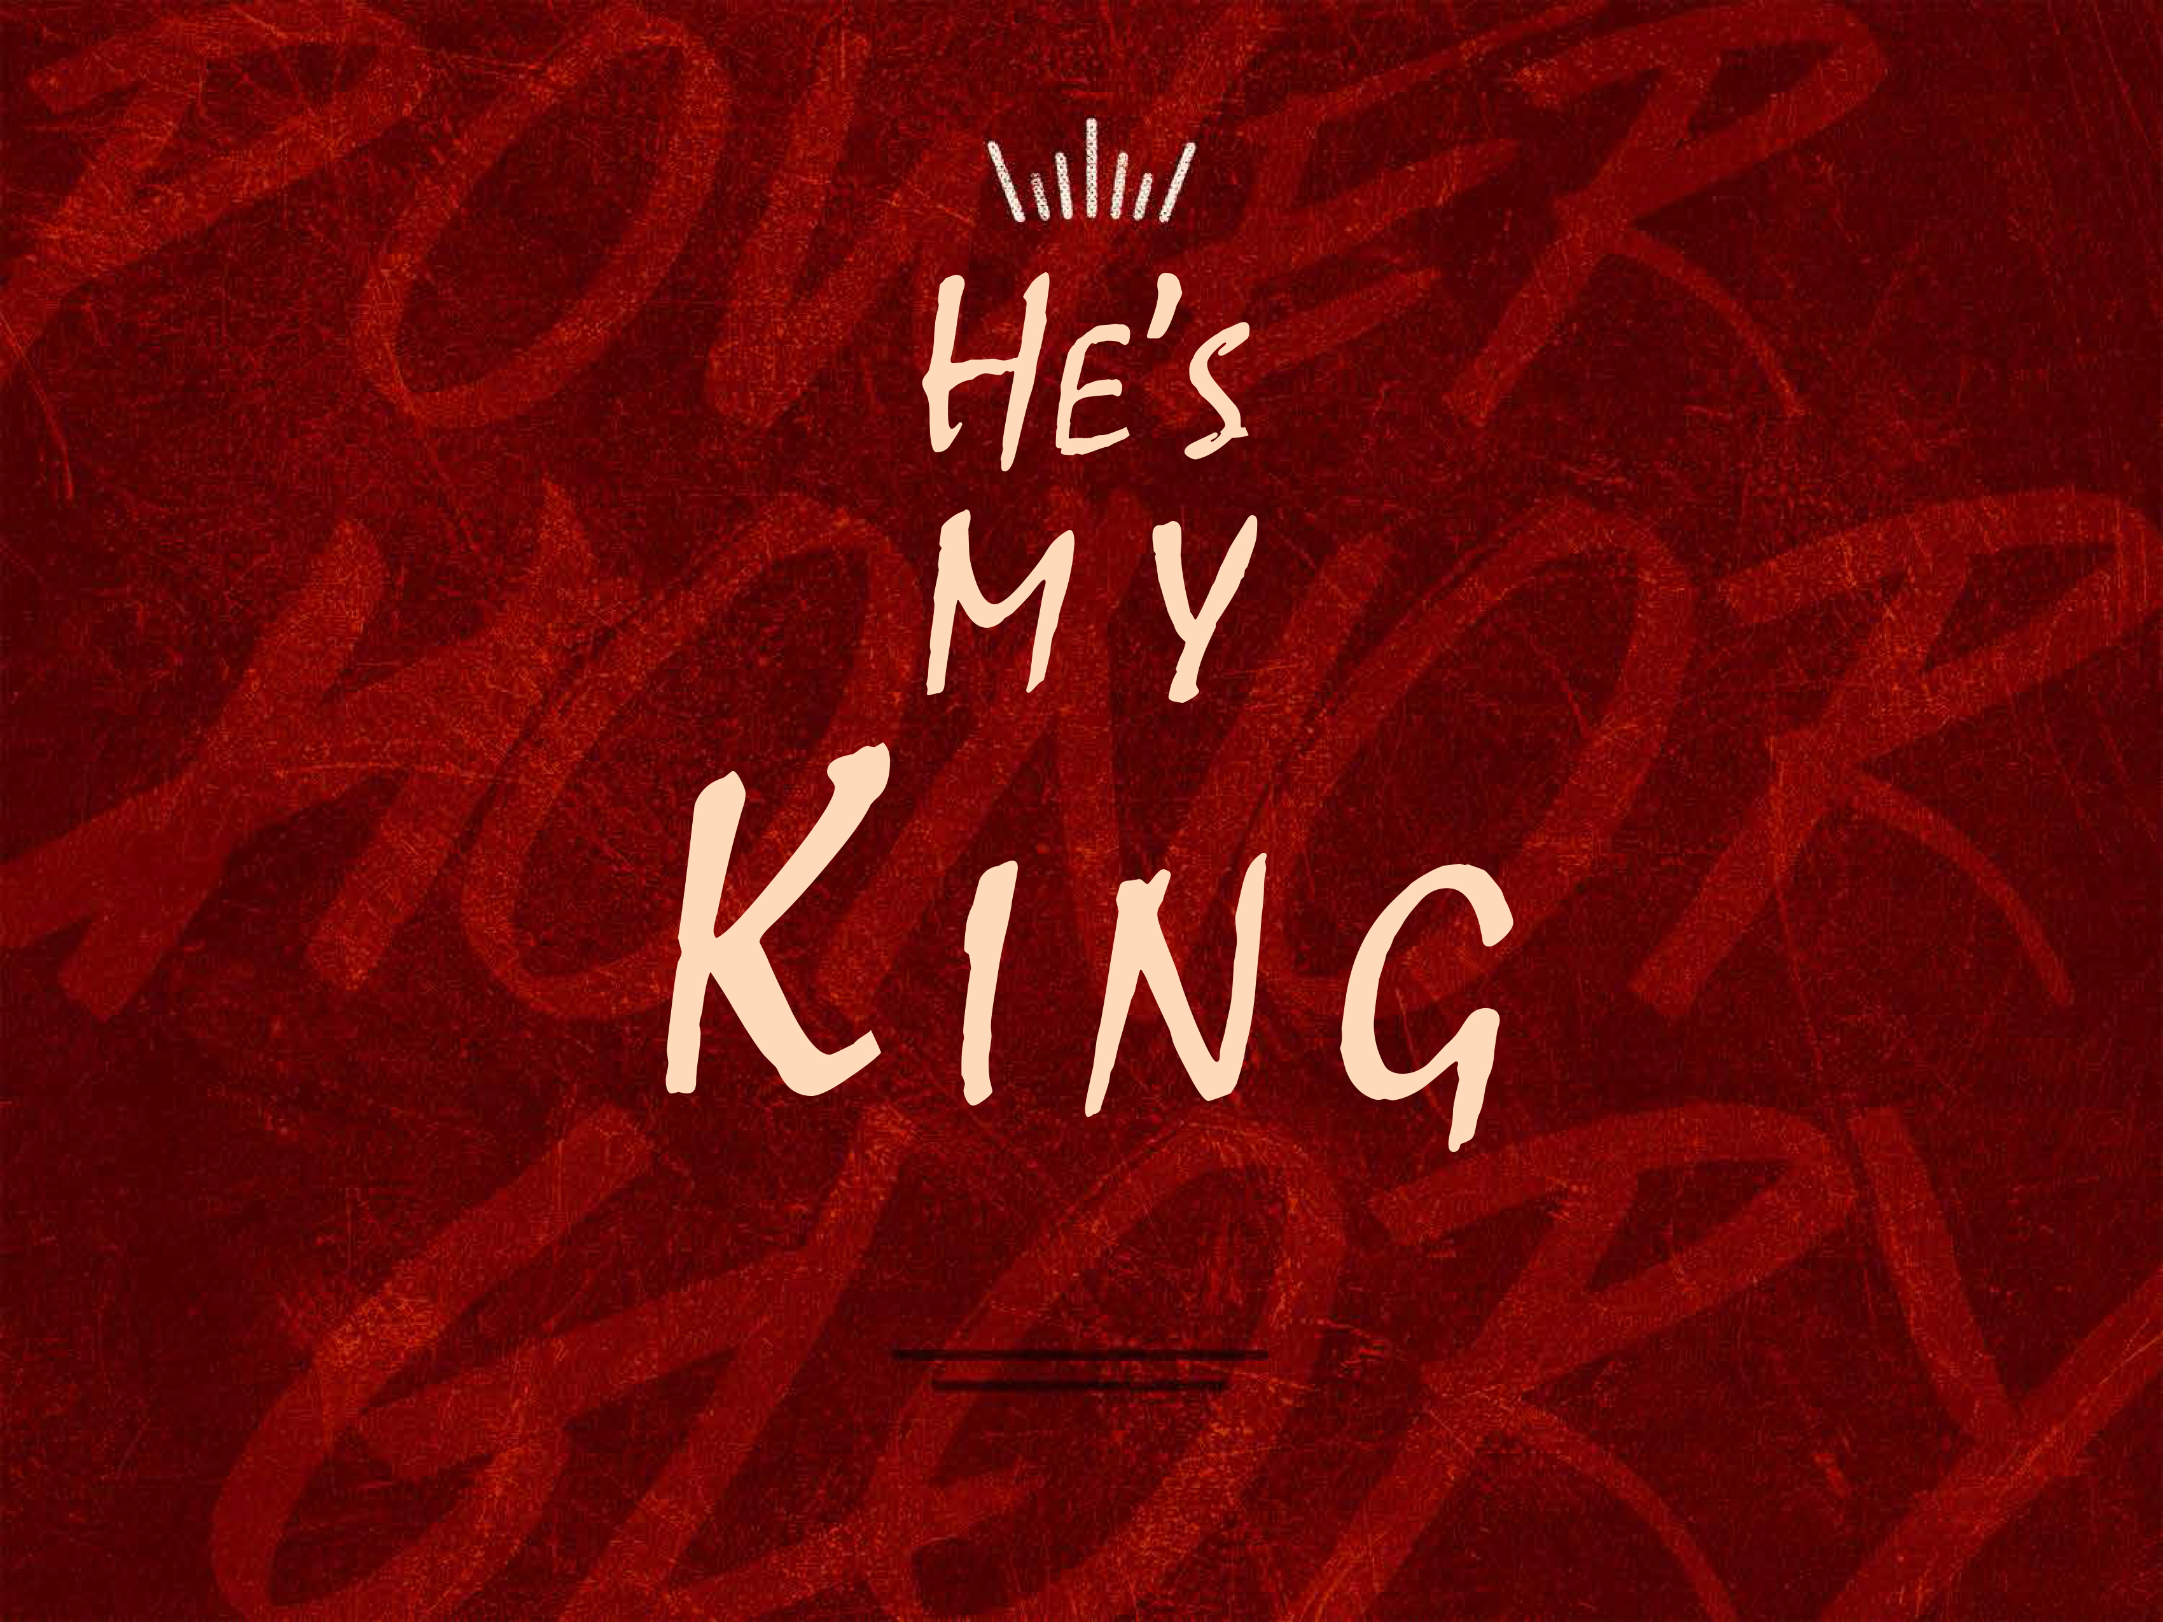

Slide 4
God rules everything.
Psalm 97:1
The word “reign” is a political term.
God is sovereign (Psalm 97:9).

Slide 5
God is worthy of our praise.
Psalm 97:6–7
Joshua 5:13–14

Slide 6
We must support His cause by hating evil.
Psalm 97:2. 10
We hate evil—not people.
We are His loyal subjects.

